Slide 2
Watch this short film
https://www.inspiringthefuture.org/

Slide 3
What misconceptions about future job roles do we see in this film?
What other misconceptions do you think there are about future job roles?
Why is it important we challenge misconceptions about future career options?

Slide 4
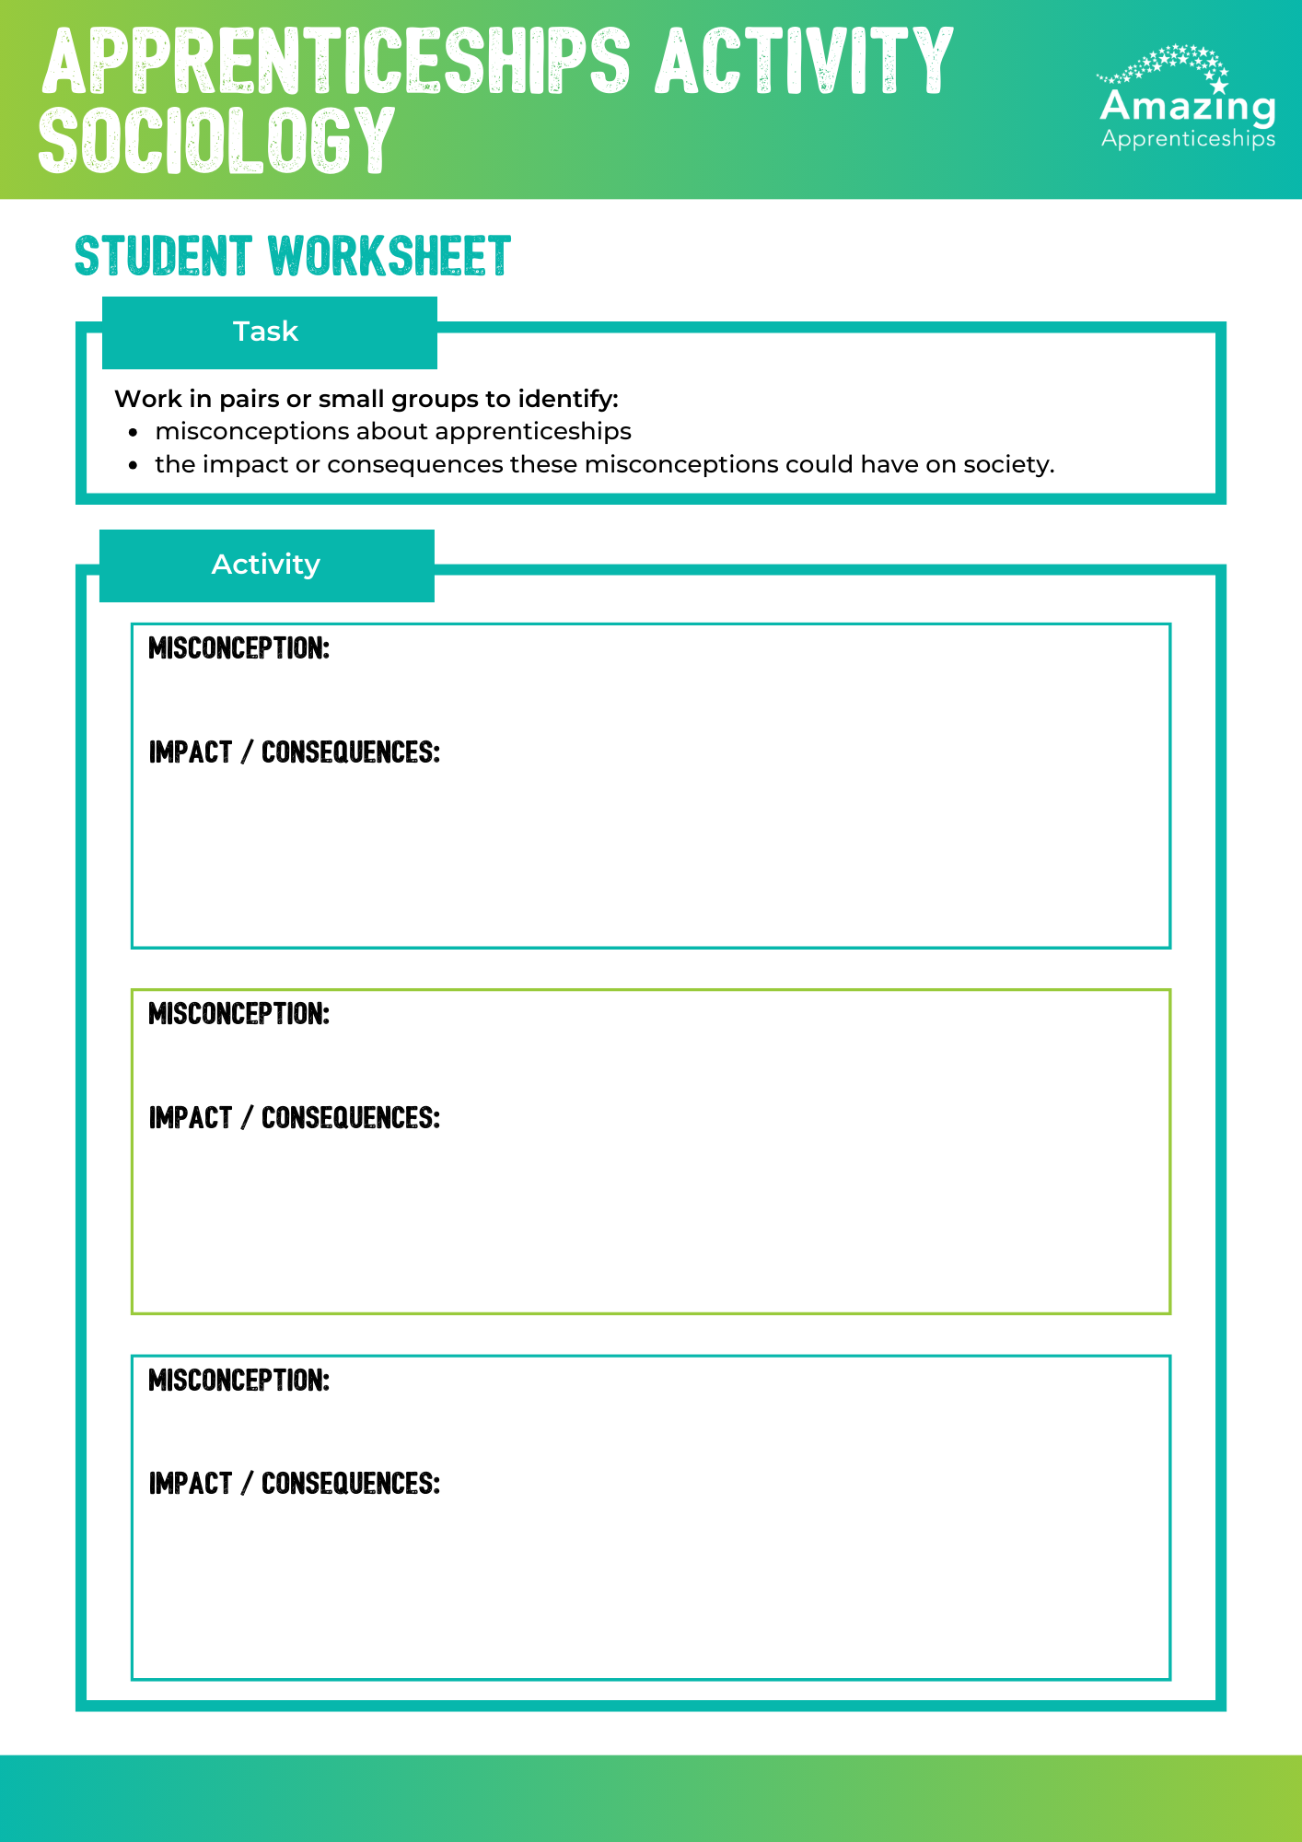
What do you feel are the biggest misconceptions about apprenticeships?
Why do you think these misconceptions exist?
TASK: work in pairs or small groups to discuss the impact misconceptions about apprenticeships could have.
There are some misconception ideas on the next slide if you need them.

Slide 6
What impact could these misconceptions about apprenticeships have?
Apprenticeships are only for young people.
Apprenticeships are for people with no qualifications / lower grades.
Apprenticeships aren’t paid well.
Apprenticeships are only for manual jobs.
The range of apprenticeships is limited.
‘Good’ universities don’t offer degree apprenticeships.

Slide 7
What impact could these misconceptions about apprenticeships have?
Apprenticeships are only for young people.
Employers will not benefit from having older people who already have lots of professional skills and older people not getting opportunities to develop their career and themselves.
Apprenticeships are for people with no qualifications / lower grades.
Apprenticeships aren’t paid well.
Deters people from taking an apprenticeship so they miss out on a potential career-making opportunity.
Apprenticeships are only for manual jobs.
The range of apprenticeships is limited.
Lots of people will miss out on excellent opportunities and go down a different route to their career - potentially costing them time and money.

Slide 8
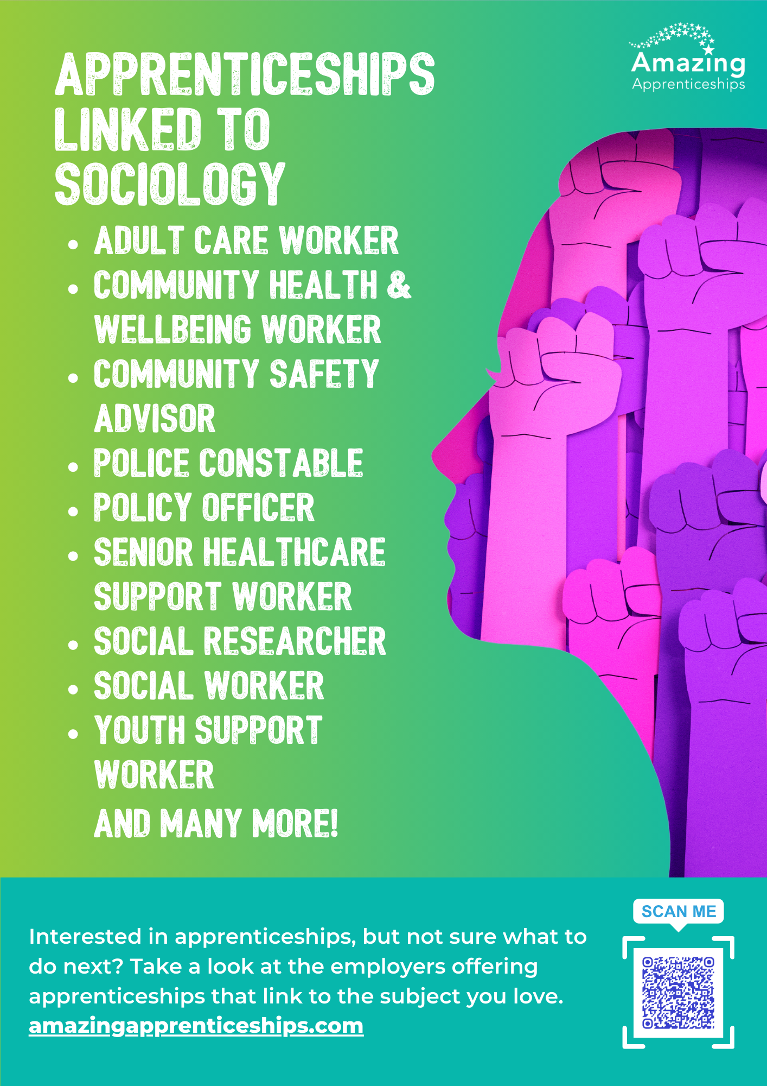
Home learning
Research the apprenticeships that are linked to sociology https://www.instituteforapprenticeships.org/
Pick one apprenticeship that you think sounds really interesting.
Be ready to present to the class.

