Slide 1
Time for Change:
Youth Matters
23rd February 2021
Notes:
Good afternoon
My name is Anna Morrison, Founder and Director of Amazing Apprenticeships
More about me…..
Social Mobility is something that I, and the team at Amazing Apprenticeships, are really passionate about.
I have been working with young people in schools and through local communities for more than 20 years and have witnessed first hand the life-changing positive effects of apprenticeships for individuals and their families.
We are fairly uniquely placed as an organisation. As well as working extensively with schools, teachers, parents, carers and young people, we also work with many high-profile employers and smaller businesses – just like ours. We engage with Local Authorities and Local Enterprise Partnerships, policy makers, researchers, training providers and countless other national and international organisations around the apprenticeships and vocational education agenda.
I feel really passionately that we could all be doing more to help our most vulnerable and disadvantaged young people and adults to access, secure and progress through apprenticeships. And so today is the start of a series of events and activities that we will be leading with key partners, such as The Sutton Trust and Social Mobility Commission to bring people together to discuss this important topic.
We want to help to raise awareness of the issues and challenges and to inspire people to work together to find solutions.

Slide 2
Housekeeping
Today’s webinar is being recorded
Please keep cameras switched off and remain muted
The chat can be used to submit questions
www.amazingapprenticeships.com

Slide 3
Time for Change webinar series
Workshop 1: Social Mobility in Apprenticeships Sutton Trust & Social Mobility Commission
Workshop 2: Apprenticeships for All The Open University & Disability Rights UK
Workshop 3: Mental Health Matters Gen. Healthy Minds
Workshop 4: Youth Matters Impetus & Youth Employment UK
Workshop 5: Monday 15th March Overcoming barriers – hear from apprentices
www.amazingapprenticeships.com
Notes:
Housekeeping
Cameras off / stay on mute
Use chat
Recording
Introduce speakers
Some questions submitted before the conference Any additional questions add to chat and if we don’t answer today, will follow up
SMC
What more could we do to show small employers the importance of social mobility and the role they can play?
Sutton Trust
What more could training providers do to influence the recruitment decisions of employers to be more mindful of social mobility?

Slide 4
Get involved…
www.amazingapprenticeships.com/genie
www.amazingapprenticeships.com
Notes:
Housekeeping
Cameras off / stay on mute
Use chat
Recording
Introduce speakers
Some questions submitted before the conference Any additional questions add to chat and if we don’t answer today, will follow up
SMC
What more could we do to show small employers the importance of social mobility and the role they can play?
Sutton Trust
What more could training providers do to influence the recruitment decisions of employers to be more mindful of social mobility?

Slide 5
Today’s workshop
Welcome & housekeeping
Sam Windett, Director of Policy, Impetus
LJ Rawlings, Founder and CEO of YEUK
Q&A
Next steps
www.amazingapprenticeships.com

Slide 6
YOUTH EMPLOYMENT UK
Youth Voice
The experiences and challenges facing young people

Slide 7
Who we are
Experts in youth employment
Our core aims :
Giving young people a voice on the youth employment issues that affect them
Support young people on their journey to employment with a range of skills and careers support
Support organisations to develop and be recognised for their youth friendly employment practice and connecting young people to those Youth Friendly Employers
Providing expert insight across all youth employment policy areas
Youth Employment UK is a not-for-profit social enterprise actively tackling youth unemployment.
As a youth-led organisation we are pretty unique, our expertise, services and advice is centred around what young people tell us they are experiencing, what they want and need.
We understand the root causes of youth unemployment, what works and what doesn't.

Slide 8
What young people tell us
Since 2012 young people have been sharing their views, experiences and challenges of their journey to work with Youth Employment UK.
Repeatedly we have heard that:
Young people do not feel prepared for the world of work, they do not know what skills employers are looking for or what careers and pathways exist
Young people do not feel that employers are particularly youth friendly, or that they will be able to find good quality work where they live
Young people face additional barriers such as metal health, anxiety, socio-economic status, discrimination
Covid 19 has amplified all of these challenges and widened the inequality gaps.

Slide 9
Systemic Challenges
Labour market - job creation, economic confidence, new economies, industry 4.0
Employer perceptions of young people - lack of employability skills, attitudes and work experience, skills mismatch
Quality of work - young people often find themselves in low paid, precarious work, last in first out
Discrimination - gender, race and ethnicity, social class, disability
Regional variances
Social Mobility - lack of social, economic or cultural capital
Education, training and access to information
Fall out from 2008

Slide 10
Youth Voice Census 2020
What have young people been telling us?
Information inequality
Young people are not being prepared
Barriers to employment
Mental health
Location
Lack of jobs
Disability
Lack of work experience
Social status
Discrimination
Link to Census
% of respondents who had never had discussions:
55% starting a business
77% accessing Jobcentre provision
76% traineeships
Only 33% of the young people who had spent time as NEET told us that they would access the JobCentre
Young people consistently tell us that they need one-to-one support
It needs to be personalised

Slide 11
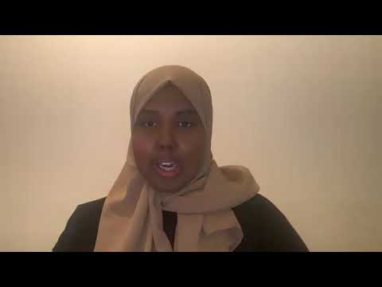
Impact of Covid-19 on young people
Saida

Slide 12
Impact of Covid-19 on young people
Cerys

Slide 13
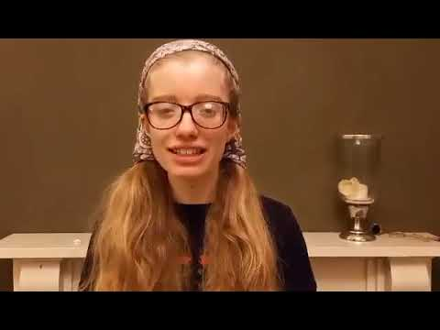
Impact of Covid-19 on young people
Ella

Slide 14
Impact of Covid-19 on young people
Harvey

Slide 15
Youth Voice
Youth Voice Census
Youth Ambassadors
APPG for Youth Employment
Youth Employment Group - Youth Voice Forum
Roundtables
Policy Submissions
Consultations
Co-Design of services

Slide 16
Youth Voice - getting it right
Ensure it is not tokenism - you have to listen and act
Bring young people into the earliest stages to co-design and lead
Invest the proper time and resource and be prepared for some challenges
Get feedback along the way and at the end, learn, adapt
Bring in expert guidance and support

Slide 17
The Careers Hub
The Careers Hub is packed with impartial and inspirational information for 14-24 year olds, covering everything from education to employment, with additional support around mental health and wellbeing, digital skills, entrepreneurship, volunteering and more. Updated daily & no login required young people can access quality information wherever and whenever they need it.

Slide 18
Young Professional - The journey
The Young Professional supports young people aged 14-24 at the different stages of their lives.
The Young Professional - Explore Programme provides support, learning and inspiration to young people who are still in education and/or just beginning to think about their futures and the choices and opportunities ahead of them
The Young Professional - Journey to Work provides a programme of support to young people who are further on in their journey, supporting those who are preparing for work, looking for work or in their first roles and keen to continue their personal and professional development
Young people can share their journey progress with their teacher, employer, work coach or other trusted adult.
In addition to the virtual learning platform young people will have access to their own personalized dashboard where they can create a virtual CV, capture their reflections, save opportunities, favourite content and so much more!

Slide 19
Virtual Work Experience
Work Experience plays a vital role in helping young people to feel more confident about their skills and understanding of the world of work.
In partnership with some of our Youth Friendly Employers we have created virtual work experience programmes.
Introduction to the World of Work - this video and accompanying workbook introduces young people to the world of work, the careers and types of roles that exist and helps them to learn where they can start on their journey to work
Introductions to key sectors - do any of us really understand how big and exciting different sectors are in the UK, what businesses operate in them and all of the career opportunities available? These short videos take us inside some of the biggest sectors in the UK
Introduction to Youth Friendly Employers - take virtual tours of some of our Youth Friendly Employers to see what careers are available and what happens behind the scenes
Access our virtual work experience programmes through the Young Professional or as a standalone activity in the Careers Hub & Careers Education pages

Slide 20
Before you go...
Visit our site What young people have to say about their barriers to work in our Youth Voice Census See who our Youth Friendly Employers Visit our Youth Friendly Places Hubs | Check out the skills and careers hub Visit the Hub which is full of information, inspiration and support Show young people our free training and boost their life and work skills For educators, careers leaders, youth workers and work coaches stay up to date with our free resources | Give young people a voice Unlock opportunities today by looking at our Ambassador programme See what our incredible Youth Ambassadors team have been up to

Slide 21
Links to resources
Website: www.youthemployment.org.uk
Email: info@youthemployment.org.uk

Slide 22
February 2021
The employment prospects of young people from disadvantaged backgrounds

Slide 23
Impetus and Youth Employment
Impetus transforms the lives of young people from disadvantaged backgrounds by ensuring they get the right support to succeed in school, in work and in life
Impetus’ Youth Jobs Gap research established the Employment Gap between young people from disadvantaged backgrounds and their better off peers.

Slide 24
The landscape
Over 700,000 young people were out of education, employment and training before the crisis hit.
Young people who spend long periods of time unemployed go on to earn less, have worse health and are more likely to be unemployed in the future.
Are young people from disadvantaged backgrounds more likely to be NEET? - LEO data
15

Slide 25
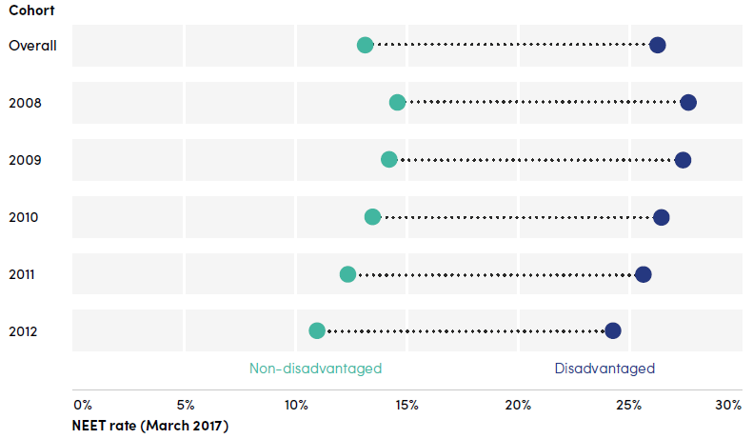
Young people from disadvantaged backgrounds are twice as likely to be NEET as their better-off peers
Disadvantage vs non-disadvantage NEET rate for young people, by cohort, at March 2017
7

Slide 26
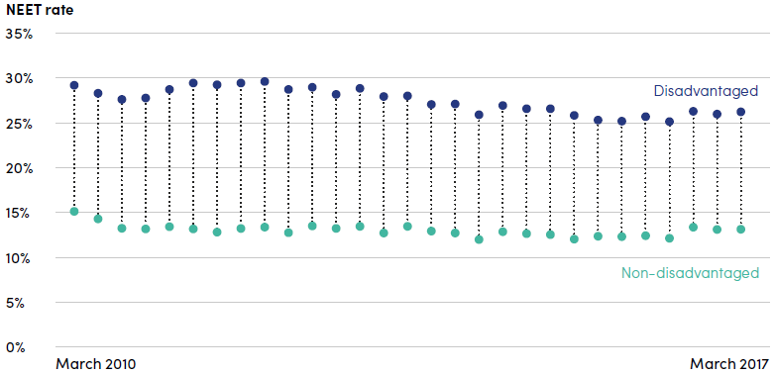
The Employment Gap is consistent over time
Disadvantage vs non-disadvantage NEET rate for young people, quarterly from March 2010 to March 2017
8

Slide 27
Better qualified young people less likely to be NEET
Source: Impetus Youth Jobs Gap: Establishing the Employment Gap
NEET rate (March 2017)
< Level 2 Level 2 Level 3+
Highest level of qualification at age 18
2

Slide 28
Disadvantaged young people are 50% more likely to be NEET after controlling for qualifications
Source: Impetus Youth Jobs Gap: Establishing the Employment Gap
NEET rate (March 2017)
< Level 2 Level 2 Level 3+
Highest level of qualification at age 18
3

Slide 29
NEET rates vary enormously within regions (case study: West Midlands)
NEET rate for 21 year olds, by local authority area, at March 2017
National figure
Solihull
Warwickshire Sandwell
West Midlands local authorities
NEET rate
4

Slide 30
NEET rates vary enormously within regions (case study: West Midlands)
NEET rate for 21 year olds, by local authority area, at March 2017
National figure
Solihull Sandwell
West Midlands Combined Authority local authorities
NEET rate
5

Slide 31
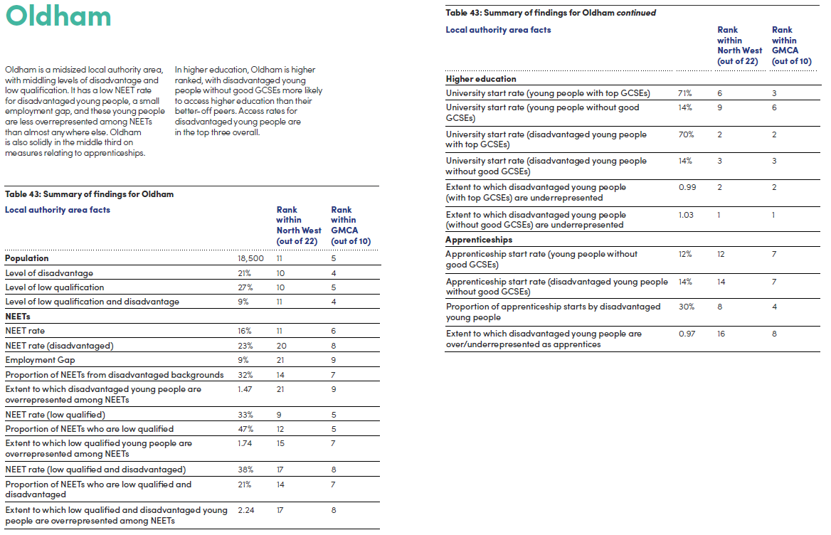
7

Slide 32
Most NEET young people have been NEET for 12 months
Percentage of young people NEET for 3 months to September 2016: 16%
Percentage of young people NEET for 12 months to September 2016: 12%
8

Slide 33
Implications – we need to look at…
Preventing young people becoming NEET
Supporting young people to move from NEET to EET quickly
Supporting long-term NEET young people with the biggest barriers
9

Slide 34
The latest support available…
Preventing young people becoming NEET
Young people moving into education – now what?
Supporting young people to move from NEET to EET quickly
JCP - Kickstart, SWAPs, Youth Offer, Youth Hubs
Incentives for Apprenticeships, are they working for this group of young people? Expanded Traineeships
Supporting long-term NEET young people with the biggest barriers
ESF – UKSPF…?
Restart (long term unemployed Summer 2021)
‘Opportunity Guarantee’ of a high-quality education, training or employment place
9

Slide 35
More about the Youth Jobs Gap: https://impetus.org.uk/youth-jobs-gap

Slide 36
Please get in touch…
Twitter @AnnaMorrisonCBE and @AmazingAppsUK
Email Anna@AmazingApprenticeships.com
Website www.amazingapprenticeships.com
LinkedIn linkedin.com/company/amazing-apprenticeships
www.amazingapprenticeships.com

Slide 37
Any questions?
“I WONDERED WHY SOMEBODY DIDN’T DO SOMETHING. THEN I REALISED, I AM SOMEBODY” Unknown
www.amazingapprenticeships.com

