Slide 1
Time for Change
Supporting disadvantaged apprentices: thinking beyond budget
21st April 2021

Slide 2
Time for Change webinar series
Workshop 1: Social Mobility in Apprenticeships Sutton Trust & Social Mobility Commission
Workshop 2: Apprenticeships for All The Open University & Disability Rights UK
Workshop 3: Mental Health Matters Gen. Healthy Minds
Workshop 4: Youth Matters Impetus & Youth Employment UK
Workshop 5: Barriers: the apprentice perspective Elle & Haider
Workshop 6: Supporting disadvantaged apprentices
www.amazingapprenticeships.com

Slide 3
Today’s workshop
Welcome & housekeeping
NUS Apprentice Extra Card, Bev McLaren
Meet the speakers and panel discussion
Q&A
www.amazingapprenticeships.com

Slide 4
Housekeeping
Today’s webinar is being recorded
Please keep cameras switched off and remain muted
The chat can be used to submit questions
www.amazingapprenticeships.com

Slide 5
NUS Apprentice Extra Card
Bev McLaren

Slide 6
Get money off the biggest brands with NUS Apprentice extra!

Slide 7
Background…
Launched in 2017, OneVoice Digital is a collaborative partnership between NUS and Arrk Group, with the objective of providing a digital business with the expertise to develop and provide digital products and services for NUS, members and similar organisations.
Operational for over 20 years, the company has over 200 employees and is based in Macclesfield and Mumbai, specialising in developing and operating digital services and products for third sector, government, higher education and private sector organisations.
Arrk Group has a strong ethical fit with NUS.
In September 2018, the NUS extra student discount card became TOTUM for students and TOTUM Pro for professional learners

Slide 8
Working with NUS
How we’re helping apprentices…
Discounts on over 350+ brands:
Travel
Fashion
Eating out
Health and fitness
Beauty
Entertainment
Everyday essentials
Finance
Telco
Groceries
Energy provider
…and more!
NUS Apprentice extra is just £11 for 1 year and just launched the 2 year card for £19

Slide 9
Working with NUS
Getting heard…
All the profits raised from NUS Apprentice extra sales fund the National Society of Apprentices (NSoA). A society for apprentices, run by apprentices and paid for by apprentices.
We have a seat at the NSoA leadership meetings – making sure the voice of the apprentice is heard and raising awareness of apprentices’ needs
We work with…
…and more

Slide 10
Working with NUS
Sharing the news…

Slide 11
Working with NUS
In the pipeline…
Discounted Bus Travel pilot with IOW Council, IOW College & Southern Vectis bus pilot started Oct 2020 – single source of truth ID card with 25% off weekly bus travel
Incorporate NUS Apprentice extra in to the TOTUM family with mobile app / wallet and new website

Slide 12
Working with NUS
Bev’s contact details
Bev McLaren
Channel Partner – apprentice
NUS Apprentice extra
Bev.mclaren@onevoicedigital.com

Slide 13
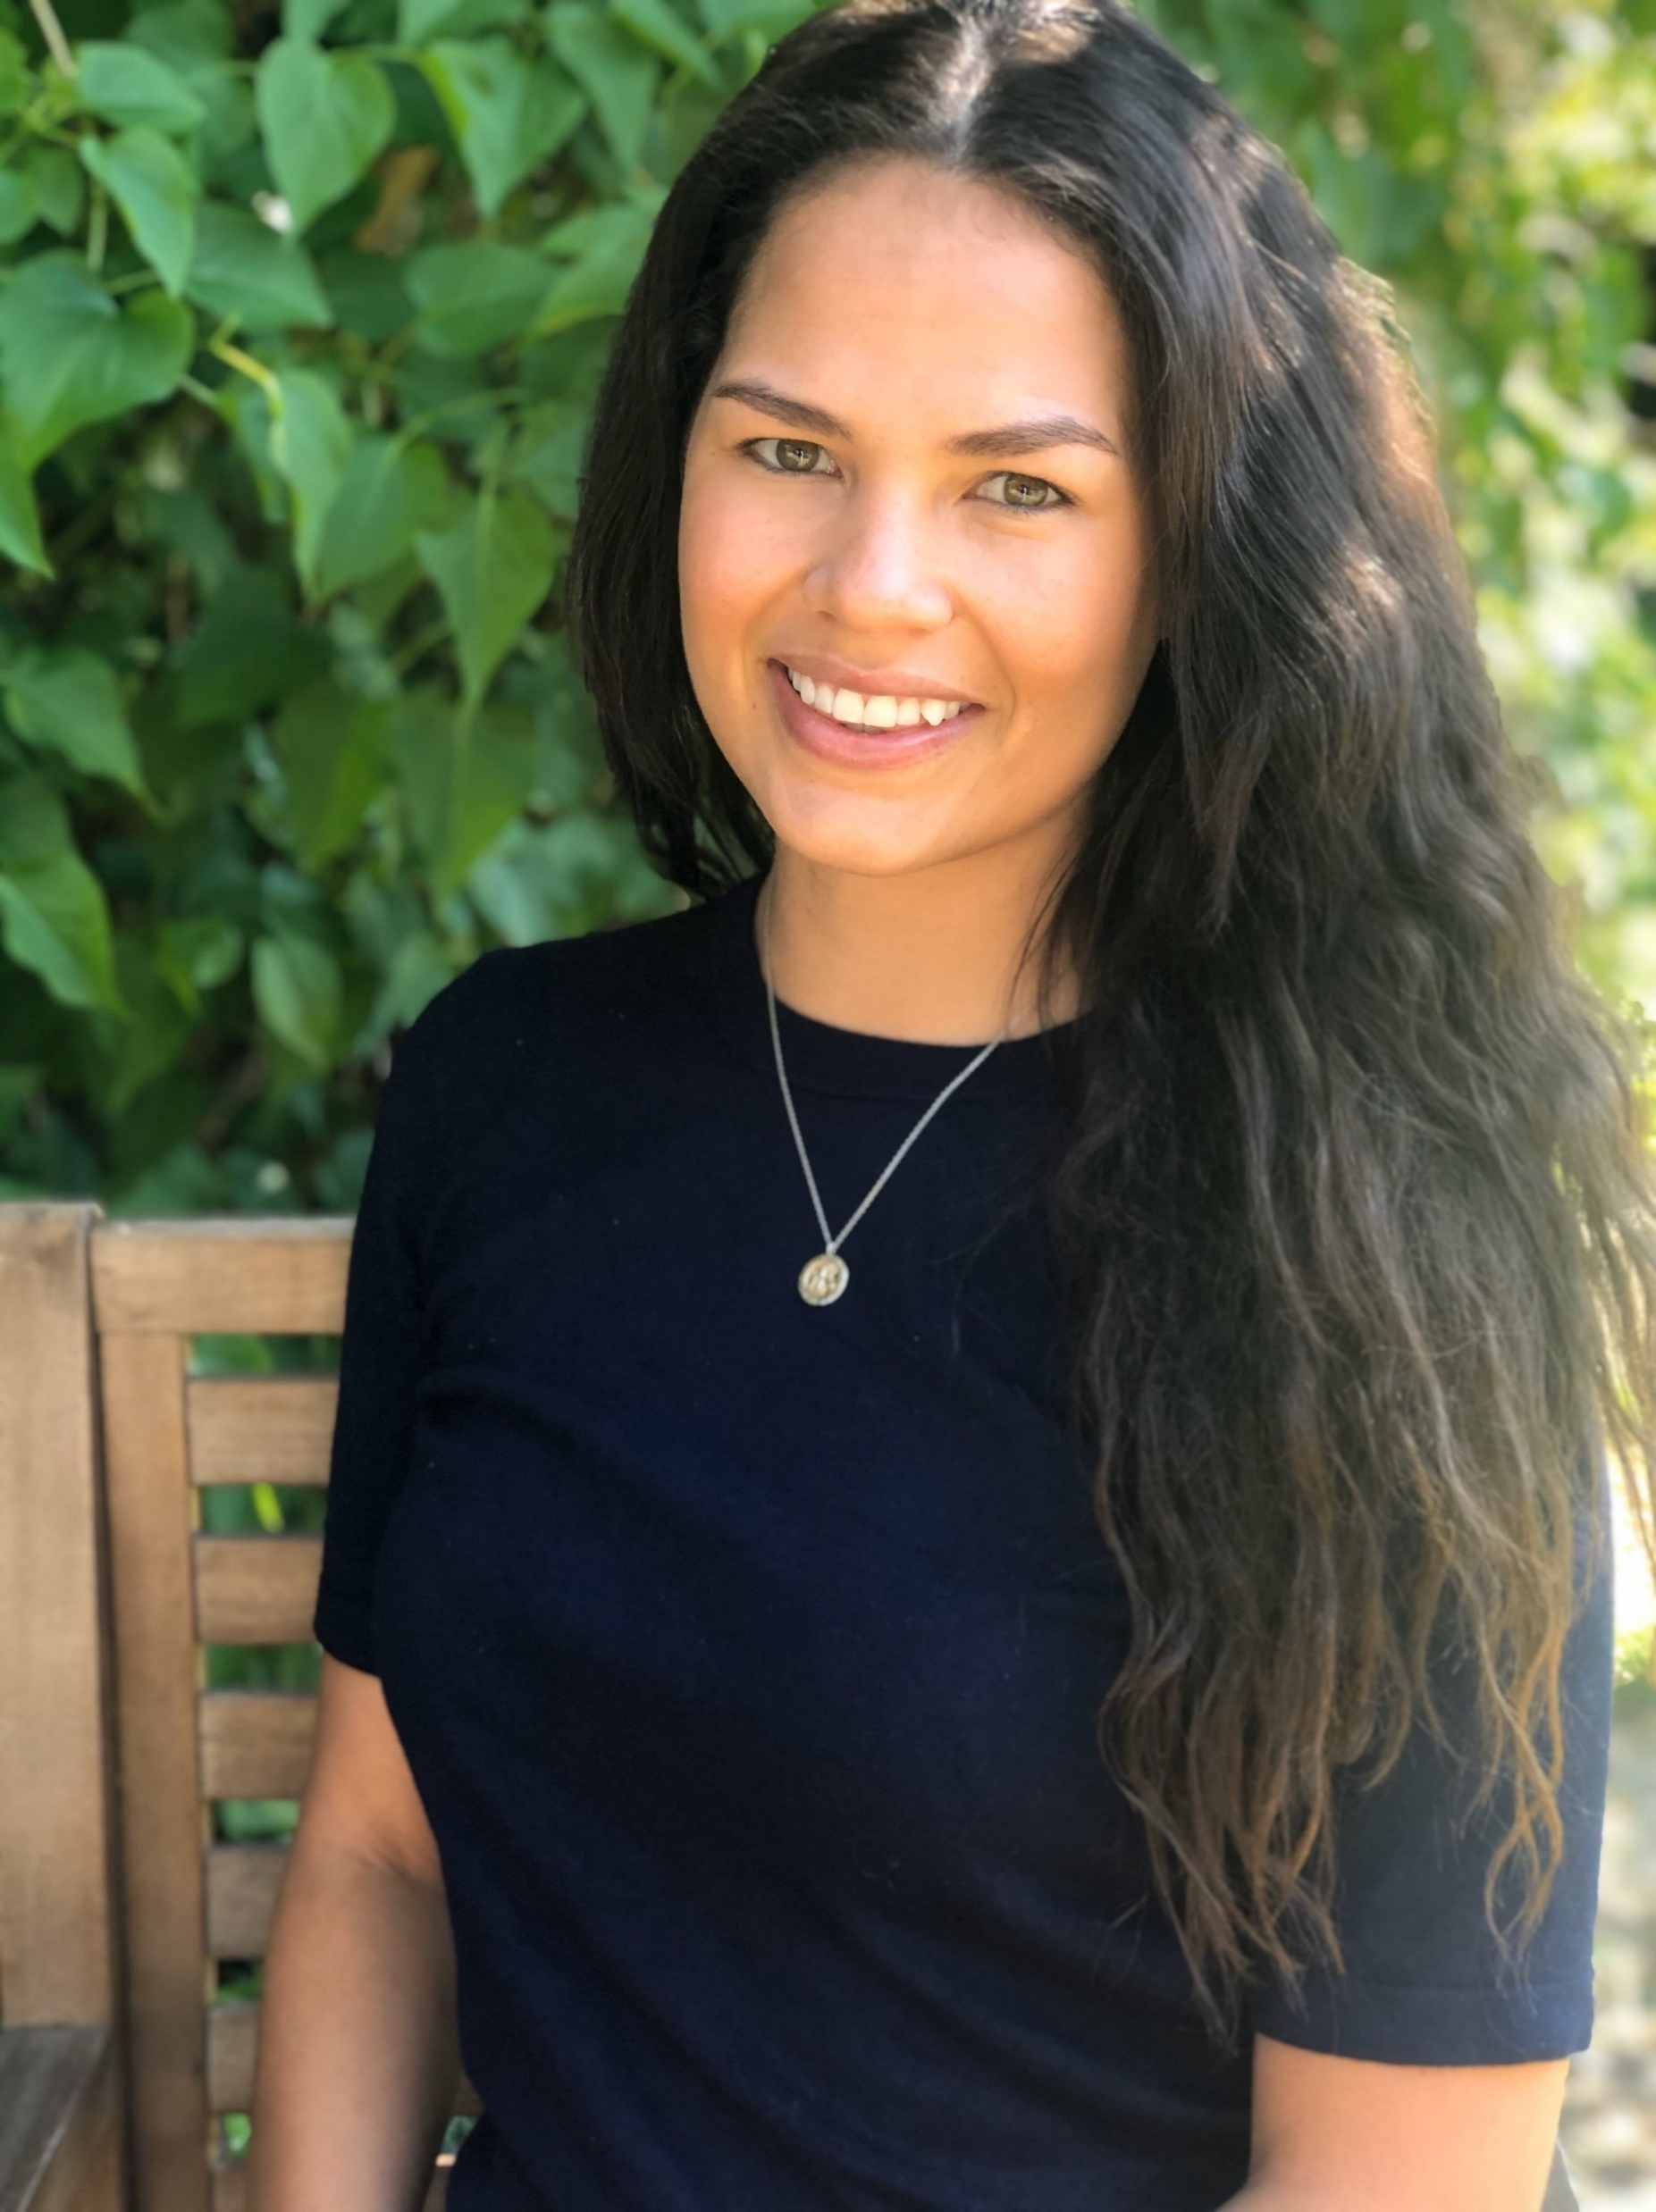
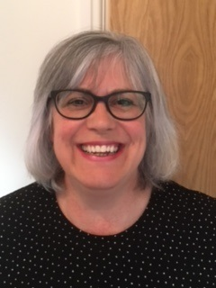
Meet the panellists
Siobhan Randell Senior Diversity, Equality & Inclusion Manager Multiverse
Bev McLaren Channel Partner
NUS Apprentice extra discount card
www.amazingapprenticeships.com

Slide 14
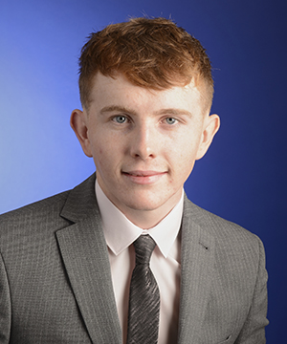
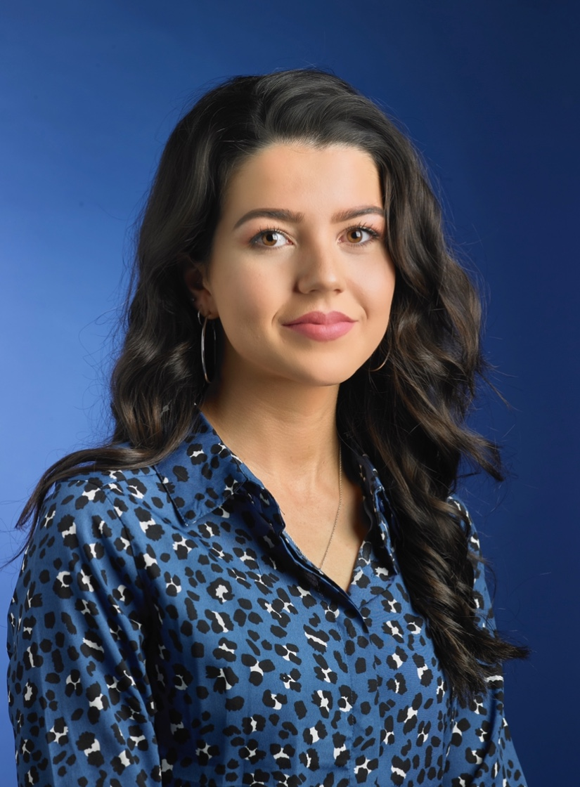
Meet the panellists
David McIntosh Management Consultant, apprentice KPMG
Helen Jones IARCS Associate, apprentice
KPMG
www.amazingapprenticeships.com

Slide 15
Let’s talk…
www.amazingapprenticeships.com

Slide 16
www.amazingapprenticeships.com/genie
www.amazingapprenticeships.com

Slide 17
www.amazingapprenticeships.com

Slide 18
Cohort one starts May '21
Cohort two starts October '21
www.amazingapprenticeships.com/genie

Slide 19
Please get in touch…
Twitter @AmazingAppsUK
Email Hello@AmazingApprenticeships.com
Website www.amazingapprenticeships.com/Genie
LinkedIn linkedin.com/company/amazing-apprenticeships
www.amazingapprenticeships.com

