Slide 1
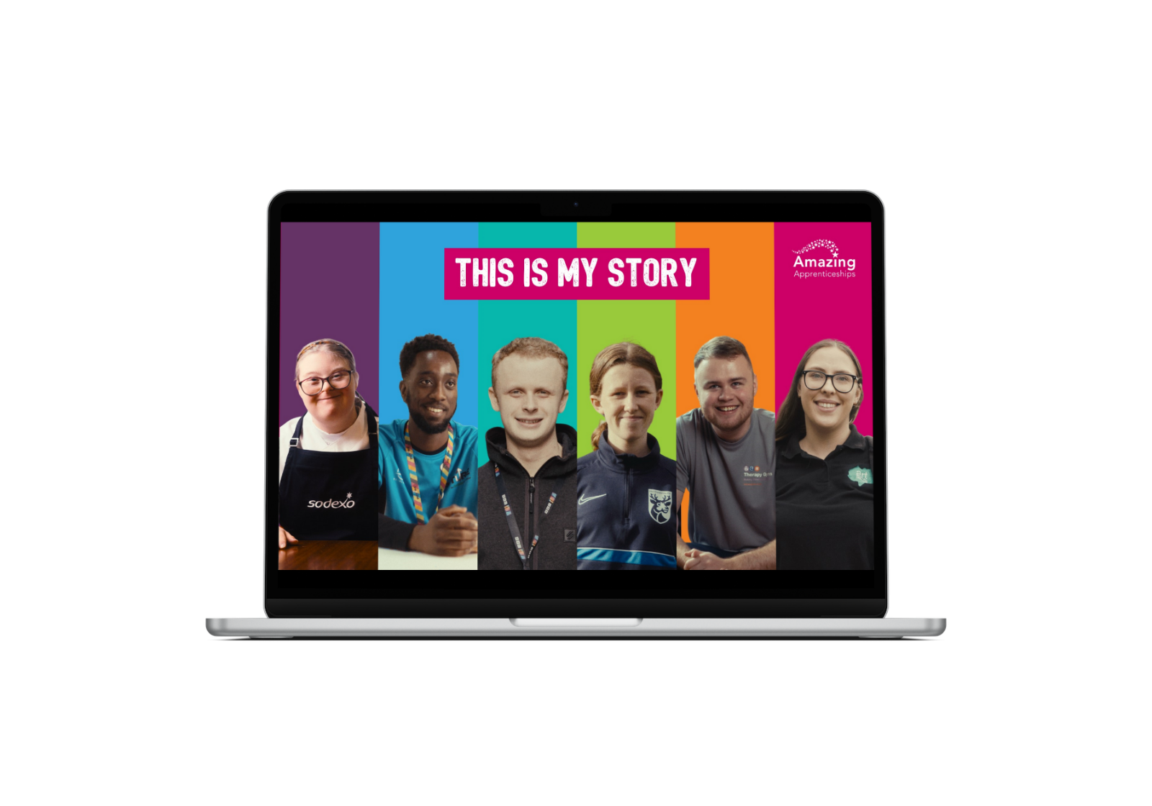

lesson activities and answers
Worksheets and answers

Slide 2
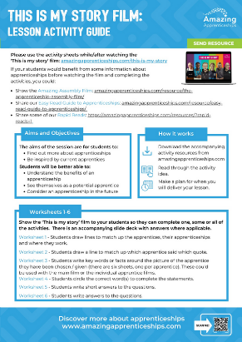

resources
Teacher guide & student activities: https://amazingapprenticeships.com/resource/this-is-my-story-teacher-guide-student-activity
All the resources and the film:
https://amazingapprenticeships.com/this-is-my-story/

Slide 3
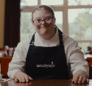
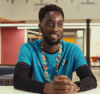

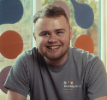
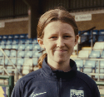
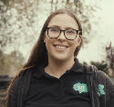
match up the apprentices, their jobs and where they work
Community activator coach
Youth centre
FILM RESOURCE
Esme
Chef
Charity
Nana
Sports Business
Management
Army base
James
Software Engineer
Therapy gym
Connell
Events & Fundraising
Officer
Football association
Maisie
Personal Trainer
BBC
headquarters
Daisy
worksheet 1

Slide 4
match up the apprentices, their jobs and where they work
Community activator coach
Youth centre
FILM RESOURCE
Esme
Chef
Charity
Nana
Sports Business
Management
Army base
James
Software Engineer
Therapy gym
Connell
Events & Fundraising
Officer
Football association
Maisie
Personal Trainer
BBC
headquarters
Daisy
worksheet 1 - answers

Slide 5



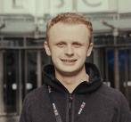
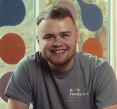


Which apprentice said what?
FILM RESOURCE
My line manager and employer have supported me so well, they’ve made adjustments to meet my needs.
Diversity and inclusion is really important to me.
It’s a very welcoming, friendly and inclusive environment.
It makes me proud to have a caring team. They help me every day.
I really like my team. They are a fantastic bunch of people and I’ve learnt so much from them.
I can work from home and in the office, which suits me and my disability.
Esme
Nana
James
Connell
Maisie
Daisy
worksheet 2

Slide 6
Which apprentice said what?
FILM RESOURCE
My line manager and employer have supported me so well, they’ve made adjustments to meet my needs.
Diversity and inclusion is really important to me.
It’s a very welcoming, friendly and inclusive environment.
It makes me proud to have a caring team. They help me every day.
I really like my team. They are a fantastic bunch of people and I’ve learnt so much from them.
I can work from home and in the office, which suits me and my disability.
Esme
Nana
James
Connell
Maisie
Daisy
worksheet 2 - answers

Slide 7
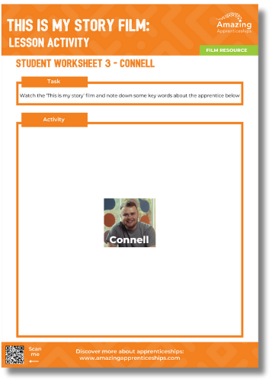
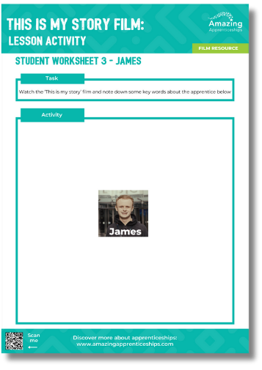
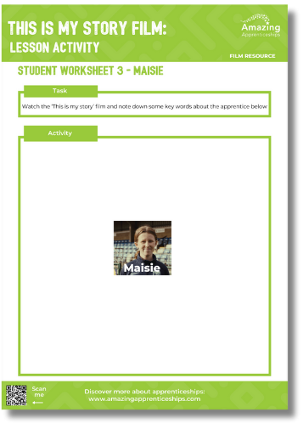
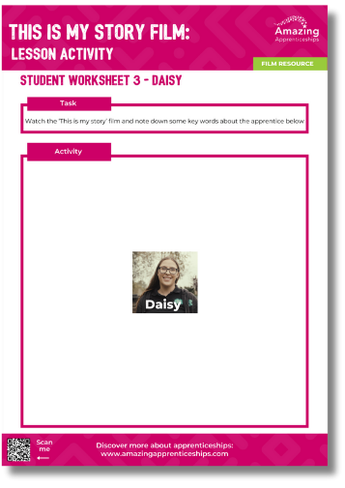
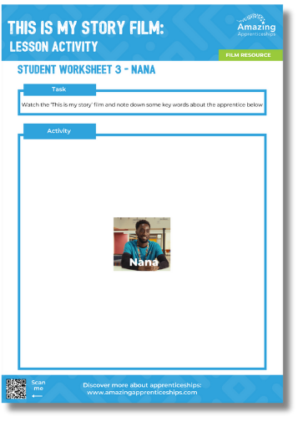
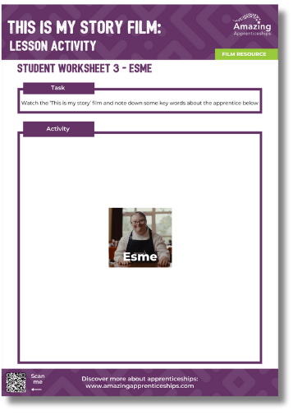
make notes about an apprentice
FILM RESOURCE
worksheet 3

Slide 8
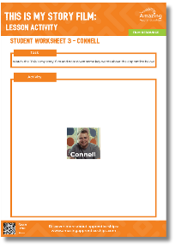
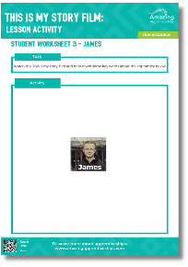
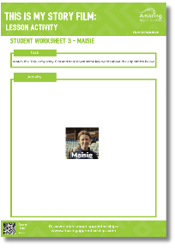
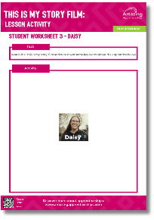
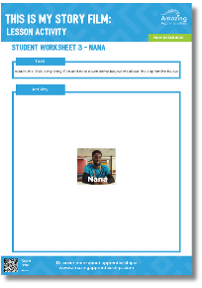
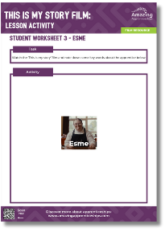
make notes about an apprentice
FILM RESOURCE
What did you learn about the apprentices?
worksheet 3 - answers

Slide 9






choose the correct words to complete the statements
FILM RESOURCE
I like being able to help / work with / talk to people and seeing the good we do.
Young people come in here to do school work / make new friends / learn a new skill.
Daisy
Nana
My favourite part of the day is when I serve customers / tidy up / follow recipes.
Working here is something I always / maybe / never imagined I’d be able to get into.
Esme
James
I knew I always wanted to work in the football / food / TV industry when I was older.
My teacher / friend / job coach sent me a link to the apprenticeship.
Maisie
Connell
Esme
Nana
James
Connell
Maisie
Daisy
worksheet 4

Slide 10

choose the correct words to complete the statements
FILM RESOURCE
I like being able to help / work with / talk to people and seeing the good we do.
Young people come in here to do school work / make new friends / learn a new skill.
Daisy
Nana
My favourite part of the day is when I serve customers / tidy up / follow recipes.
Working here is something I always / maybe / never imagined I’d be able to get into.
Esme
James
I knew I always wanted to work in the football / food / TV industry when I was older.
My teacher / friend / job coach sent me a link to the apprenticeship.
Maisie
Connell
Esme
Nana
James
Connell
Maisie
Daisy
worksheet 4 - answers

Slide 11






answer the questions
1
What is the name of the special programme Daisy got through Access to Work?
FILM RESOURCE
2
How did Nana find out about his apprenticeship?
3
What does Esme want to do when she finishes her apprenticeship?
4
How does James feel to be working at the BBC?
5
What does Maisie do at university?
6
What does Connell say he wants to be?
Esme
Nana
James
Connell
Maisie
Daisy
worksheet 5

Slide 12
answer the questions
1
What is the name of the special programme Daisy got through Access to Work?
FILM RESOURCE
Dragon
2
How did Nana find out about his apprenticeship?
At a recruitment event day
3
What does Esme want to do when she finishes her apprenticeship?
Be a chef
4
How does James feel to be working at the BBC?
Privileged
5
What does Maisie do at university?
Degree learning - lectures and seminars
6
What does Connell say he wants to be?
Be a personal trainer who can train everyone
Esme
Nana
James
Connell
Maisie
Daisy
worksheet 5 - answers

Slide 13



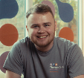


answer the questions
1
What does Daisy say about the charity she works for? (2 things)
FILM RESOURCE
2
What does Nana say about his colleagues? (2 things)
3
What do Esme’s team help her with? (1 thing)
4
What does James say he has always been interested in? (2 things)
5
What does Maisie want to make sure football is like? (2 things)
6
What would Connell say to his younger self? (1 thing)
Esme
Nana
James
Connell
Maisie
Daisy
worksheet 6

Slide 14
answer the questions
1
What does Daisy say about the charity she works for?
FILM RESOURCE
  Called Abberton Rural Training
  Help vulnerable and isolated people in Essex
2
What does Nana say about his colleagues?
  They are really nice people
  They like to have a laugh together and do crazy stuff
3
What do Esme’s team help her with?
  With her chopping, cooking and serving skills
4
What does James say he has always been interested in?
  Software engineering and coding
  Television and radio production
5
What does Maisie want to make sure football is like?
  More inclusive
  More diverse
6
What would Connell say to his younger self?
  “You’re going to go on to do so many incredible things.”
Esme
Nana
James
Connell
Maisie
Daisy
worksheet 6 - answers

