Slide 1
Notes to the presenter 1/3
This slide deck is brought to you by the DfE HTQs team.
This resource is designed for anyone running an information session about HTQs and should take around 20 minutes to deliver.
It can be quickly adapted for your setting, with the aim of generating interest, enthusiasm and positivity about HTQs among staff, students and parents/carers.
Please delete this slide before presenting

Slide 2
Notes to the presenter 2/3
Please read the slides and update all sections highlighted in yellow with details for your setting.
Slide 6 contains a video (optional) - please decide if you would like to use it, check it can be played from the presentation, and that the sound is working. This is the link for the video in case you need it: https://youtu.be/aVm97bOOOz4?si=ABjn5Qm_X-cErqCF
Please delete this slide before presenting

Slide 3
Notes to the presenter 3/3
Find out which providers local to you are offering HTQs and complete slide 12. https://www.gov.uk/government/publications/list-of-higher-technical-qualifications
If you search for HTQ providers and the closest ones are still too far away to be a viable option for this year, it is likely that your local providers will start offering HTQs in the coming years.
Please delete this slide before presenting

Slide 4
Higher
Technical
Qualifications (HTQs)
Notes:
Hello and thank you so much for being here to hear all about HTQs. We hope that you will leave today feeling confident about HTQs.

Slide 5
Today’s aim is to give you an introduction to HTQs, including:
What HTQs are
What you can study
Who they are for
Where you can study HTQs and how to find them
How to apply for HTQs
What support is available
Notes:
Our aim for today is to give you an introduction to HTQs and make sure you have a good understanding of:
What HTQs actually are
Which subjects you can study and which subjects are coming in future years
Who can study HTQs, what prior qualifications you need and what sort of person they are suited to
Where you can study HTQs and how to find them nationally and locally
What the application process is like
What support and resources are available
There will be a chance to ask questions at the end.

Slide 6
What are HTQs?
The HTQ quality mark shows that your higher education course has been approved as meeting standards set by industry. HTQs are a great way to get the skills employers want - a route to well-paid, secure and sustainable jobs. They can be studied full or part time, depending on the course.
Notes:
HTQs are new and existing level 4 and 5 qualifications, such as HNDs, HNCs and Foundation Degrees that have been approved with the HTQ quality mark.
The HTQ quality mark shows that a higher education course has been approved as meeting standards set by real employers in the industry. HTQs are a great way to get the skills employers want - a route to well-paid, secure and sustainable jobs. They can be studied full or part time, depending on the course.

Slide 7
Notes:
We’re now going to watch a short two-minute film about HTQs.

Slide 8
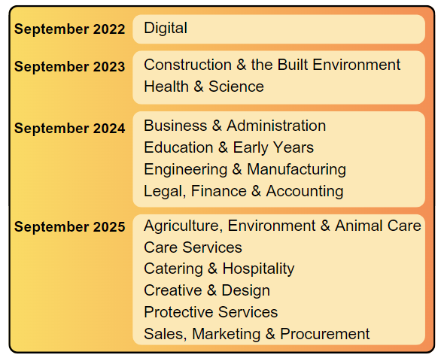
Which HTQs are available?
Notes:
Level 4 and 5 qualifications are being given the HTQ mark of quality on a rolling basis. You can see on the screen where we are now and which subject areas have been through the HTQ approval process. This means that more and more courses are becoming available each year and by 2025, we will have a wide range of HTQs across all the areas shown.

Slide 9
Who can take an HTQ?
HTQs teach specialist skills and you must have completed a level 3 qualification, such as A-levels, T Levels, BTECs or some advanced apprenticeships.
You can apply for HTQs while you are still at school.
They are also suitable for anyone looking to upskill or retrain.
Notes:
You must have completed a level 3 qualification such as A-levels, T Levels, BTECs or some advanced apprenticeships. You can apply for HTQs while you are still at school.
HTQs are also suitable for anyone looking to upskill or retrain during their career.

Slide 10
Notes:
After completing an HTQ, you could go straight into employment or use credits gained through your HTQ to progress onto further study, for example a degree, or an apprenticeship. You can top up your HTQ credits and turn it into a full undergraduate honours degree or use those credits to undertake an accelerated apprenticeship.
An HTQ at either level 4 or 5 would earn credits (a level 4 Certificate in Education that is an approved HTQ typically attracts 120 credits, for example). Students could make an application to a university to 'top up ' to a degree (in a similar subject area) on the basis of these credits. Universities would consider each application on its merits. Typically, 360 credits are needed in total to complete an undergraduate degree.

Slide 11
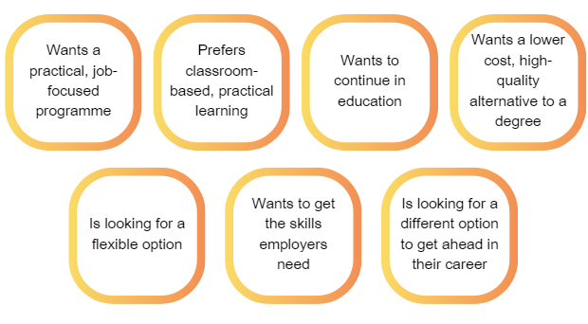
Who is an HTQ suitable for?
HTQs are suitable for someone who…
Notes:
HTQs are suitable for someone who:
wants a practical programme with a job focus.
prefers classroom-based, but practical learning to work-based learning.
wants to continue in education
wants a lower-cost, high quality alternative to a degree.
is looking for a flexible option.
wants to get the skills employers need.
is looking for a different option to get ahead in their career. An HTQ can get them ready and help boost their chances of securing their next step at the end of their HTQ.

Slide 12
Where can you do an HTQ?
HTQs are delivered by Universities, FE Colleges, Independent Training Providers and Institutes of Technology across England.
e.g. Coventry University
e.g. Bedford College
Notes:
HTQs are delivered by Universities, Further Education Colleges, Independent Training Providers and Institutes of Technology all over England.

Slide 13
How do you find HTQs?
Visit: https://www.gov.uk/government/publications/list-of-higher-technical-qualifications to find providers.
Contact or visit the websites of local FE colleges, Universities, Independent Training Providers and Institutes of Technology.
Search on UCAS (this link will take you to a pre-filtered list of HTQs: https://tinyurl.com/2s44vaby)
Notes:
There are several ways you can find HTQs:
The government has a list of all the HTQs available, which you can filter and search.
Another way is to contact or visit the websites of specific providers and find out what courses they are offering.
You can also search for full-time HTQs on UCAS, just like you would for a full degree course.

Slide 14
Where can you do an HTQ locally?
Before using this resource, go on to https://www.gov.uk/government/publications/list-of-higher-technical-qualifications, and add real examples of a local Uni provider and FE provider and their courses.
e.g.
University of Bolton HNC – Construction Management for England (HTQ)
Hopwood Hall College HND – Computing (HTQ)
Bury College HNC – Community Coaching for England (HTQ)
Notes:
PRESENTERS: Please make sure you have updated this slide with relevant examples for your audience.
Before using this resource, go on to https://www.gov.uk/government/publications/list-of-higher-technical-qualifications and find out which providers local to you are offering HTQs and which courses.
e.g.
XXX College: HND – Software Development and Programming
HNC - Construction Management
XXX University Foundation degree – Nursing Associate

Slide 15
What are the entry requirements for HTQs?
Each educational provider sets their own grade or qualification entry requirements.
Most providers state their entry requirements in terms of UCAS tariff points, and requirements could range from 0 – 112.
Notes:
Entry requirements vary from provider to provider as each sets their own grade or qualification requirements. Most providers state their entry requirements in terms of UCAS tariff points, and requirements could range from 0 – 112. Try not to be put off by entry requirements though and make sure you talk to the provider if you have concerns.

Slide 16
Do you have to pay tuition fees?
To study an HTQ tuition fees will apply, which will vary depending on the course.
Similar to a university degree, they’re likely to cost from around £7,000 to £9,250 a year – but for a one-year or two-year course.
However, you could be eligible for student support to cover tuition fees and maintenance loans.
Find out more here: https://www.gov.uk/student-finance
Notes:
If an HTQ is undertaken as a standalone qualification, tuition fees will apply, which will vary depending on the course. They’re likely to cost from around £7,000 to £9,250 a year for a one-year or two-year course.
You may be eligible for funding from student finance or a scholarship, grant or bursary. This will depend on the circumstances and the type of HTQ being studied.
In the same way as full-time university study, students may wish to make arrangements for their own payment of fees and this is also the same for HTQs.

Slide 17
How do you apply for an HTQ?
There are two ways to apply for an HTQ.
Use the UCAS website to search and apply for HTQ courses
Apply directly to the training provider
For support applying, see the application guide: https://amazingapprenticeships.com/resource/the-higher-technical-qualifications-application-guide/
Notes:
You can apply for an HTQ directly through UCAS as one of your 5 course choices.
Applications should be made in the autumn term observing the January deadline to have the best chance of securing your first choice for the following September. Applications can be made after this date as some HTQ courses have a January rather than September start, allowing lots of flexibility.
You can also apply directly to the training provider and the process will vary, but is likely to include an online application form, skills test and an interview.
There is a guide to applying for HTQs that you can download here: https://amazingapprenticeships.com/resource/the-higher-technical-qualifications-application-guide/

Slide 18
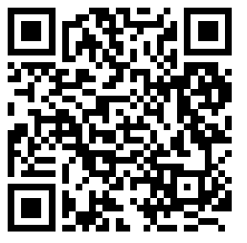
Support available
Webinars
A detailed guide and a quick guide to HTQs
HTQs application guide
Find all the resources here: https://amazingapprenticeships.com/resources/?htqs=1
Notes:
There are resources available to support you in your HTQ journey. There is a detailed guide and a one-page guide to HTQs, as well as the application guide I mentioned earlier. There are also webinars you can watch that you can find on the Amazing Apprenticeships’ workshops and webinars page.

Slide 19
Any questions?
Notes:
Thank you so much for listening today. Does anyone have any questions?

