Slide 1


Apprenticeships for the
School Workforce
Notes:
Good afternoon and thank you for joining today’s workshop, Apprenticeships for the School Workforce.
My name is Anna Morrison and I am the Director and founder of Amazing Apprenticeships
We help to raise awareness about apprenticeships, working with nearly 5,000 schools across England
This isn’t just the Careers Education side of things though, we also do a lot of work with schools to help them to understand how apprenticeships can support their School Workforce.
So, in celebration of National Apprenticeship Week, what better time to talk to you about just that!

Slide 2

amazingapprenticeships.com/school-workforce
Information
Case studies
Further reading & resources
Benefits
Funding
Apprenticeship standards
Finding a training provider
And much more….
Notes:
There is information on our website https://amazingapprenticeships.com/school-workforce/
We’ve worked with DfE to put together
This is where the slides will be
Ok – so let’s introduce our 4 brilliant speakers….

Slide 3
Today’s workshop
Kevin Gilmartin, Association of School & College Leaders
Bertie Hutchins, Education & Skills Funding Agency
Diana Taylor and Zoe Batten, Plymouth Cast Multi-Academy Trust
Q&A
This workshop is being recorded
A copy of the recording and presentation slides will be shared this week
Please submit questions through the chat function

Slide 4

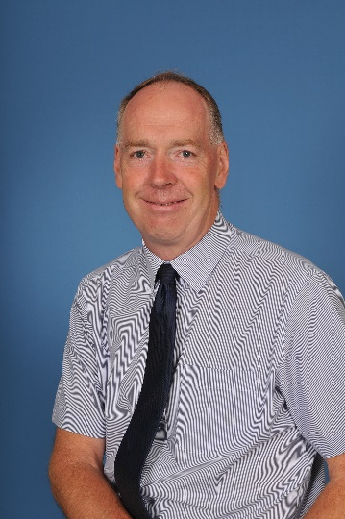
How & why do schools use apprentices?
Kevin Gilmartin
ASCL Post-16 Specialist
Ex-sixth form principal
kevin.gilmartin@ascl.org.uk
Association of school and college leaders

Slide 5
model 1 - School employs the apprentice: range of roles and levels
Teaching-related:
Teaching assistant
Learning mentor
Early years educator
General office-related:
Business administrator
Assistant accountant (AAT)
School business professional
Support services –
other/technical
Library professional
Lab technician
Digital marketer

Slide 6
model No. 1 - School employs the apprentice:
Issues to look out for:
It’s not a free pair of hands –
need a mentor, in-house support,
20% off-the-job training, pay
policy
Is there a real job at the end
of the training? (can upskill
existing workers as well)
Choice of apprenticeship
provider & final assessment
(EPA)is important
Age of the apprentice –
safeguarding/appropriateness
concerns?
Type of school is important:
VA & Foundation
Are you big enough to pay the
apprenticeship levy?
Community & voluntary controlled
Does the LA have a pool of
apprentices that benefit you?
Academies, Free Schools, MATs
More scale, more flexibility
Trust policy ?

Slide 7
Model 2 – School “leases” the apprentice:
The school (the lessee):
Leases the apprentice for a monthly fee via an approved Apprenticeship
Training Agency (ATA)
Doesn’t have to use their levy or any co-investment
Option to employ the apprentice at the end (usually no fee)
The employer (the lessor):
Recruits, employs and supports the apprentice
Arranges the training and assessment
Deals with the HR issues e.g. grievances, performance, holiday &
sickness
Replaces the apprentice if necessary

Slide 8
Funding for apprenticeships
Bertie Hutchins – National Account Manager (ESFA)

Slide 9
Apprenticeship funding - Levy payers
 | Voluntary aided and foundation schools | Community and voluntary controlled schools | Academies, free schools and multi-academy trusts
Do I pay the levy? | If your school’s annual pay bill is over £3 million - yes | If your local authority’s annual pay bill is over £3 million - yes | If your pay bill is over £3 million - Yes The trust is likely to be your employer and operate under one pay bill so they’re likely to pay the levy.
Where are my funds? | Get in touch with your governing body and see how much allocation is available. | Your local authority should have already let you know how much levy you have available to spend. If you’re unsure how to access the funds, contact your local authority to find out. | Get in touch with your trust and see how much allocation is available.
What can I use the funds for? | To fund training and assessment costs of apprenticeships (anyone can be an apprentice, there is no upper age limit and it can also be for existing staff)
Apprenticeship funding - Non-levy payers
Do I pay the levy? | If the annual pay bill is under £3 million – no
What funding is available? | You can still take on apprentices and access funding to purchase training from an approved training provider/assessment organisation. The government will pay 95% of the training and assessment costs, and you/your employer will pay the remaining 5% (up to the maximum funding band set) for the apprenticeship
If you employ fewer than 50 staff | The government will pay 100% of the training and assessment costs if your apprentice is: Aged between 16 – 18 Aged between 19 - 24 with an Educational Health and Care Plan (EHCP)

Slide 10
Incentive payments for hiring a new apprentice
Employers who hire a new apprentice between 1 August 2020 and 31 March 2021 can apply for:
£2,000 for each new apprentice aged 16 to 24
£1,500 for each new apprentice 25 and over
The deadline for applying for these is 30 April 2021.
This incentive is in addition to the existing £1,000 you’ll already get for taking on an apprentice who is:
aged 16 to 18 years old
under 25 and has an education, health and care plan or has been in the care of their local authority

Slide 11
Other schemes
Kickstart
6 month job placements
Designed to support young people (16-24) on universal credit, at risk of long-term unemployment
To help develop the skills and experience they need to find work
Government will cover 100% of minimum wage (up to max. 25 hours per week)
Traineeships
Skills development programme that includes a work placement
Can last between 6 weeks and 1 year (most are about 6 months)
Designed to support young people (16-24) to get ready for an apprenticeship or job, if they don’t have the appropriate skills or experience
Financial incentive £1000 per trainee

Slide 12


Plymouth CAST MAT:
Utilising apprenticeships for staff in schools
Diana Taylor, Staff Development Officer
& Zoe Batten, Chief Executive Officer
Notes:
ZB

Slide 13
Plymouth CAST: the context
What geographical area do we cover?
How many schools do we serve?
What does our workforce look like?
How many pupils do we educate?
Notes:
ZB

Slide 14
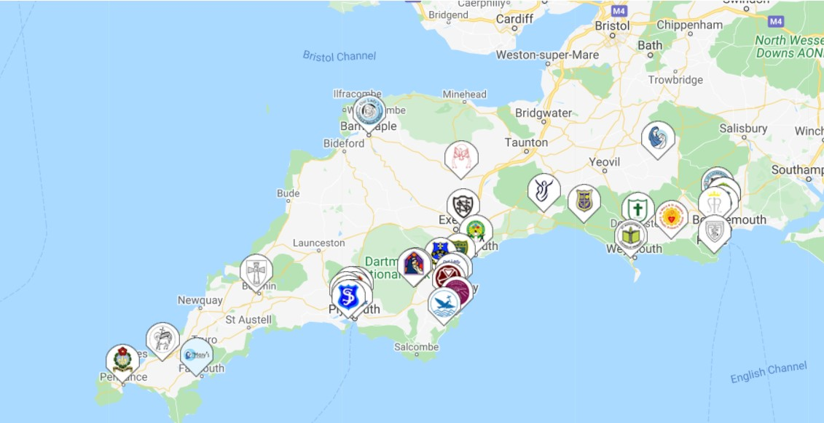
Where are we based?
Our schools are located in Dorset, Devon and Cornwall, from Poole in the east to Penzance in the west.
Notes:
ZB

Slide 15
Plymouth CAST in numbers:
33 primary schools
2 secondary schools
1 nursery
1,300 staff employed
7,000 pupils educated
Notes:
ZB

Slide 16
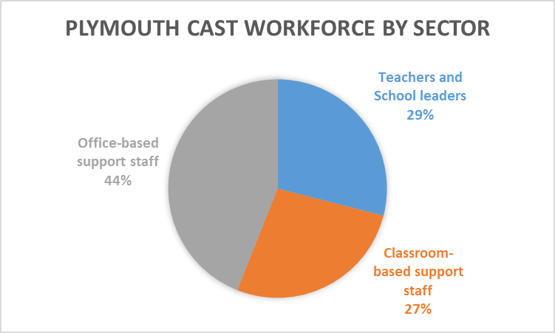
Our workforce
Notes:
DT

Slide 17
Between April 2017 and January 2021
82 apprenticeships were started
Between February 2021 and March 2021,
34 apprenticeships will be started.
Notes:
DT

Slide 18
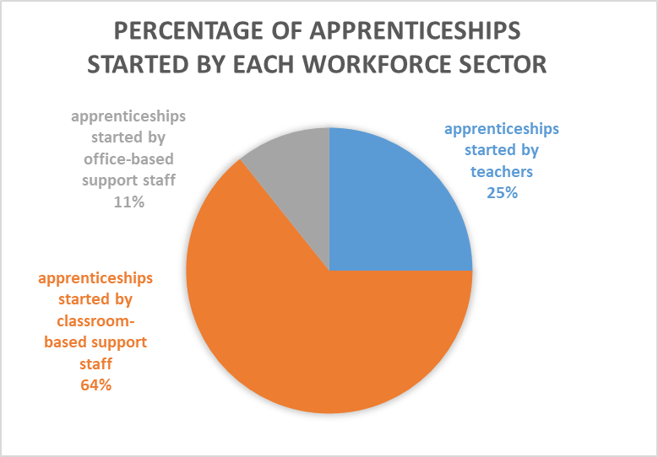
Notes:
DT

Slide 19
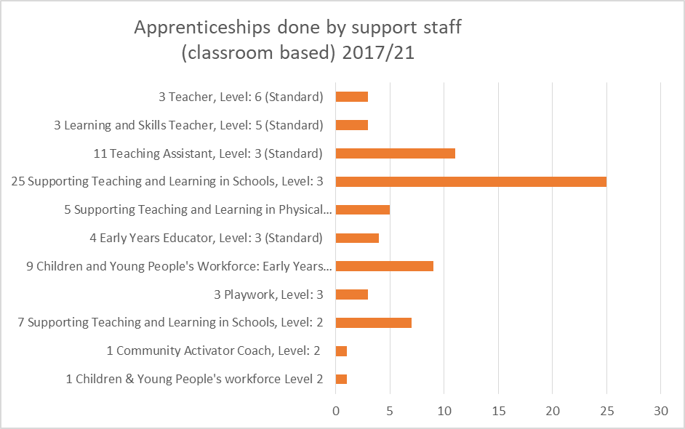
Notes:
DT

Slide 20
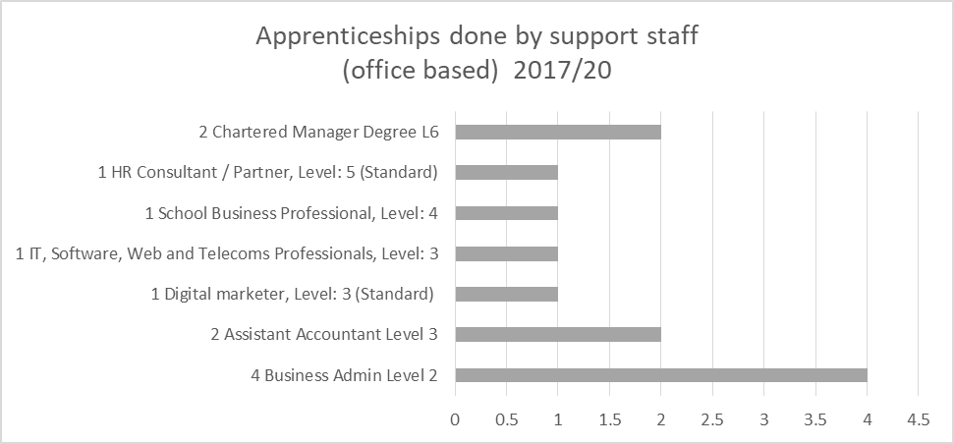
Notes:
DT

Slide 21
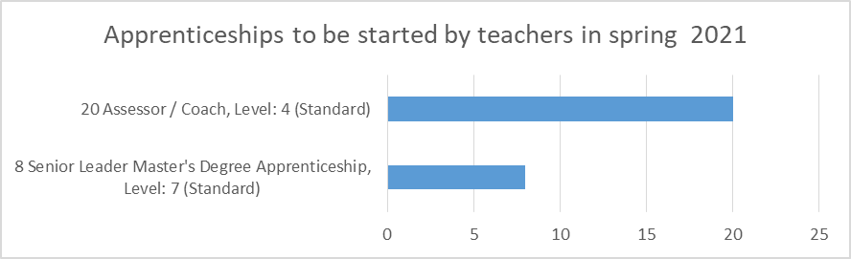
Notes:
DT

Slide 22
How have we achieved this?
Notes:
DT

Slide 23
Initial strategy (Autumn 2017– Spring 2018)
The Staff Development Officer visited every school and met with head teachers, to explain how apprenticeships could be used within a school context, to debunk myths about apprenticeships, and to identify which staff might be eligible.
GOALS:
upskill existing classroom support staff (27% of workforce)
offer apprenticeships to new employees
upskill existing non-classroom based support staff (23% of workforce)
encourage suitably qualified support staff to do a teaching apprenticeship
LIMITATIONS:
lack of relevant apprenticeships for teachers, who comprise 29% of workforce
Notes:
DT

Slide 24
Development (Autumn 2019 – Autumn 2020)
GOALS:
Continue to promote apprenticeships in schools.
Identify apprenticeships that were relevant for teachers in schools.
Senior Leader Masters Level 7 apprenticeship
Schools often asked if the SENCO qualification could be funded from the Apprenticeship Levy. One apprenticeship training provider was found that was offering the Senior Leader Masters Level 7 apprenticeship with either a Masters in Inclusion and SEND, (incorporating the SENCO qualification) or a Masters in Values Led Leadership. A cohort of 10 teachers was identified who wanted to do one of these qualifications in summer 2020. The pandemic caused some delays in the course being approved. This cohort is now due to start their apprenticeship in Spring 2021.
Identify apprenticeships that helped offer classroom support staff a route into teaching.
Learning and Skills Teacher Level 5 apprenticeship
This apprenticeship is equivalent to a Diploma in Education (two thirds of an honours degree). Three secondary school classroom-based support staff started this apprenticeship in June 2020.
Notes:
DT

Slide 25
Current strategy (Autumn 2020 - present)
2020 saw a change in senior leadership in the trust, with a new Director of Education joining in February, and a new CEO joining in September. They initiated a renewed focus on improving the quality of teaching and learning across the Trust. The CEO had a vision to equip a cohort of effective teachers across the trust with coaching skills to enable them to coach other teachers to excellence. CPD Pathway maps* were also created for each workforce sector, mapping how apprenticeships fitted into the Trust’s CPD offer.
The Assessor/Coach Level 4 apprenticeship was identified as a course that could facilitate this goal. The vision was to equip at least one effective teacher per school across the trust with coaching skills.
Information was shared with heads and staff, and a formal tender was issued to three training providers, because the projected spend for this cohort was greater than £100K. By December 2020, a suitable training provider had been identified, and a cohort of 20 teachers were identified who wanted to do the Assessor/Coach apprenticeship.
* Copies of these are included as slides at the end of this presentation
Notes:
ZB

Slide 26
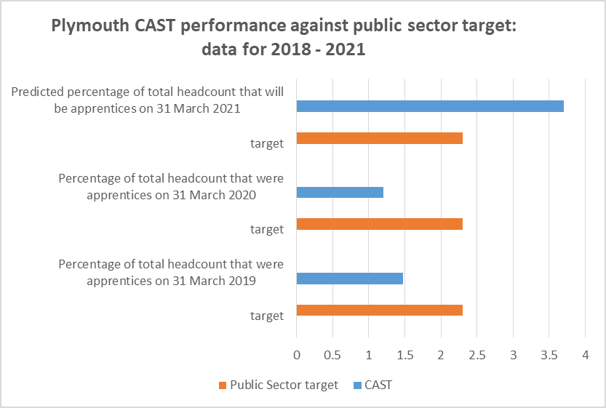
Notes:
DT

Slide 27
Finance - how does it work?
In 2017, initial yearly levy funding equated to £113k.
Current yearly levy funding is projected to be £115k.
Increased funding for CPD has been secured through Levy Transfer Funding.
A Plymouth based manufacturing company has promised to sponsor eighteen Assessor/Coach level 4 apprenticeships at a cost of £7000 each, by transferring up to 25% of their surplus apprenticeship levy fund to the Plymouth CAST apprenticeship levy pot.
This is a significant boost to our levy funds, and CPD budget.

Slide 28
How was Levy Transfer Funding secured?
Contact was made with:
Learning Education Partnership Network
Apprenticeships Ambassador Network Southwest
South West Growth Hub
Devon and Plymouth Chamber of Commerce
This led to contact with a corporate accounts manager at South Devon College.
Plymouth CAST was then signposted to a manufacturing company that wanted to find a public sector employer to partner with, in terms of levy transfer.
A conversation took place with the corporate partner. Information was shared about our Trust’s apprenticeship journey, and aspirations to improve the quality of teaching and learning through putting a cohort of teachers through Assessor/Coach Level 4 apprenticeships. The company already had an interest in STEM and had worked with one of our secondary schools to deliver 3 STEM days to KS3 pupils, so a pre-existing relationship existed.
The result was that an existing relationship between one school in our Trust and a regional manufacturing company developed into a relationship between the Trust and the manufacturing company, with levy transfer funding promised, plus ongoing support in terms of promoting careers in STEM to pupils in our schools.
Notes:
DT

Slide 29
Challenges
Enabling 20% off the job training
  An outdated notion of 20% off the job training is that it means one day a week block-release at college.
  The vast majority of our apprenticeships are delivered ‘at location’, and time is managed more creatively. Due to Covid-19, most training providers have moved to a 100% remote learning delivery model in terms of training.
  In terms of 20% off the job training, there are a number of ways this can be achieved.
Impact of Covid-19
One training provider ceased to trade, so we had to find alternative training providers for a handful of apprentices
    The pressure that teachers in schools are under at present means that we’ve had a lower take up of the Assessor/Coach Level 4 and Senior Leader Masters Level 7 apprenticeship than initially anticipated.
Notes:
ZB

Slide 30
Where do we go from here?
Continue to put cohorts of effective teachers through the Level 4 Assessor/Coach apprenticeship.
Promote the Learning and Skills Teacher Level 5 (equivalent to Diploma in Education) to HTLAs, to offer competent classroom based support staff the opportunity for career progression to eventually train to become teachers.
Use levy funds to pay for NPQ suite of school leadership courses.
Build on relationship with our corporate partners in terms of levy transfer funding and raising aspirations for pupils.
Advocate for reform of certain apprenticeships, so that they better fit the needs of the primary education sector
Notes:
ZB

Slide 31
Any questions?
Contact details:
Zoe.batten@plymouthcast.org.uk
Diana.taylor@plymouthcast.org.uk
www.plymouthcast.org.uk
Notes:
ZB

Slide 32
Notes:
ZB

Slide 34
Notes:
ZB

Slide 35

Any questions?

