Slide 1

Armed Forces Apprenticeships
25th November 2020
Please note, this webinar is being recorded
A recording will be made available through www.amazingapprenticeships.com/armed-forces

Slide 2
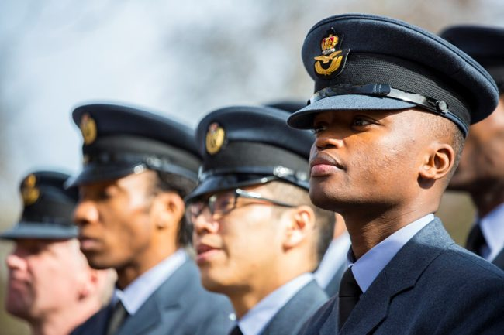

OPERATIONAL
Armed Forces Apprenticeships
Amazing Apprenticeships Webinar
25 Nov 20
Lieutenant Colonel Rory Pogson

Slide 3
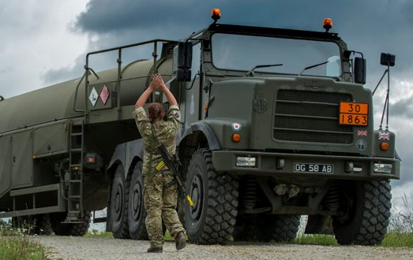

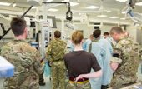
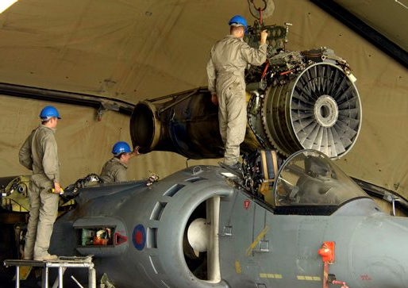


Armed Forces Apprenticeships
Armed Forces Apprenticeships
OPERATIONAL
Why the Armed Forces?
Top 100 Employer Apprenticeships
Top 100 Times Employers for Women
Top 100 Stonewall LGBT Employers

Slide 4
Armed Forces Apprenticeships
Armed Forces Apprenticeships
OPERATIONAL
Why the Armed Forces?
Apprenticeships:
- Range
- Choice
- Quality
Careers:
- Through-life development
Progress through performance
Interesting and unique opportunities
We are recruiting!

Slide 5
OPERATIONAL
Armed Forces Apprenticeships
Amazing Apprenticeships Webinar
25 Nov 20
RAF Squadron Leader Amanda Scarth
Warrant Officer Steve Perham
RN Lieutenant Commander Sara Balls
Army Eleanor Brown

Slide 6



Squadron Leader Amanda Scarth
Warrant Officer Steve Perham

Slide 7
Video URL
https://vimeo.com/474659445/e930378740

Slide 8



Slide 9
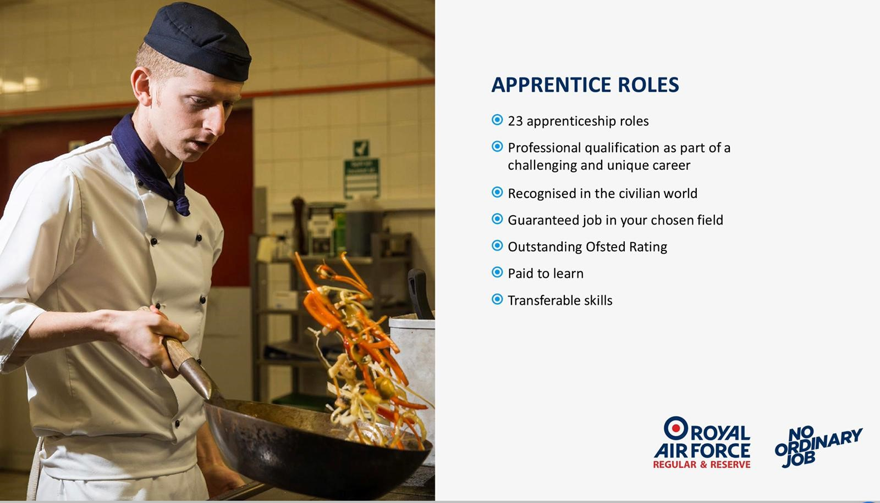

Slide 10
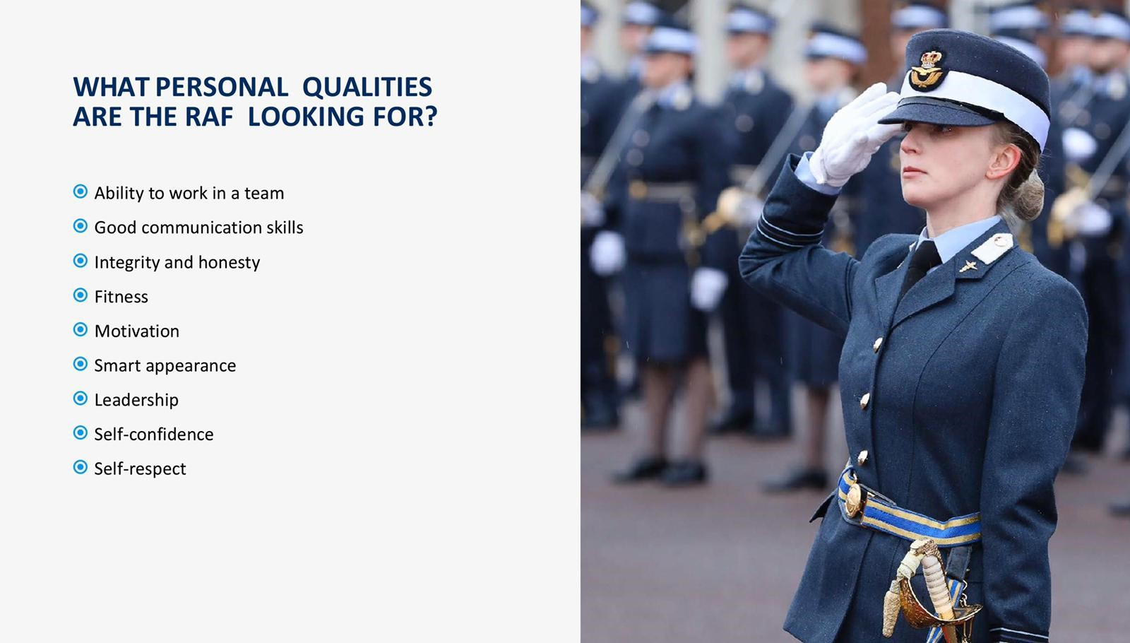

Slide 11
APPRENTICE APPLICATION PROCESS
APPLY ONLINE
HEALTH ASSESSMENT
PRESENTATION
FITNESS TEST
SELECTION TEST
HOW TO
PRFV
JOIN AS AN
APPRENTICE
INTERVIEW
OFFER OF SERVICE
SPECIALIST INTERVIEW (CERTAIN ROLES)
ENTER SERVICE

Slide 12

YOUNG PEOPLE’S PRECEPTIONS OF JOBS AND CAREERS

Slide 13
MOTIVATIONS FOR A CAREER
“Good pay, work-life balance, flexibility.” Wales
“There are jobs out there, yes, but they can be hard to get.” Wales
“I hate to say it, but pay because you need something that’s going to be able to provide your lifestyle.” England

Slide 14


Slide 15


Slide 16





LIFE AS A ROYAL NAVY APPRENTICE

Slide 17
Video URL
https://www.facebook.com/RoyalNavyRecruitment/videos/1185081138521638/?vh=e&extid=wzkAaTEopjzhQQkr&d=n

Slide 18

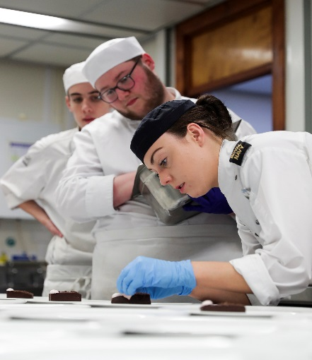
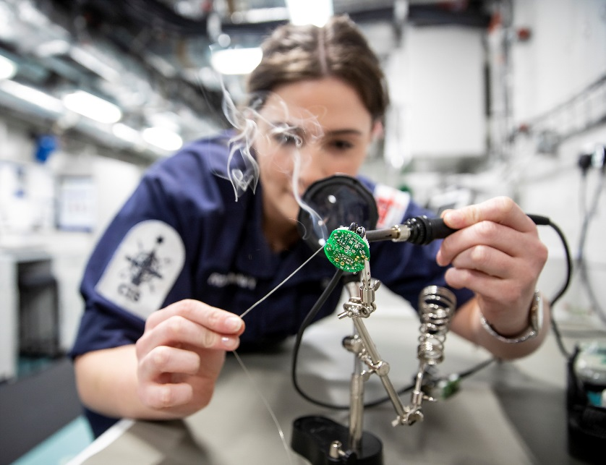
Royal Navy Apprenticeship Offer
23 different Apprenticeship schemes
6 different sectors
Fast track routes – Accelerated Apprenticeships and Under Graduate Apprenticeship Scheme

Slide 19
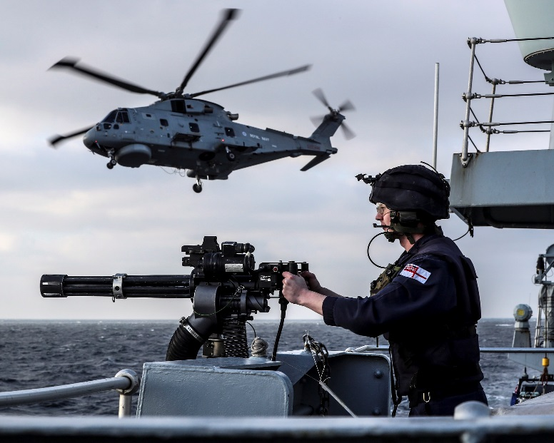
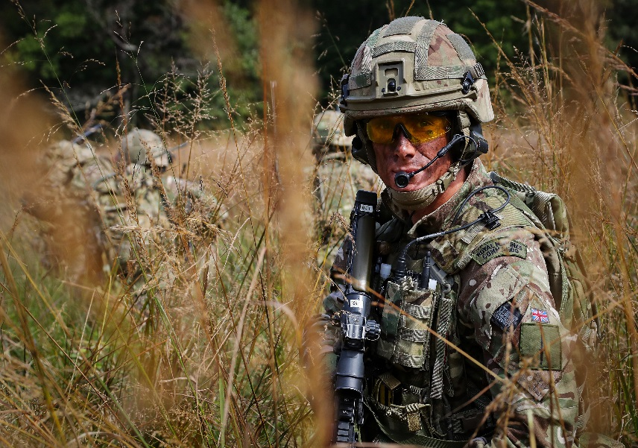
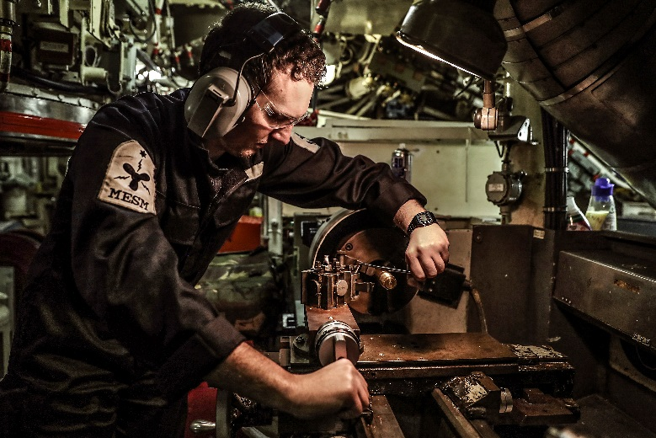
Unique on-job training
Ships
Submarines
RM Units
Air Squadrons

Slide 20

Success in the Royal Navy
100% of roles in the Royal Navy open to women
Embrace all cultures and backgrounds
Top Achievement rates
Learning Organisation supports all careers
Routes to Degrees
Royal Navy Apprenticeships – www.royalnavy.mod.uk/careers/apprenticeships

Slide 21
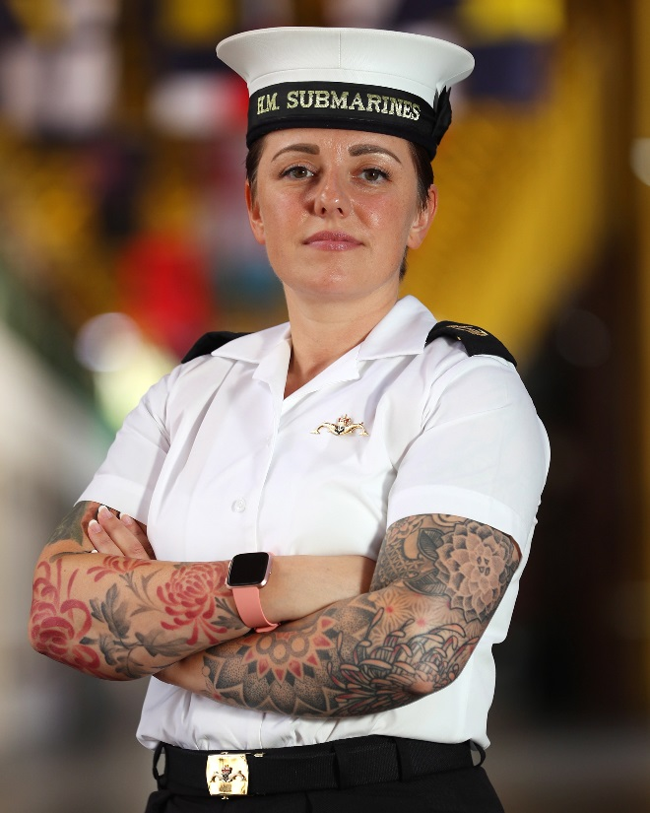
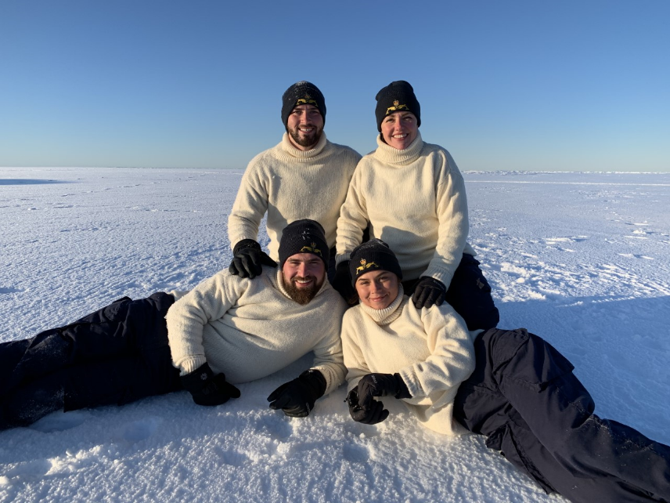
Emily’s story
“I wanted to be part of something that’s more than just a job.”
UGAS Scheme
Fast track scheme
Fully funded Degree Scheme
Unique Submarine Life
Earn while you Learn

Slide 22
MADE IN THE ROYAL NAVY

Slide 23
Video URL
https://vimeo.com/258617804

Slide 24




Slide 25
Video URL
https://vimeopro.com/grosvenorfilm/army-apprenticeships-social-media-safe-versions
Password
aRmYa

Slide 26
10,000

Slide 27

40

Slide 28











STARTING SALARY OF £20,400*
£15,985

Slide 29
0

Slide 30
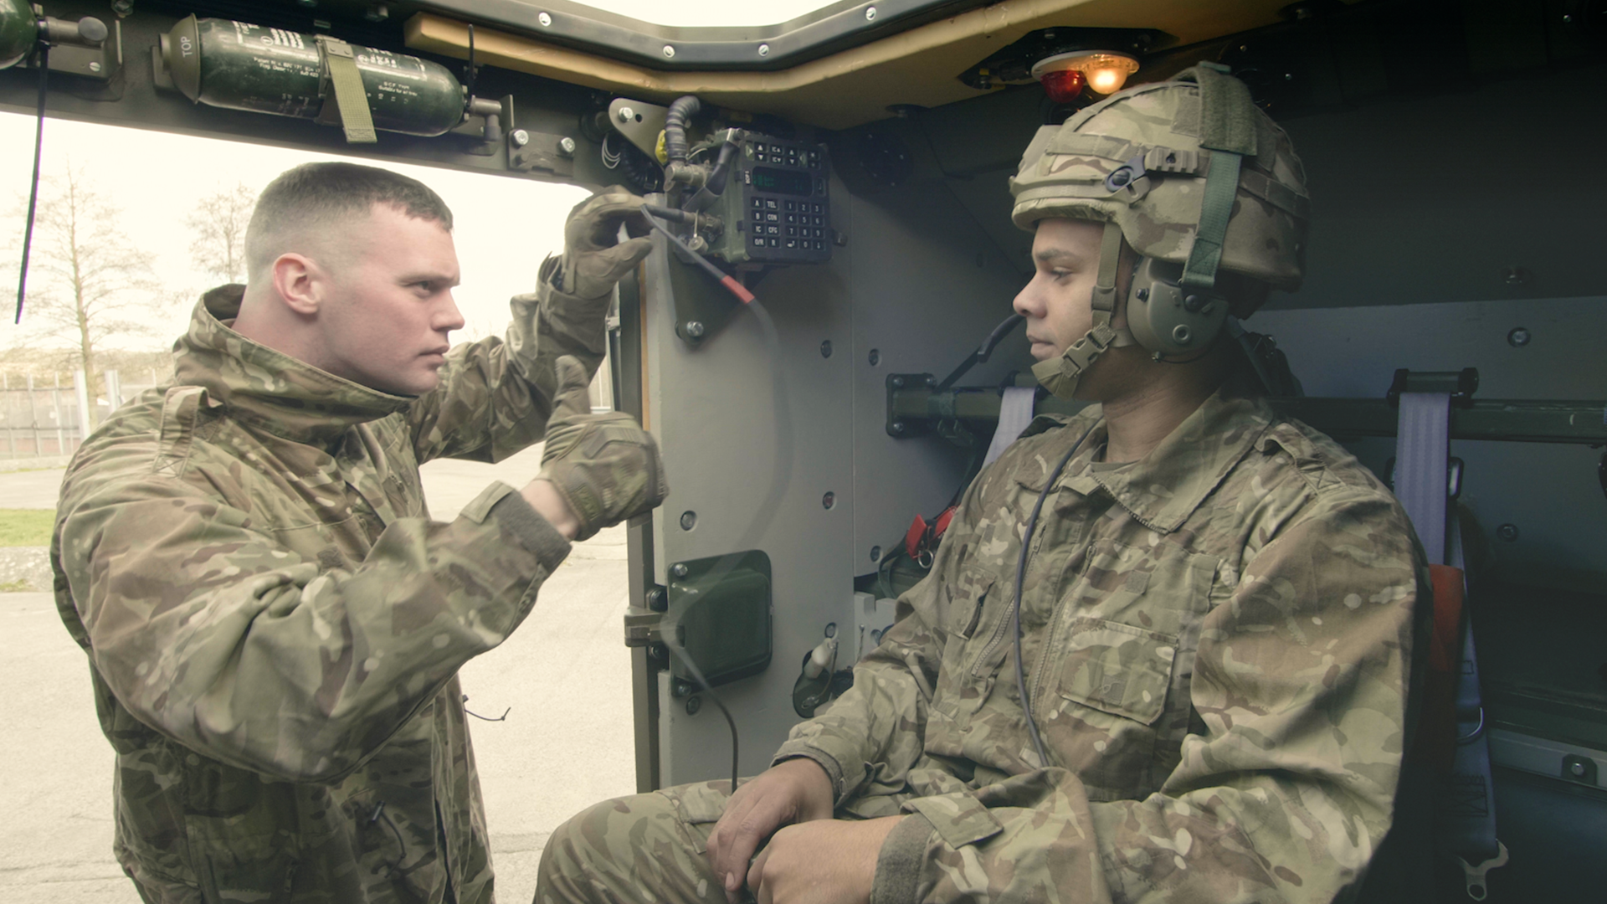






Slide 31


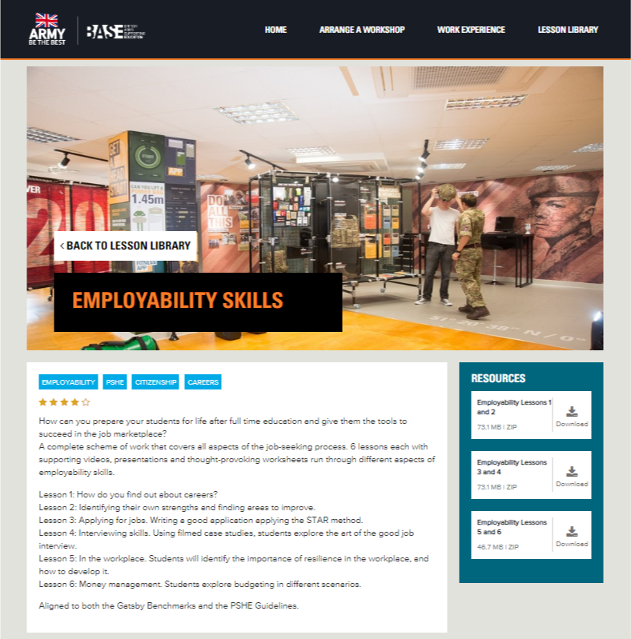
British Army Supporting Education

Slide 32
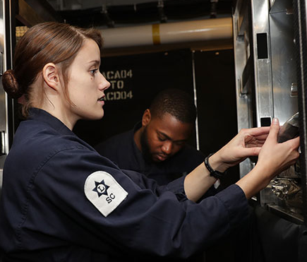
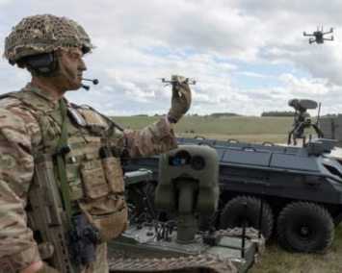



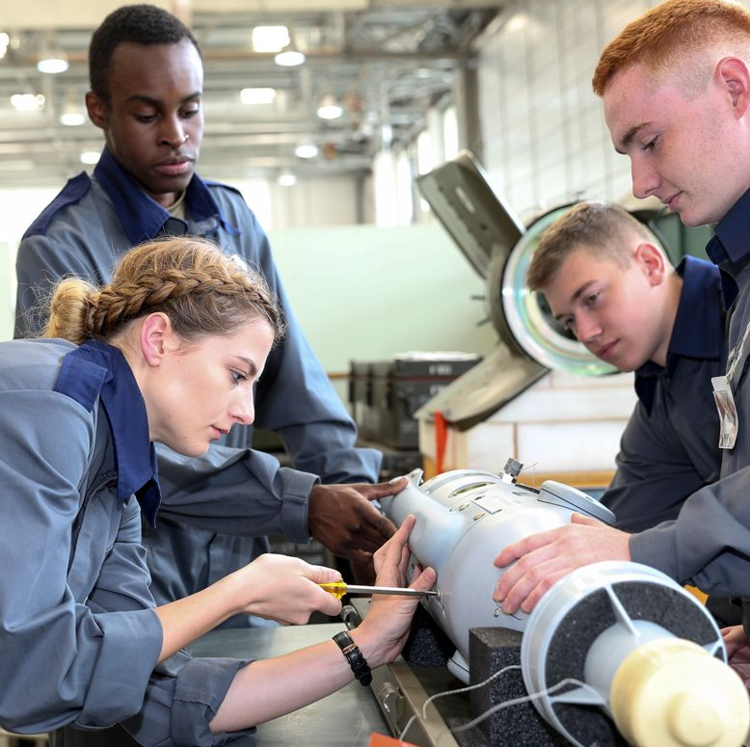
Armed Forces Apprenticeships : Armed Forces Careers
MOD Rory Pogson
RAF Amanda Scarth
Steve Perham
RN Sara Balls
Army Eleanor Brown

Slide 33
OPERATIONAL
Thank you
Please submit your questions in the chat facility

