Slide 1
T LEVELS
For students
Notes:
Notes to presenter
Slides 3 and 5 include link to films. Please ensure that this is downloaded and embedded before you present.
The film on slide 5 has sound so please ensure the venue has speakers.

Slide 2

PRESENTATION OVERVIEW
Introduction to T Levels
Key facts
Structure
Industry placement
Rollout
Find out more
Notes:
Today, we’re going to introduce you to a new qualification – T Levels.
By the end of the session, you should have a good understanding of
what a T Level is
some key facts about how they work
how the government is rolling T Levels out over the next few years, and
How you can find out more

Slide 3

Intro to t levels
Notes:
https://www.youtube.com/watch?v=doW5-SUpUN0
This film was created before the first T Levels started so while it talks about 3 areas there will also be health and science courses starting. A total of 10 T Levels covering 4 areas with more starting over the coming years in a range of areas.

Slide 4
KEY FACTS
ALTERNATIVE TO A LEVELS
80% STUDY/
20% WORK
DESIGNED BY AND FOR EMPLOYERS
1 T Level =
3 A Levels
LEVEL 2 MATHS AND ENGLISH
VARIETY OF PROGRESSION OPTIONS
PHASED ROLL OUT
GET WORK READY
45 DAY INDUSTRY PLACEMENT
Notes:
Let’s start with what a T Level is.
New qualification aimed at 16-19 years. A practical, employer-led alternative to A Levels
Two-year technical qualification that follows GCSEs, designed to get students work ready.
Spend 80% of time in the classroom or in specialist facilities, learning the theory and developing practical skills and the other 20% on an industry placement with an employer putting this into action.
Spend a minimum of 9 weeks (315 hours) on a meaningful industry placement (this can be split across two employers if needed and the time spent with these employers can be carried out as day release, in one solid block, multiple smaller blocks or a mixture of any of these models, depending on what works for the provider, student and employer)
Designed by employers to ensure students are learning the skills industries are looking for, improving employability. Around 250 employers have been involved in developing T Levels, ranging from small local businesses to large multinationals.
Nationally recognised certificate, with 1 T Level equivalent to 3 A Levels and attracting the same level of UCAS points
If not already achieved, then students would work towards level 2 maths and English.
44 colleges and other providers started offering the first 3 courses in September 2020 in Digital; Education & Childcare and Construction, . Another 7 T levels launch this September with more to follow in the coming years.
Phased rollout of all 24 T Levels by September 2023
Progression includes skilled employment, apprenticeships or further study, including at university in linked courses

Slide 5

Watch the CAMPAIGN FILM
Notes:
Here’s a video about T Levels, which also shows the courses available from this year.
Notes to presenter:
Please download and embed this film if you need to
https://www.youtube.com/watch?v=exbd7zsGnUw
The film is 40 seconds long and has sound

Slide 6
How does a t level work?
80% classroom learning
20% industry placement
Core curriculum
Learn concepts, theories and principles of general subject
Specialism
Opportunity to specialise within chosen course
English and maths
Assessed through an external examination and a substantial project
Develop knowledge and skills needed for a job in that area
At least half of the classroom time
If not achieved, work towards these qualifications
Also any digital skills relevant to the course
Industry placement
Spend at least 20% of the course on placement
With a real employer
Generally unpaid, but travel and subsistence costs may be available
Notes:
T Levels are structured differently to existing qualifications.
For your chosen subject, you will start off by studying a core curriculum. That means you will cover the theory, concepts and principles for the general subject or whole industry or sector
At some point after the start of the course, students will move onto a specialism. For some, like those taking the Early Years Educator specialism within Education & Childcare T Level, this will be early on in your first year, but for others you may not start your specialism until the second year. The number of occupational specialisms and the level of choice varies depending on the T Level.
80% of your time will be spent with a college or training provider. You will also do a 45 day industry placement, allowing you to put the skills and theory you’ve learned into practice. As I said earlier, this is counted in hours because you could be with different employers throughout the T Level.
This is unlikely to be paid as it's part of your course of study, but support for travel and expenses may be available.
If you haven’t achieved English and maths Level 2, then you will need to achieve this by the end of the course (GCSE grade 4 or above or Functional Skills level 2 pass).
Entry requirements vary for different T Levels - it is up to the T Level provider to set these depending on the course content

Slide 7

Industry placement
Minimum of 9 weeks (315 hours)
Benefits
Put skills and knowledge into practice
Try out a career
Grow your confidence
Learn transferable skills such as team-working and communication
Improve employability
Notes:
The industry placement is what makes T Levels stand out as a new, different and exciting offer
It gives students the chance to practice the skills they’ve learnt in the classroom, building employability skills such as teamwork and communication, and developing the confidence they need in a workplace environment

Slide 8
What do students think?
Levi (Digital Production, Design and Development T Level student) says….
“Since starting the Digital T-Level, I feel supported by the computing staff. They are friendly, helpful and always approachable for anything I need to know. I feel I can ask questions and I am learning new skills and knowledge that I can use in the workplace and put into context for my future career. The building I study in feels brand new and I am using PCs that are better than my computer at home. There is all the software I need available to me and even some that I have not yet used.”
Kacey (Education & Childcare T Level student) says….
“I enjoy learning about the different types of education, such as the EYF and the different types of careers that studying Childcare can lead to. I also enjoy the research tasks that we are set as they allow me to learn more about the course and let me be creative. I would like to become a primary school teacher and the placement is really helping my development. Once I complete my course, I plan on going onto studying childcare further at University.”
Notes:
T Level style industry placements have been happening over the past couple of years (as part of current vocational courses) so there’s already some feedback on how they work – and many T Level students who started their Education & Childcare course in September 2020 have been on their placement.
Notes to presenter
There are some videos on Youtube of students’ experiences on these placements

Slide 9
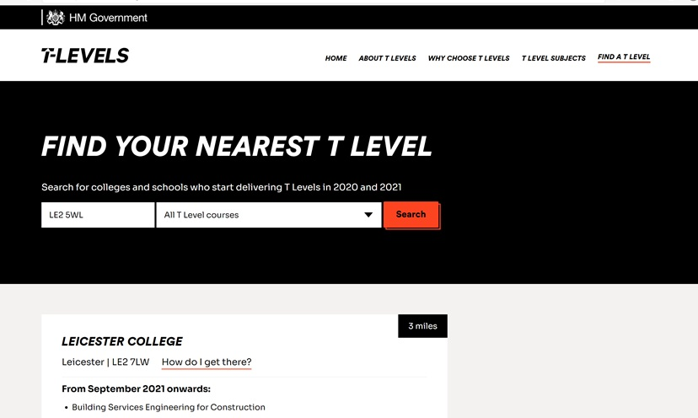
WHERE CAN I STUDY?
Tlevels.gov.uk/students/find
Notes:
You can find out what T Levels are available near you using the handy ‘Find a T Level’ tool on Tlevels.gov.uk.
Simply put in your postcode and press search. It shows those that started last year and will be running again this September as well as the new ones starting this September.

Slide 10
COURSES AVAILABLE
Started in 2020
Starting in 2021
Building Services Engineering for Construction
Health
Digital Business Services
Digital Support Services
Healthcare Science
Onsite Construction
Science
Starting in 2022
Management and Administration
Engineering Manufacturing Design and Development
Accounting
Digital Production, Design & Development
Education & Childcare
Design, Surveying & Planning for Construction
Maintenance, Installation
and Repair for Engineering and Manufacturing
Engineering, Manufacturing, Processing and Control
Finance
And more coming in 2023

Slide 11



What next?
Visit Tlevels.gov.uk
Follow T Levels on Instagram or Twitter
tlevels_govuk
Look at the resources available
https://amazingapprenticeships.com/tlevels/ (includes a film from T Level students giving their experiences of the course, as well as a longer film where you can see teachers, employers and students describing T Levels in more detail)
Look at the resources available
https://amazingapprenticeships.com/tlevels/

