Slide 1

National Apprenticeship Week 2024
Staff Briefing Toolkit
An adaptable resource for anyone hosting a staff briefing about
National Apprenticeship Week in their school or college

Slide 2


A message to the presenter:
This resource is designed for schools and colleges who are running a staff briefing about National Apprenticeship Week 2024 and should take approximately 10-15 minutes to deliver.
It can be quickly adapted for your setting with the aim of generating enthusiasm and willingness among staff to:
Promote National Apprenticeship Week in their classrooms.
Understand the free resources available to support them.
Appreciate their role in engaging parents and carers, as well as learners.
Engage in conversations with parents and carers about apprenticeships.
Please see the next 3 slides for guidance notes to help you to prepare.
We hope you find this resource useful and easy to use. If you have any questions about this resource, please contact Hello@AmazingApprenticeships.com

Slide 3
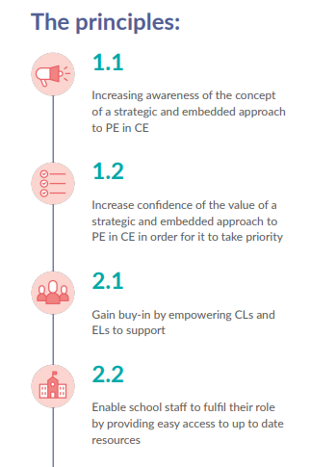
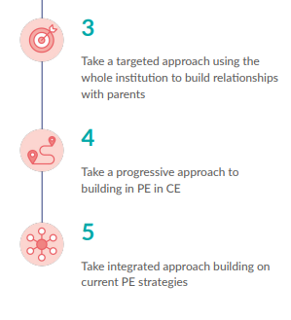
Additional note to presenter
Additional note to the presenter:
Parents and carers need to have up to date and accurate information to support their child’s decision making.
These principles underpin The Careers & Enterprise Company’s approach to supporting Careers Leaders to embed a successful parental engagement strategy.
Principle 2.2 highlights the need to include all staff to enable effective parental involvement.
This staff briefing enables you to help all staff, both teaching and non-teaching, understand the importance of their role.

Slide 4


Before you use this resource…
Book a 10-15 minute slot at a staff briefing, ideally 2 weeks before NAW.
All sections that need personalising for your school are highlighted in yellow.
Collate what your school or college is doing to celebrate NAW and complete slides 11 and 12.
Delete ‘school’ / ‘college’ as applicable
Consider printing the accompanying School & College Guide to NAW to share with colleagues in the session.
Please personalise the messaging within this presentation to your school/college. You know them best!
Please delete/hide slides 1 - 4, once you’ve done the above.
Notes:
Use Talking Futures: parental engagement in NAW to consider how to involve parents more explicitly in NAW.

Slide 5
National Apprenticeship Week 2024
Staff Briefing
[Please insert your school logo here]

Slide 6

What we’re going to cover
What is National Apprenticeship Week?
Our school / college plans for the week
How you can get involved and resources to help you
  Classroom resources
  Homework resources
How to engage parents and carers in careers conversations
Where you can find further information and support

Slide 7

What is National Apprenticeship Week?

Slide 8

What is National Apprenticeship Week?
National Apprenticeship Week is the biggest week in the Apprenticeships calendar! It is an annual week-long celebration of apprenticeships, and anyone involved with them.
It runs from Monday 5th – Sunday 11th February 2024.
It includes a wide range of activities and events.
It is a time to engage a variety of audiences – staff, students, parents/carers, leadership/management.
It is a chance for us to position apprenticeships as a positive and exciting option, showcasing the wide range of employers, apprentices and their success stories.

Slide 9

Why do we need to tell our students and their families about NAW?
It the right thing to do to ensure that our students and their parents/carers understand all options available post-16 and post-18.
It is also a legal requirement that all students should receive access to high-quality, impartial information about all of their options, and this includes apprenticeships.
It is crucial that we challenge some potential misconceptions that students or their parents/carers may have about apprenticeships.
The NAW events and activities could inspire some of our students and end up changing their lives!

Slide 10
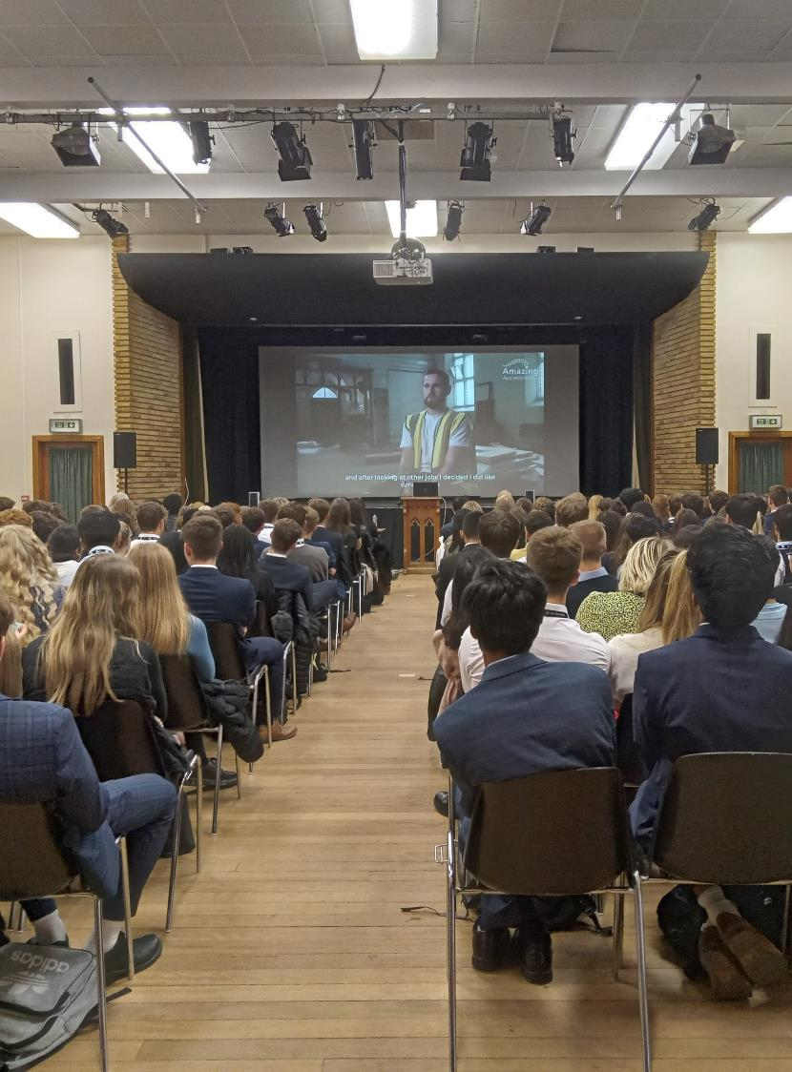
Our
plans
for the week

Slide 11

What are our plans?
Our activities for NAW will include: [please amend as applicable and use this editable plan to help you]
Assemblies
Form time activities (apprentice stories, quizzes)
Visits (could you take interested students out to visit any local apprentices)
Speakers (local providers, local employers, local MP)
Displays – in corridors or on display screens
Newsletters
Websites
Alumni (find out which of your former students have done / are doing apprenticeships and showcase them in assemblies / form time activities. Could they come into school and talk to students?)
Parents (do any of your students’ parents employ apprentices? Could they come in and talk about apprenticeships or make a video to show?)

Slide 12
Our planned activities during week
[please amend as applicable or adapt this editable planner]
Day | Activty
Monday 5th Feb
Tuesday 6th Feb
Wednesday 7th Feb
Thursday 8th Feb
Friday 9th Feb

Slide 13

How you can get involved & resources to help you

Slide 14


Resources to help you
There are many resources provided free of charge to help
you. These include:
Subject resources (30 minutes x 15 lessons) and posters
Classroom display ideas
NAW Student Activity Pack
The Apprenticeship Arcade (10 fun games)
Please visit www.amazingapprenticeships.com/naw
to access them.
For more ideas and resource, explore My Learning My Future
from The Careers & Enterprise Company

Slide 15

How you could get involved:
Classroom ideas
[Please add in your own ideas or use these suggestions below]
Within your lessons, use the resources and games to help students to explore potential apprenticeship routes from their subject.
Share the stories of any students that you know who have gone onto an apprenticeship.
Discuss the different skills and attributes students think employers might be looking for and how these are being developed through your subject area.
Include information about any local employers that you know of that recruit apprentices in roles that link with your subject.

Slide 16

How you could get involved:
Homework ideas
[Please add in your own ideas or use these suggestions below]
Use the home learning idea from the 15 x subject resources
Set a homework task enabling awareness raising with families, for example, ask each family member to choose and share back the apprenticeship that appeals to them the most in each subject area. Use My Learning My Future from the CEC.
Set discussion/research-based homework into apprenticeships by signposting student to the Career Starter Apprenticeship information and case studies including job roles they may not have considered, such as International Freight Forwarding.

Slide 17

How to engage parents & carers in careers conversations during NAW

Slide 18

A 2023 survey of 8,838 parents and carers revealed that
only 1 in 10 parents would feel confident in supporting their child to research and apply for an apprenticeship.

Slide 19

We would like all staff to:
[Please consider your asks of staff and adapt the ideas below to suit your context]
Mention it’s NAW during any conversations with parents and direct parents to [add in here what is relevant for you - an event, newsletter,].
Mention it’s NAW during any conversations with students and if they want to know more, direct them to [add in here what is relevant for you - an event, newsletter,].
Make a positive phone call home this week, if possible, to a student who has expressed an interest in apprenticeships, and encourage a conversation at home.
Set some of the suggested homework tasks to help develop understanding of apprenticeships and engage parents/carers. [add in how engagement could be fed back to you]
Find a way your department/faculty can post about NAW on social media for parents, e.g. a fact about apprenticeships / local industry linked to your subject.

Slide 20

Where you can find further information

Slide 21

Useful websites
amazingapprenticeships.com/naw
resources.careersandenterprise.co.uk
nationalcareers.service.gov.uk/
apprenticeships.gov.uk/
tlevels.gov.uk/
[Please insert locally relevant sites/ paid for services offered by the school/college]
[Please insert the link to the staff intranet where you have saved The Careers & Enterprise Company supporting resource]

Slide 22


Using Talking Futures
Talking Futures has a range of resources to help
parents to further research and develop careers
conversations.
Signpost parents towards this site to support them in having informed careers conversations with their children or for further information about all pathways.
https://www.talkingfutures.org.uk/
For further information to support you to feel confident having careers conversations with parents, please refer to [Insert the link to the staff intranet where you have saved The Careers & Enterprise Company supporting resource]

Slide 23

You can contact
Consider inserting here:
Details of the Careers Leader
Details of the Careers Adviser
Details of any support services you offer more widely

Slide 24
Thank you

