Slide 1


Slide 2

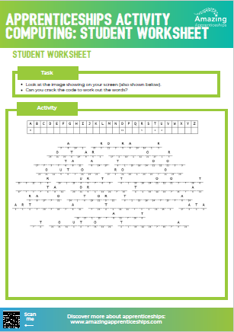
Cracking the apprenticeship code
Your teacher will show you a puzzle – can you crack the code?
Use the student worksheet to record your answers.
The correct answers will be displayed after you have attempted to
crack the code.

Slide 3
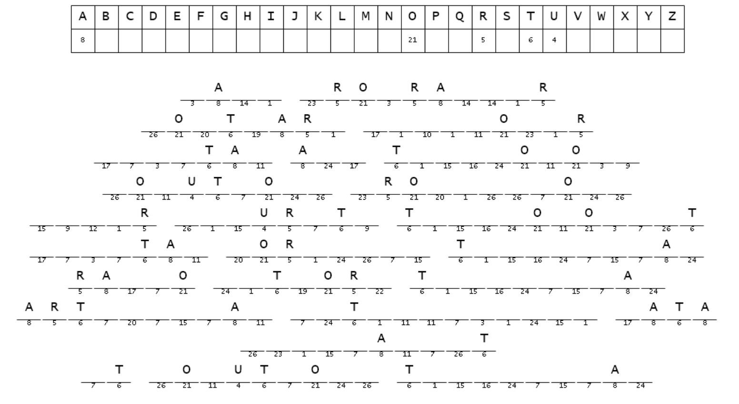

Slide 4


Slide 5
Home Learning
Using the activity sheet from the lesson, select one of the job roles that you are interested in researching further.
You may find it useful to visit this site where you can type the role into the Key Word search https://www.instituteforapprenticeships.org/apprenticeship-standards/
Prepare a list of key facts about the apprenticeship selected.

