Slide 1


Slide 2

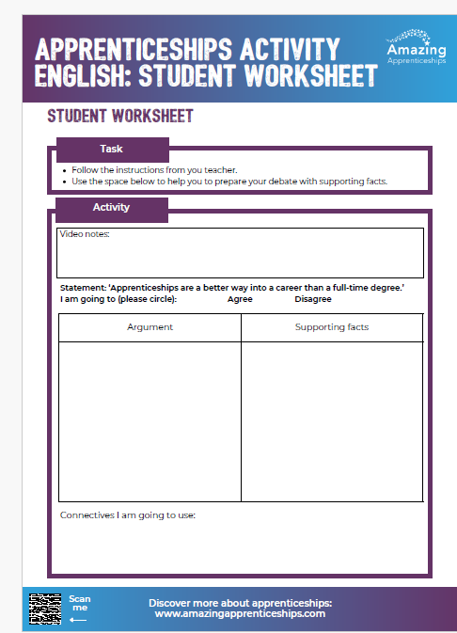
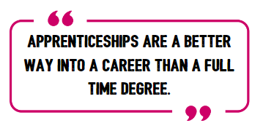
The great apprenticeship debate
In this lesson we will be holding a debate. Your task will be to argue either for or against the following statement
Use the student worksheet to record some of your ideas for the debate.
We will now watch a short film to provide you with more information.

Slide 3
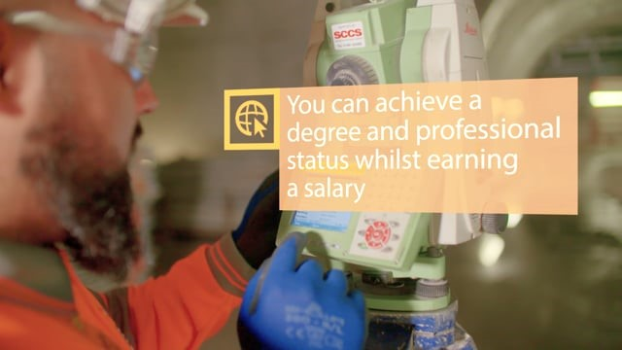
Notes:
To access this film, please visit https://vimeo.com/173753735

Slide 4
FOR or AGAINST ideas
For apprenticeships | Against apprenticeships
Apprentices don’t pay any fees for an apprenticeship so finish without debt. | Apprentices don’t have as much dedicated time to devote to their subject because they are also working full time.
Apprentices are paid a salary and are also entitled to paid holiday time. | Apprentices don’t have the university social life.
Apprentices learn on the job, in the workplace, working alongside experienced colleagues. | University students don’t necessarily have to choose a career to specialise in whilst studying.
Apprentices start gaining workplace experience and building professional connections straight away. | Apprentices have fewer holidays than full time students.

Slide 5
Debate rules:
Make sure you use a range of connectives when you are speaking. Don’t start speaking without a connective ready.
Be courteous to others. Do not talk over each other.
If a speaker makes a statement, they must be able to provide evidence or reasons to support the statement.
Facts presented in a debate must be accurate.
Respect the time limits for each speaker.
Allow space for questions from the audience.

Slide 6


Slide 7
Home learning
Using the ideas from the debate lesson, be ready to give a short speech (1-2 minutes) on the benefits of apprenticeships.
You may find it useful to refer to the latest Higher & Degree Apprenticeship listing which can be found here https://amazingapprenticeships.com/higher-degree-listing/

