Slide 1
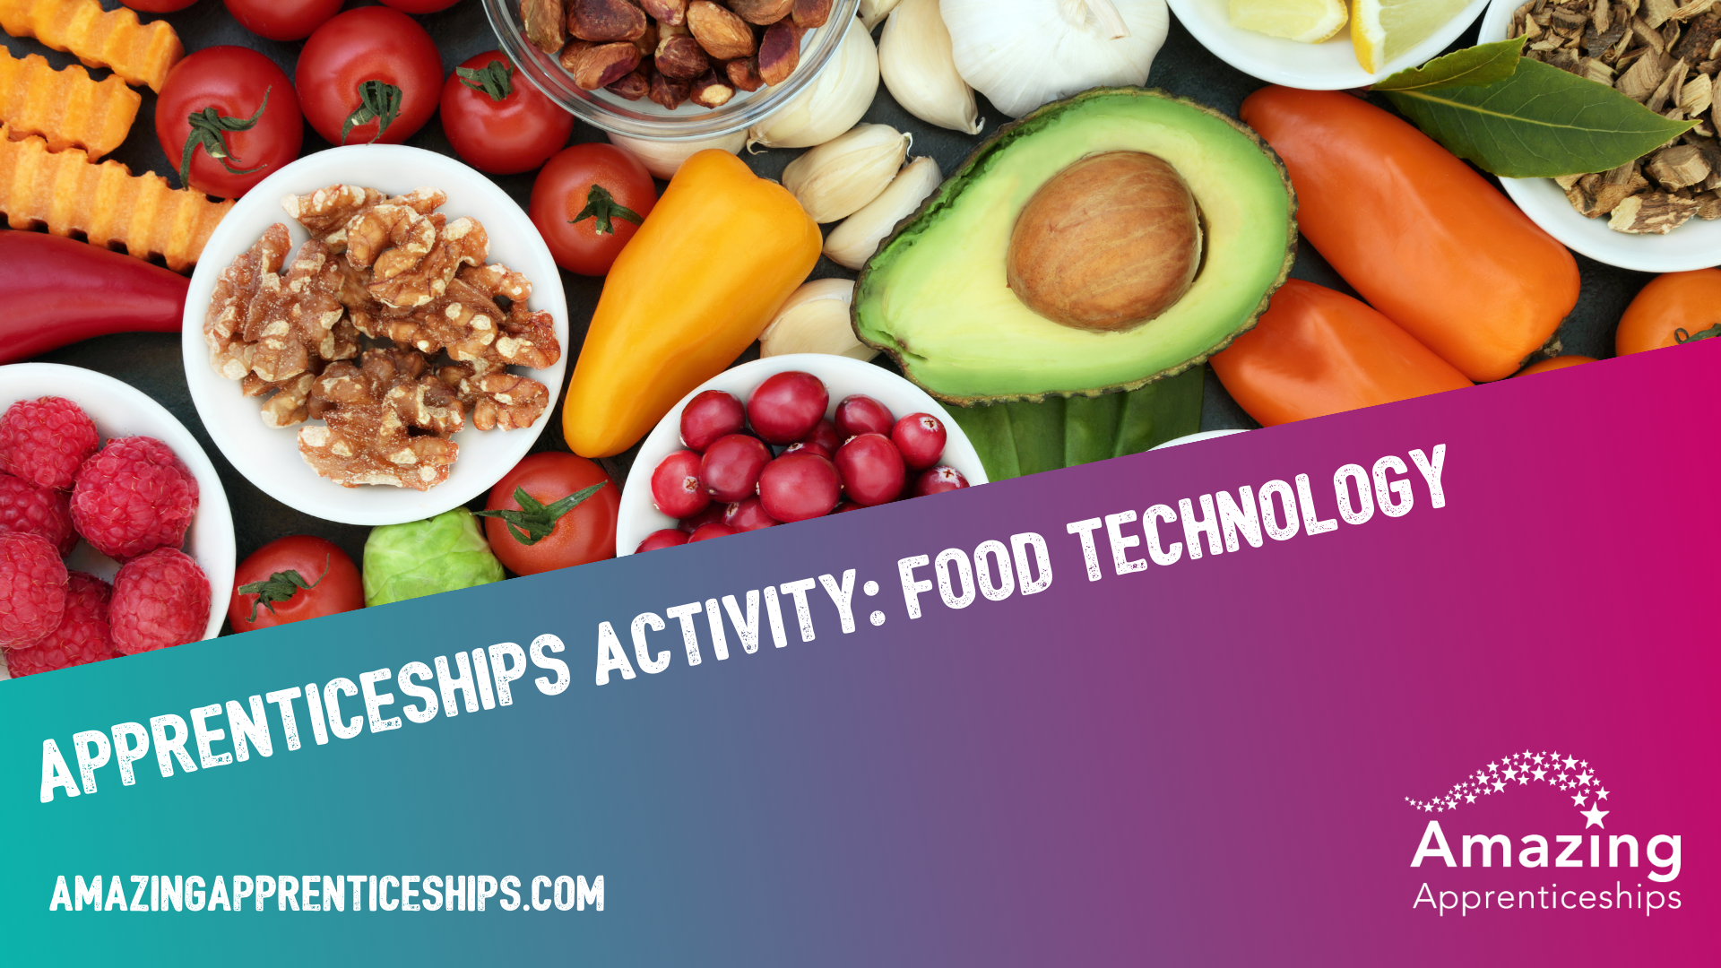

Slide 2
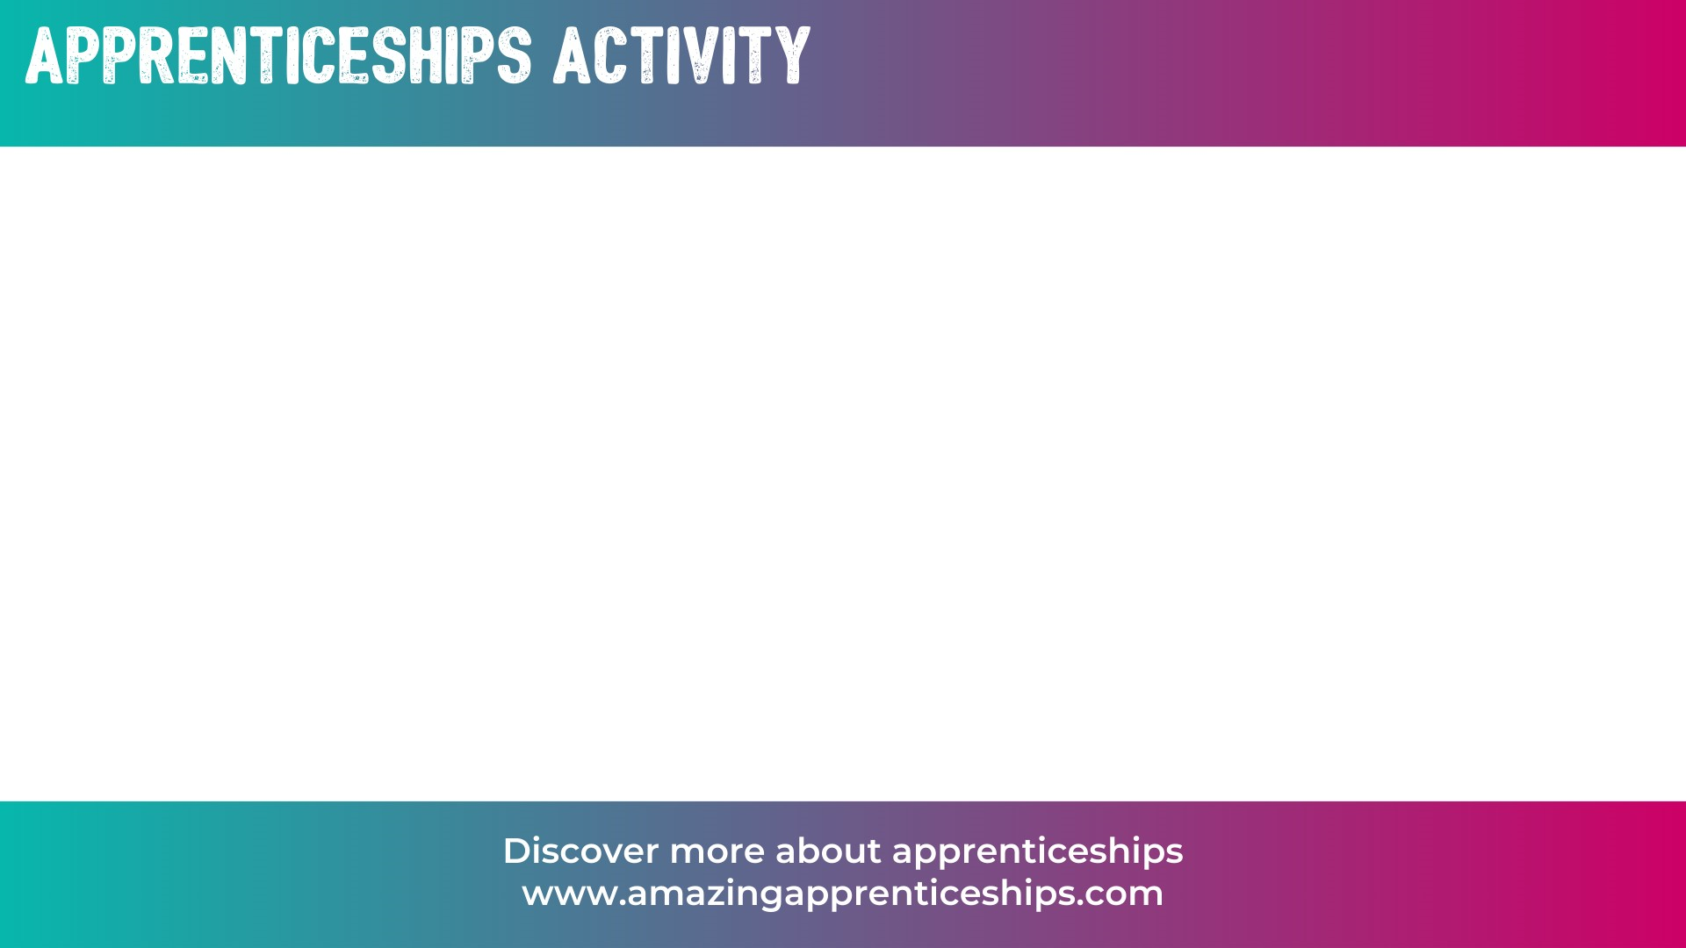
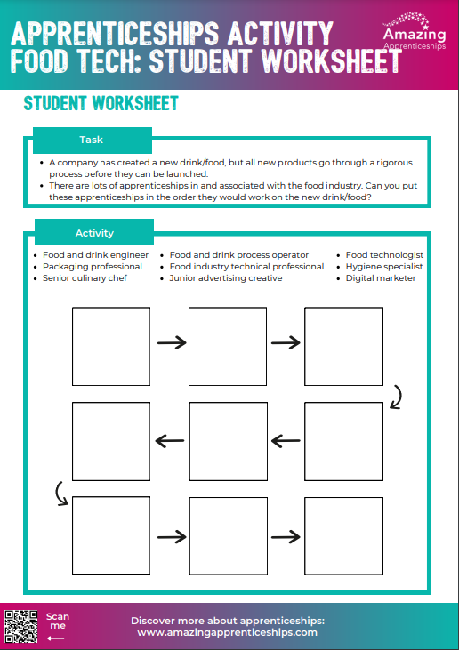
Apprenticeships in the food and drink industry
A company has created a new drink/food, but all new products go through a rigorous process before they can be launched.
There are lots of apprenticeships in and associated with the food industry.
Using the activity sheet, can you put these apprenticeship job roles in the order that you think they would follow for a new product being developed?
For example, it might start with the Chef developing a new flavour…

Slide 3
Food and drink engineer
Packaging professional
Senior culinary chef
Food and drink process operator
Food industry technical professional
Junior advertising creative
Food technologist
Hygiene specialist
Digital marketer

Slide 4

SENIOR CULINARY CHEF
FOOD TECH-NOLOGIST
FOOD AND DRINK ENGINEER
HYGIENE SPECIALIST
FOOD AND DRINK PROCESS OPERATOR
FOOD INDUSTRY TECHNICAL PROFESSIONAL
PACKAGING PROFESS-IONAL
JUNIOR ADVERT-ISING CREATIVE
DIGITAL MARKETER
Everyone may have slightly different answers, as there isn’t necessarily one right answer.

Slide 5
Home Learning
Think of a company that produces food or drink e.g. Nestle, Premier Food, Coca-Cola.
Research if they offer apprenticeships.
Produce a report on the company’s apprenticeship offer.
When do they recruit?
Which programmes do they run?
How many apprentices do they recruit?
What are the main benefits of their programmes?

