Slide 2
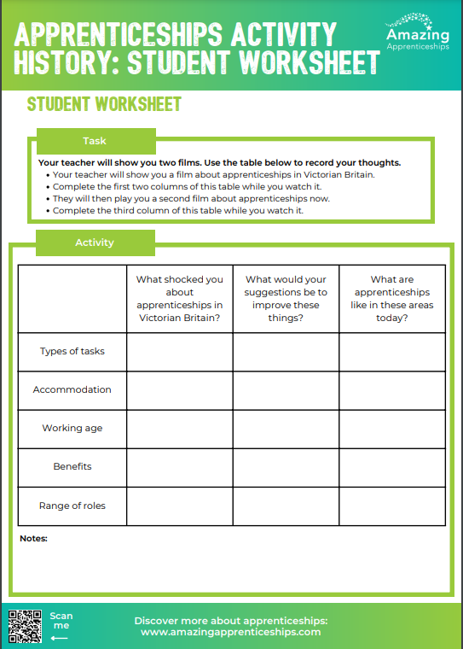
How apprenticeships have changed through the years
Watch the film about apprenticeships in Victorian Britain. Complete the first two columns of the table on the worksheet while you watch it.
Then watch the second film about apprenticeships now. Complete the third column of the table while you watch it.
Notes:
If you are not using the Student Worksheet, you could ask the students to consider:
What shocked you about apprenticeships in Victorian Britain?
What are apprenticeships like today, and what are the main differences?

Slide 3
Notes:
If you need to access the film, visit https://cdn.jwplayer.com/previews/cvIt8fBq

Slide 4
Notes:
If you need to access this film, visit https://vimeo.com/613415806

Slide 5
Home learning
Research the history of apprenticeships and create a timeline of key events.
You could include:
Key facts and figures about apprenticeships at different times, including quotes
Pros and cons for apprentices at different times

