Slide 1
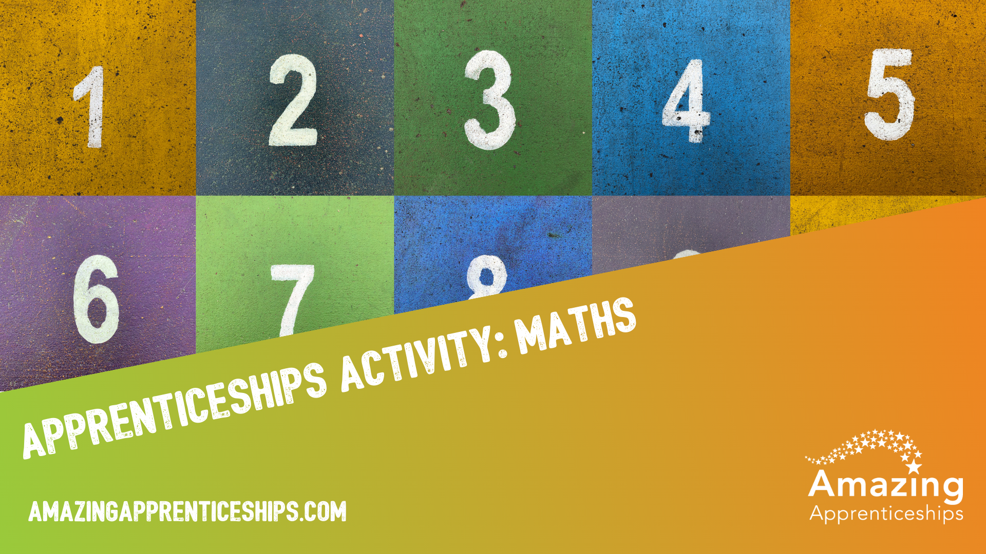

Slide 2
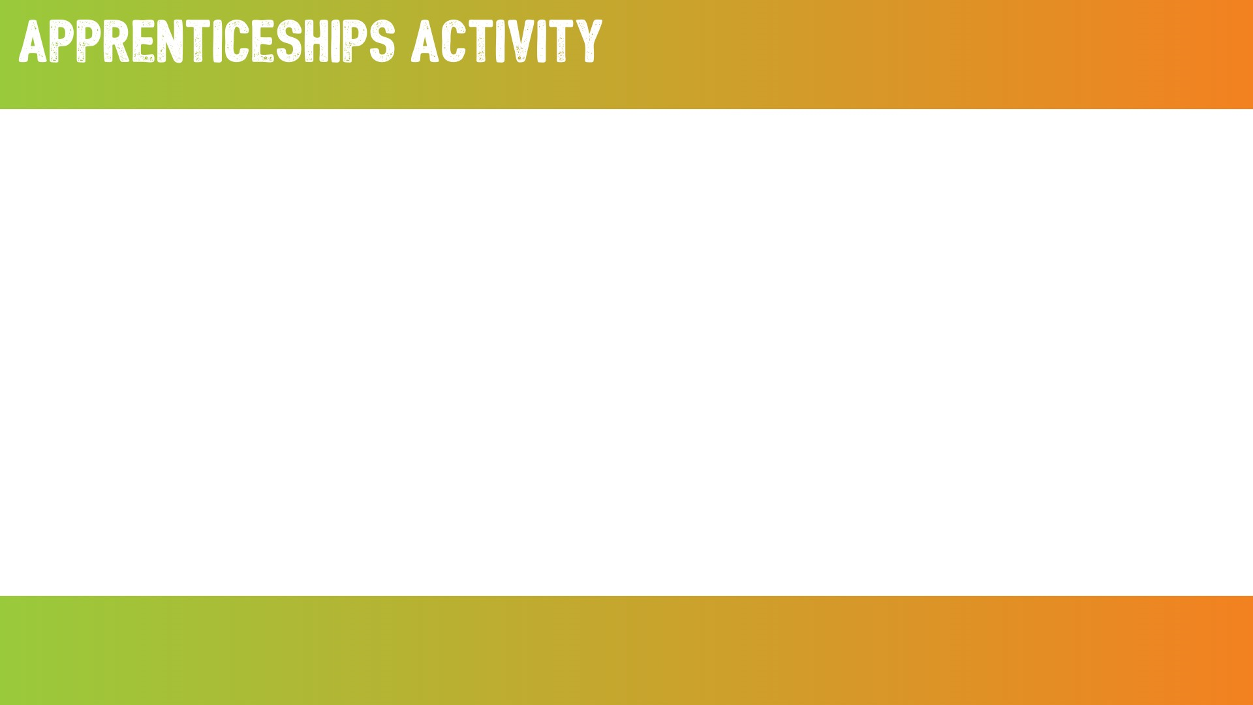
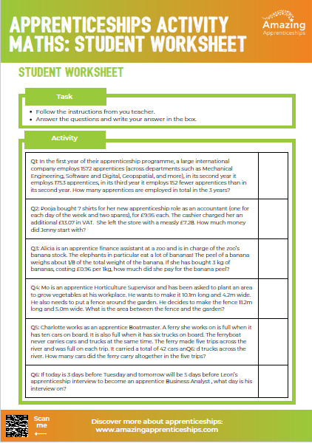
Calculating the benefit of apprenticeships
In this activity, you will work through a number of apprenticeship related maths questions.
Use the student worksheet to record your answers.

Slide 3
The questions
Question | Answer
Q1. In the first year of their apprenticeship programme, a large international company employs 1572 apprentices (across departments such as Mechanical Engineering, Software and Digital, Geospatial, and more), in its second year it employs 1753 apprentices, in its third year it employs 152 fewer apprentices than in its second year. How many apprentices are employed in total in the 3 years?
Q2. Pooja bought 7 shirts for her new apprenticeship role as an accountant (one for each day of the week and two spares), for £9.95 each. The cashier charged her an additional £13.07 in VAT. She left the store with a measly £7.28. How much money did Pooja start with?
Q3: Alicia is an apprentice finance assistant at a zoo and is in charge of the zoo’s banana stock. The elephants in particular eat a lot of bananas! The peel of a banana weighs about 1/8 of the total weight of the banana. If she has bought 3 kg of bananas, costing £0.96 per 1kg, how much did she pay for the banana peel?

Slide 4
The questions
Question | Answer
Q4: Mo is an apprentice Horticulture Supervisor and has been asked to plant an area to grow vegetables at his workplace. He wants to make it 10.1m long and 4.2m wide. He also needs to put a fence around the garden. He decides to make the fence 11.2m long and 5.0m wide. What is the area between the fence and the garden?
Q5: Charlotte works as an apprentice Boatmaster. A ferry she works on is full when it has ten cars on board. It is also full when it has six trucks on board. The ferryboat never carries cars and trucks at the same time. The ferry made five trips across the river and was full on each trip. It carried a total of 42 cars and trucks across the river. How many cars did the ferry carry altogether in the five trips?
Q6: If today is 3 days before Tuesday and tomorrow will be 5 days before Leon’s apprenticeship interview to become an apprentice Business Analyst , what day is his interview on?

Slide 5
The answers
Question | Answer
Q1. In the first year of their apprenticeship programme, a large international company employs 1572 apprentices (across departments such as Mechanical Engineering, Software and Digital, Geospatial, and more), in its second year it employs 1753 apprentices, in its third year it employs 152 fewer apprentices than in its second year. How many apprentices are employed in total in the 3 years? | 4,926
Q2. Pooja bought 7 shirts for her new apprenticeship role as an accountant (one for each day of the week and two spares), for £9.95 each. The cashier charged her an additional £13.07 in VAT. She left the store with a measly £7.28. How much money did Pooja start with? | £90
Q3: Alicia is an apprentice finance assistant at a zoo and is in charge of the zoo’s banana stock. The elephants in particular eat a lot of bananas! The peel of a banana weighs about 1/8 of the total weight of the banana. If she has bought 3 kg of bananas, costing £0.96 per 1kg, how much did she pay for the banana peel? | 36p

Slide 6
The answers
Question | Answer
Q4: Mo is an apprentice Horticulture Supervisor and has been asked to plant an area to grow vegetables at his workplace. He wants to make it 10.1m long and 4.2m wide. He also needs to put a fence around the garden. He decides to make the fence 11.2m long and 5.0m wide. What is the area between the fence and the garden? | 13.5m m2
Q5: Charlotte works as an apprentice Boatmaster. A ferry she works on is full when it has ten cars on board. It is also full when it has six trucks on board. The ferryboat never carries cars and trucks at the same time. The ferry made five trips across the river and was full on each trip. It carried a total of 42 cars and trucks across the river. How many cars did the ferry carry altogether in the five trips? | 3 trips with 10 cars, 2 trips with 6 trucks
Q6: If today is 3 days before Tuesday and tomorrow will be 5 days before Leon’s apprenticeship interview to become an apprentice Business Analyst , what day is his interview on? | Friday

Slide 7
Which apprenticeships or job roles were mentioned in this activity?
Mechanical Engineering
Software and Digital
Geospatial
Accountant
Cashier (Customer Service Assistant)
Finance assistant
Horticulture Supervisor
Boatmaster
Business Analyst
Can you think of any others?

Slide 8
Home Learning
Research apprenticeship job roles that have a strong link to maths.
You may need to refer back to the PowerPoint slide or activity sheet.
Try to write 2-3 maths puzzles related to them.
You could be really creative with this!

