Slide 1


Slide 2

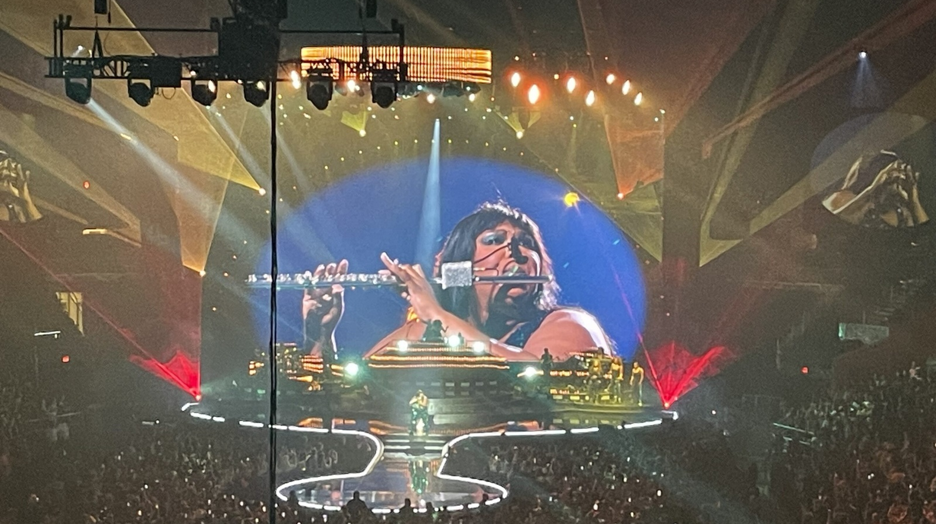
Apprenticeships – putting on a concert
Look at this image of a concert.
Discuss with your class all of the different roles that it might take to put on a concert like this.

Slide 3
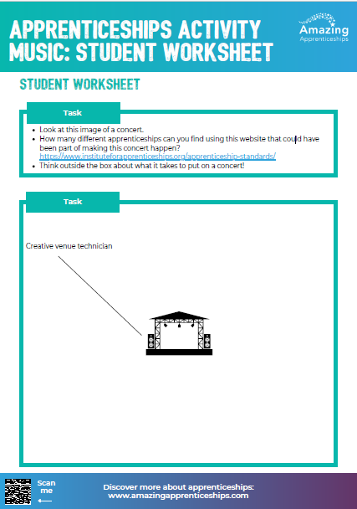
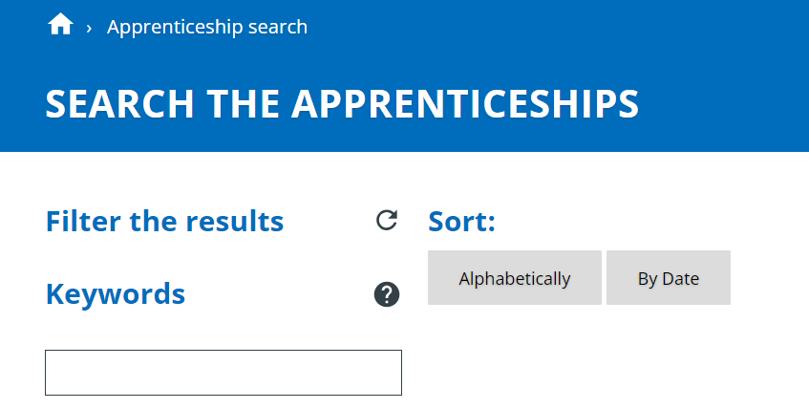
Think about the concert and the job roles you discussed.
How many different apprenticeships can you find using https://www.instituteforapprenticeships.org/apprenticeship-standards/
Keyword search that could have been part of making this concert happen?
Think outside the box about what it takes to
put on a concert!
Use your worksheet to list all of the apprenticeships
that you find.

Slide 4
Home Learning
Research one of the apprenticeships you found today using the website https://www.instituteforapprenticeships.org/apprenticeship-standards/
Create a 1-2 minute video describing the apprenticeship.
We want to use these to raise awareness of apprenticeships in other music lessons / at open evenings / on our website.

