Slide 1


Slide 2

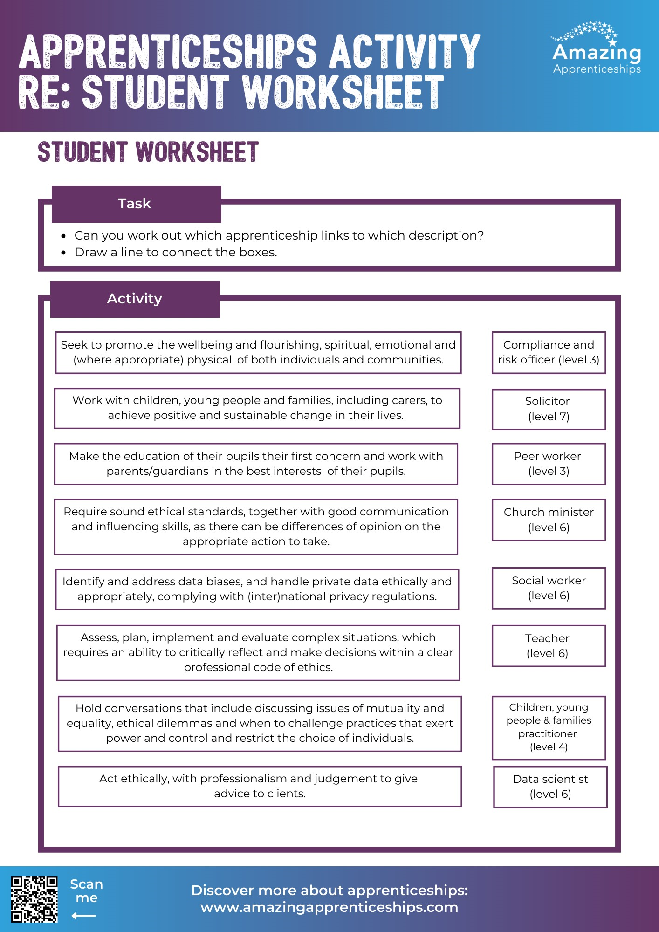
Making the link: Apprenticeships & Religious Education
There are different apprenticeship job roles that have a connection to Religious Education. For example, you could be in a role that requires you to make ethical decisions or could be working within the community.
Use the worksheet to think about some of the different apprenticeship roles. Can you make the connection?

Slide 3
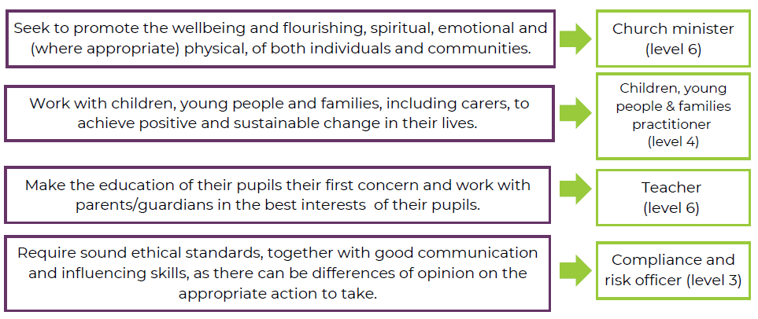
ANSWERS

Slide 4
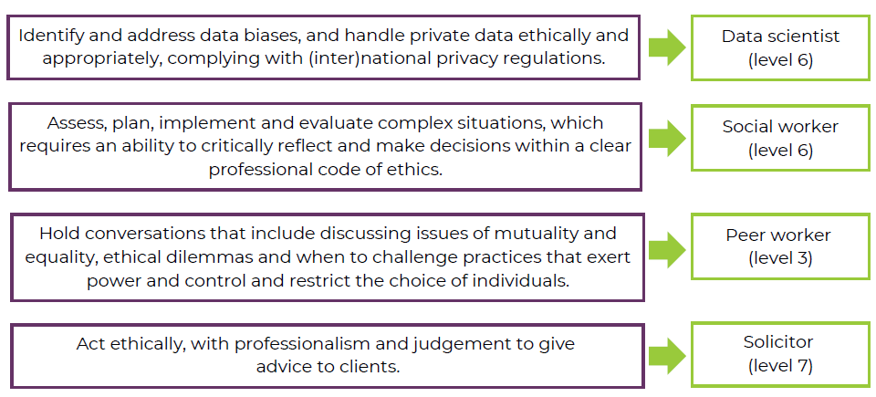
ANSWERS

Slide 5
Home Learning
Using the activity sheet from the lesson, select one of the job roles that you are interested in researching further.
Try to come up with 3 scenarios that someone in that job role may face where they have to make a difficult decision.
List out the reasons why it would be difficult and some of the factors that you may need take into consideration.

