Slide 1


Slide 2

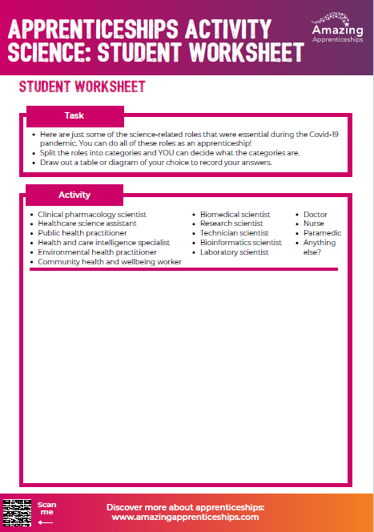
Apprentices on the front line
During the Covid-19 pandemic, there were many apprenticeships related to science that were essential.
Today we are going to explore some of those different roles and think about how they could be categorised.

Slide 3

These are just some of the science-based jobs that we needed during the Covid-19 pandemic.
Doctor
Biomedical scientist
Research scientist
Clinical pharmacology scientist
Healthcare science assistant
Public health practitioner
Technician scientist
Environmental health practitioner
Nurse
Paramedic
Health and care intelligence specialist
Bioinformatics scientist
Community health and wellbeing worker
Laboratory scientist

Slide 4
Home Learning
The NHS recently introduced the new Doctor degree apprenticeship.
Read the apprenticeship standard here https://www.instituteforapprenticeships.org/apprenticeship-standards/doctor-degree-v1-0 and the recent article on the Government site here https://educationhub.blog.gov.uk/2023/06/30/nhs-doctor-apprenticeships-everything-you-need-to-know/
Imagine you are writing an article for the school magazine or website, telling students about the new Doctor apprenticeship and the benefits of studying in this way.
Set out at least three benefits within your article.

