Slide 2
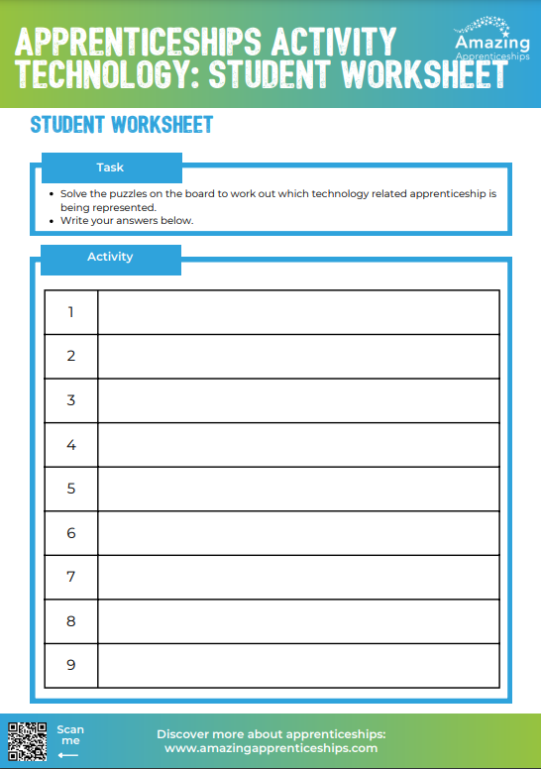
The puzzling world of apprenticeships
We are going to look at a number of different pictures that make up a word.
Solve the puzzles on the board to work out which technology related apprenticeship is being represented.
Write your answers on the student worksheet provided.

Slide 4
architectural assistant
Level 6 Degree Apprenticeship
architect
Level 7 Degree Apprenticeship

Slide 5
a e

Slide 6
carpentry & joinery
Level 2 Apprenticeship
craft carpentry & joinery
Level 3 Apprenticeship

Slide 8
stonemason
Level 2 Apprenticeship

Slide 10
organ builder
Level 3 Apprenticeship

Slide 12
blacksmith
Level 3 Apprenticeship

Slide 14
construction site
supervisor
Level 4 Apprenticeship

Slide 16
boatbuilder
Level 3 Apprenticeship

Slide 18
marine engineer
Level 3 Apprenticeship

Slide 19
Home Learning
Visit https://www.technicians.org.uk/unblock-game/ and play their Unblock game.
Screenshot how far you get!
While you are there, explore what they have to say about apprenticeships.

