Slide 1
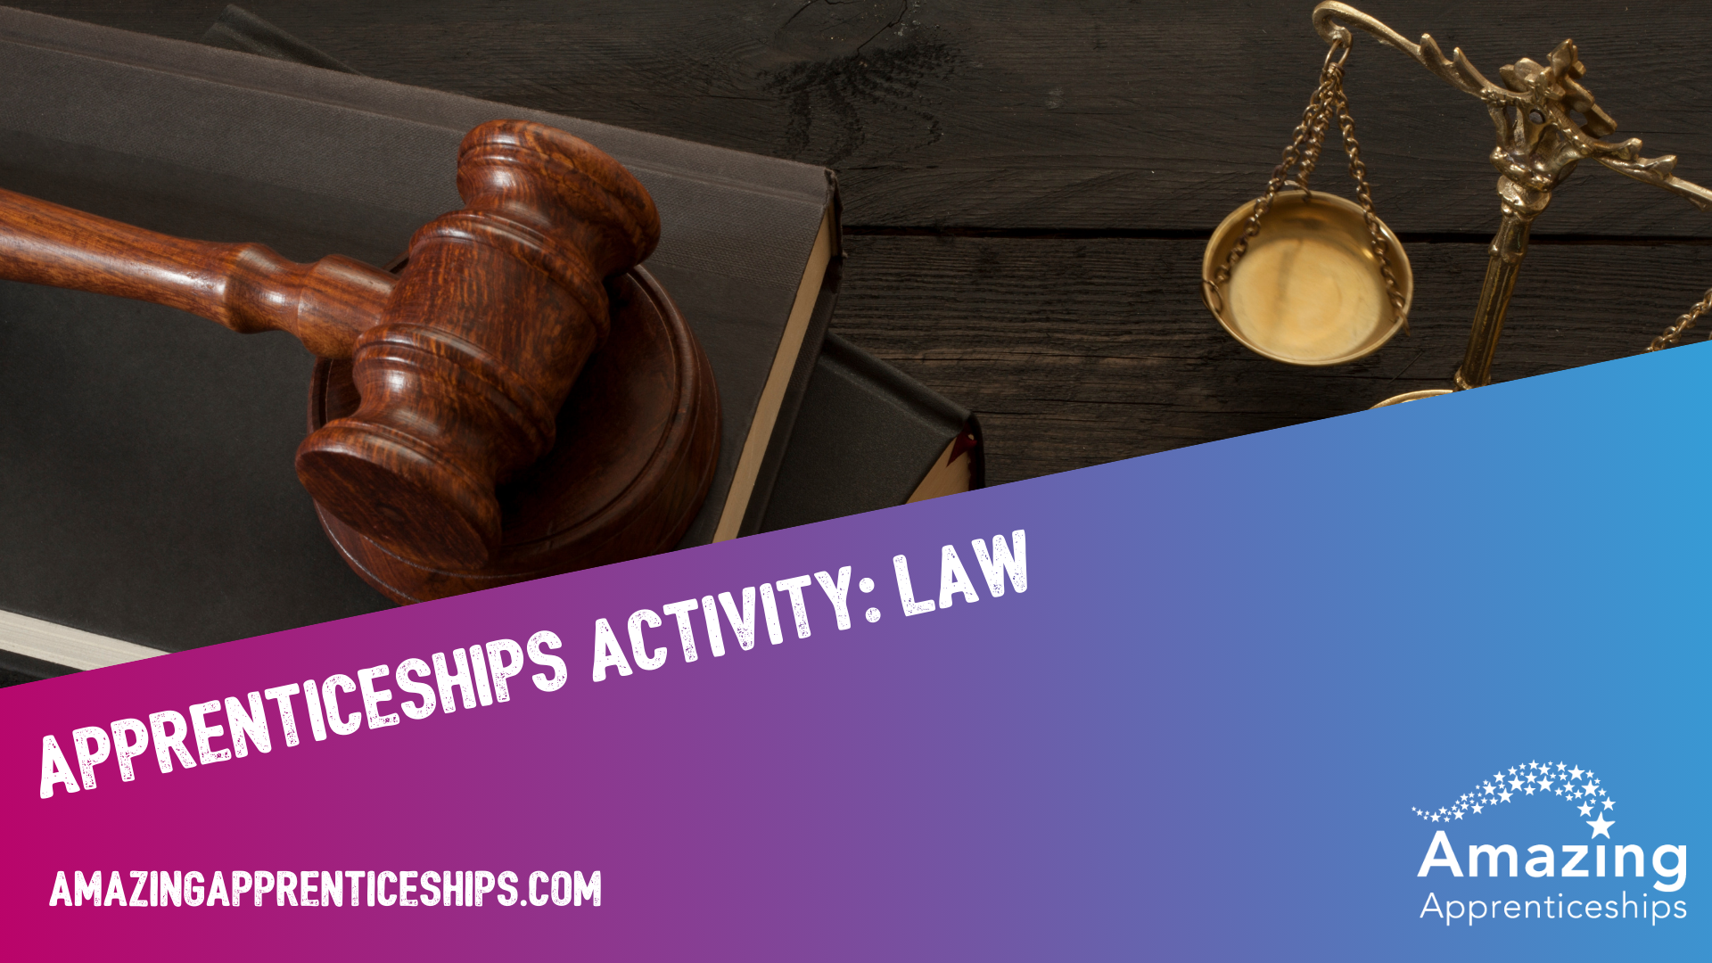
amazingapprenticeships.com

Slide 2
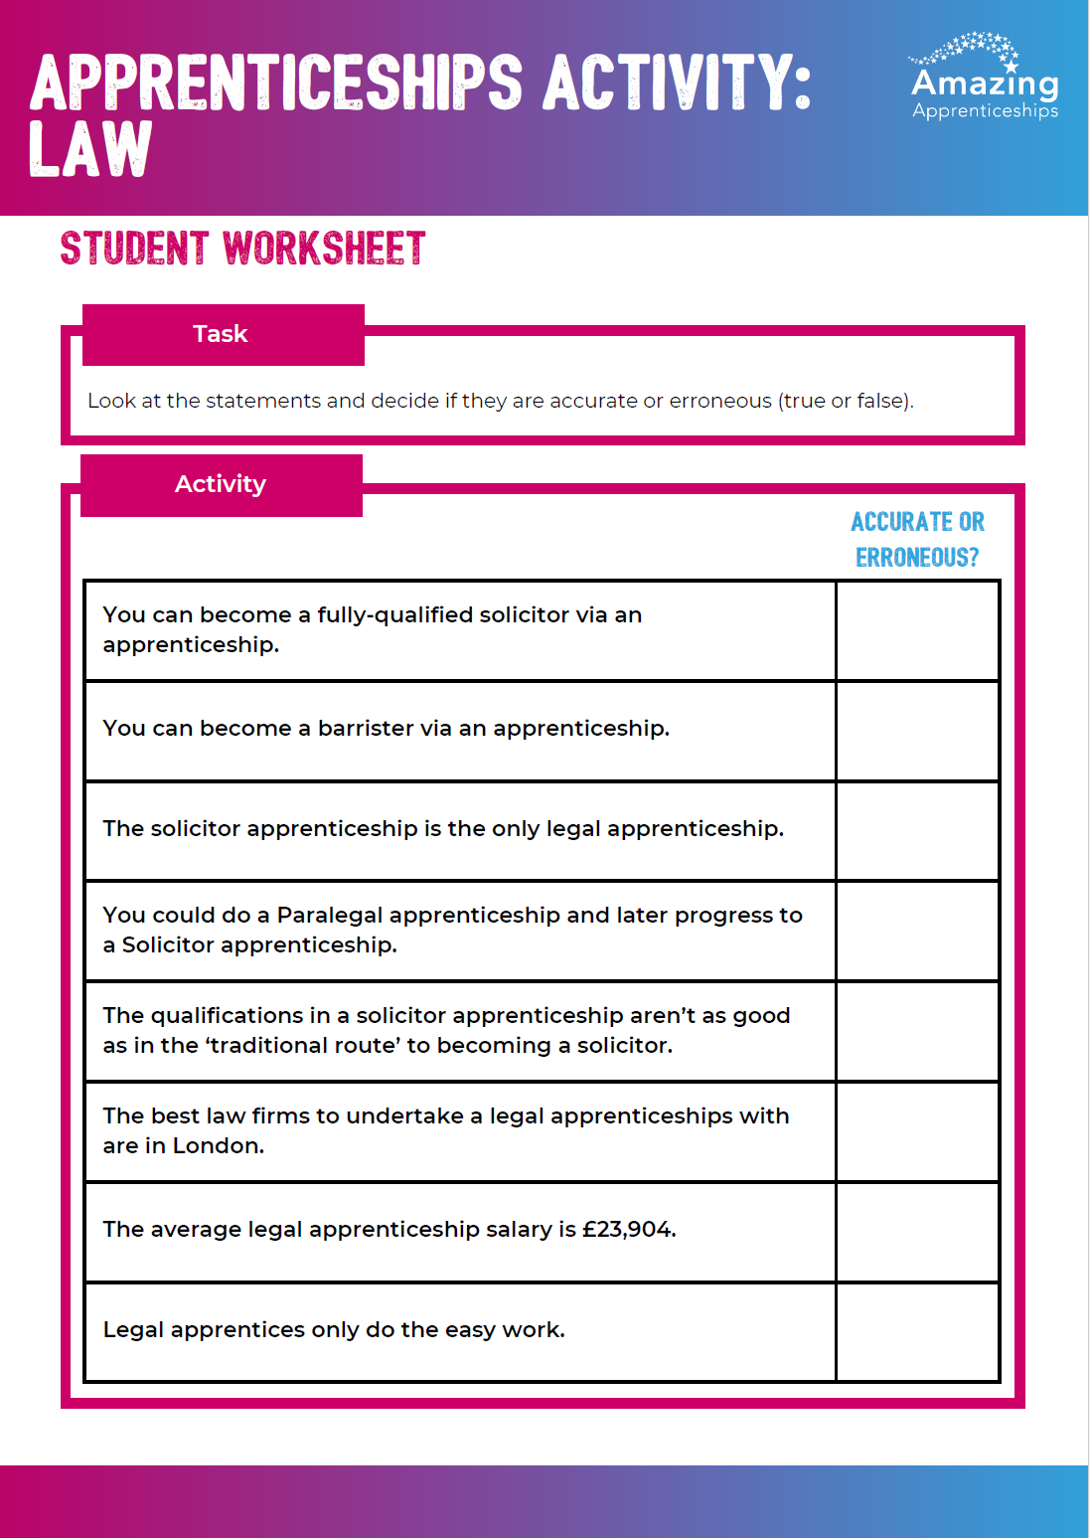
Accurate or erroneous?
Your teacher will guide you through this activity.
Please use the worksheet to record your learning.

Slide 3
accurate or erroneous?
You can become a fully-qualified solicitor via an apprenticeship.

Slide 4
accurate
You can become a solicitor via an apprenticeship – earning a salary, getting a degree and qualifying as a solicitor.
Your fees will be paid by your employer and/or government.
https://www.instituteforapprenticeships.org/apprenticeship-standards/solicitor-v1-1

Slide 5
accurate or erroneous?
You can become a barrister via an apprenticeship.

Slide 6
erroneous
You can’t become a barrister via an apprenticeship YET, but it is in development and will hopefully launch soon.
https://www.instituteforapprenticeships.org/apprenticeship-standards/barrister

Slide 7
accurate or erroneous?
The solicitor apprenticeship is the only legal apprenticeship.

Slide 8
erroneous
There are several different legal apprenticeships:
Paralegal
level 3
Public sector compliance investigator
level 3
Legal technician
level 4
Chartered legal executive
level 6
Chartered legal executive litigator and advocate
level 7
Law firms often offer lots of other apprenticeships too, for example in HR, finance, marketing etc.

Slide 9
accurate or erroneous?
You could undertake a Paralegal apprenticeship and later progress to a Solicitor apprenticeship.

Slide 10
accurate
You can undertake a Paralegal apprenticeship and then progress to a Solicitor apprenticeship.
“Once you’ve completed your Paralegal Apprenticeship, you can apply to the Solicitor Apprenticeship program which will allow you to become a solicitor”
“Our programme allows you to qualify as a solicitor by completing the Level 3 Paralegal and Level 7 Solicitor apprenticeships over a period of six years. This is the same time as it would take you to qualify through the traditional route.”

Slide 11
accurate or erroneous?
The qualifications in a solicitor apprenticeship aren’t as good as in the ‘traditional route’ to becoming a solicitor.

Slide 12
Erroneous
The ‘traditional route’ doesn't include any qualifications that are more valuable than the apprenticeship. The examinations and qualifications are the same.
Solicitor apprentices gain hands-on experience while studying, and by the time they complete their qualification, they will have gained six years of practical experience as well as the same qualifications as someone on the traditional route. They will also have accrued no student debt.

Slide 13
accurate or erroneous?
The best law firms to undertake a legal apprenticeships with are in London.

Slide 14
Erroneous
This is definitely not true.
There are many brilliant firms, across England - large to small - who offer legal apprenticeships.

Slide 15
accurate or erroneous?
The average legal apprenticeship salary is £23,904.

Slide 16
accurate
Legal apprenticeship salaries vary, as they are decided by the law firm. The average legal apprenticeship salary is £23,904.*
Some solicitor apprentice salaries are as high as £28,000 in the first year and £53,000 by the sixth year. **
* https://www.allaboutlaw.co.uk/school-leaver-law-careers/legal-apprenticeships/how-much-do-law-apprentices-make
** https://www.legalcheek.com/solicitor-apprenticeship/norton-rose-fulbright/

Slide 17
accurate or erroneous?
Legal apprentices only do the easy work.

Slide 18
erroneous
When they start, apprentices may have limited legal knowledge and they may not have studied law in an academic setting yet, so they will need to spend some time learning and developing their understanding of legal matters.
Over time, they will take on more challenging work. This doesn’t mean they will only be doing ‘easy work’ though - they are being paid to do a real job.

Slide 19
Home learning
Research a company or a law firm that offers legal apprenticeships - it could be a big city firm or a smaller local firm.
Find out which apprenticeships they offer, how they work, when you can apply, what you need to do to apply and any other key facts.
Be ready to present to the class.

