Slide 2
Watch this short film about WorldSkills UK
https://youtu.be/taB-iVPgC6w

Slide 3
WorldSkills has an exciting opening ceremony to prepare costumes for...

Slide 4
...and team kits that need to be ready to wear in competition!
See more images from WorldSkills here: https://worldskills.org/media/photos/

Slide 5
Your task:
Design one of the following items for the WorldSkills UK team:
Opening ceremony costumes
Team shirts
An accessory for the opening ceremony like a hat or flag
An accessory for a particular competitor, e.g. an apron for a hairdresser apprentice, a protective mask for a laboratory scientist apprentice.
You should carefully consider the type of material you use and make sure it is practical and appropriate.

Slide 6
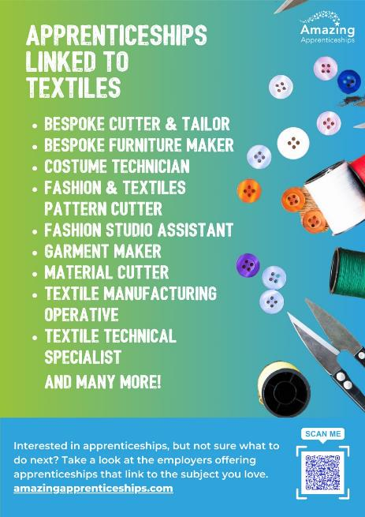
Home learning
Research the apprenticeships that are linked to textiles https://www.instituteforapprenticeships.org/
Pick one apprenticeship that you think sounds really interesting.
Be ready to present to the class.

