Slide 8
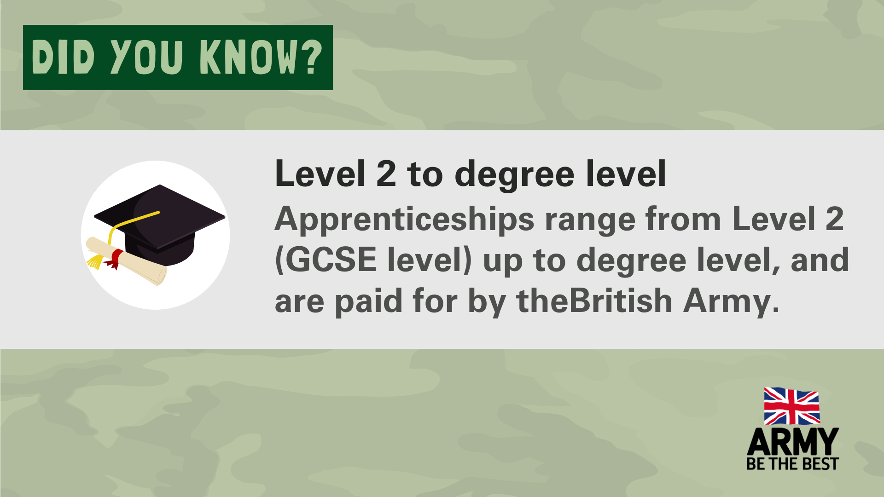

Slide 10
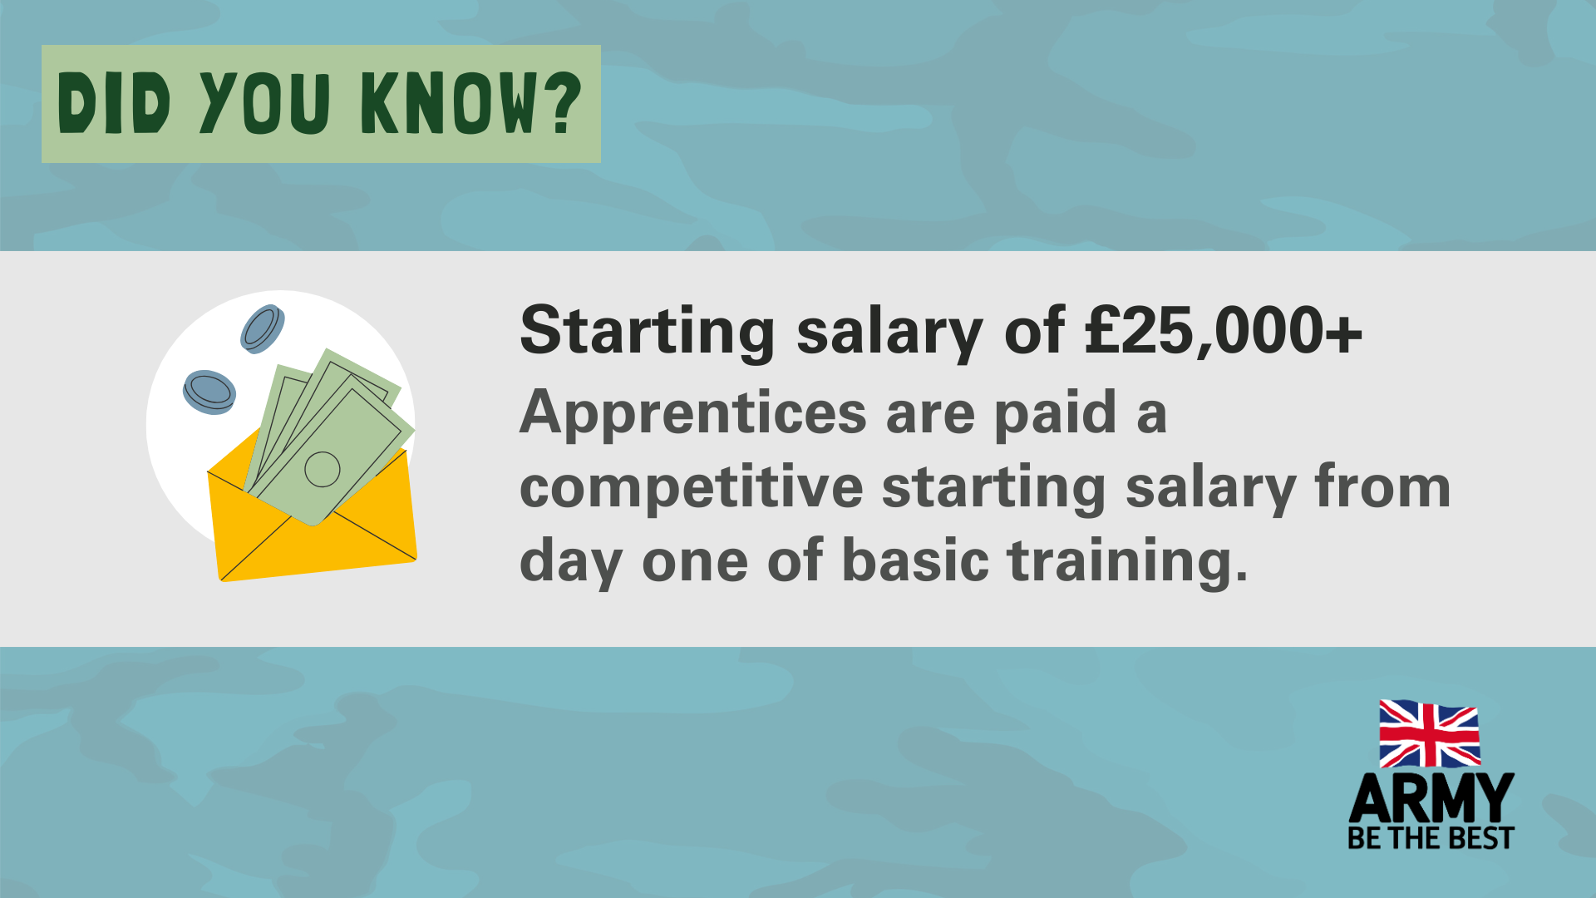

Slide 13
Other posters are also available - visit amazingapprenticeships.com/british-army and download our subject posters.

Slide 16
SOCIAL MEDIA POSTS
The following slide has images you can download to use in social media or anywhere else you like. For example, we know more and more schools and colleges are using LinkedIn to showcase what they are doing in National Apprenticeship Week.
The British Army share lots of information during NAW, so check out their social media and share anything that is relevant for your students: Instagram - @ArmyJobs Facebook – Army Jobs LinkedIn – British Army

Slide 17
Social Media - Image 1
Social Media - Image 2

Slide 19
Parents & Carers
CELEBRATING NATIONAL APPRENTICESHIP WEEK WITH THE BRITISH ARMY!
This National Apprenticeship Week, we wanted to share some information about apprenticeships in The British Army, the no.1 apprenticeship employer in England.
The British Army offer over 40 different apprenticeships, ranging from engineering to animal care, chef to construction and many more, in levels 2 to degree level.
If your child is looking for an exciting career where they will be making a difference, an Army apprenticeship could be a brilliant option. Find out more by downloading this parents and carers’ guide to Army apprenticeships:
amazingapprenticeships.com/resources/army-apprenticeships-parent-carer-guide/
Find out more about Army Apprenticeships by visiting:
amazingapprenticeships.com/employers/the-army/

Slide 20
Students
CELEBRATING NATIONAL APPRENTICESHIP WEEK WITH THE BRITISH ARMY!
This National Apprenticeship Week, we wanted to share some information about apprenticeships in The British Army, the no.1 apprenticeship employer in England.
The British Army offer over 40 different apprenticeships, ranging from engineering to animal care, chef to construction and many more, in levels 2 to degree level.
If you are looking for an exciting career where you will be making a difference, an Army apprenticeship could be a brilliant option.
Find out more by visiting:
www.amazingapprenticeships.com/british-army/
jobs.army.mod.uk/regular-army/what-you-get/apprenticeships-skills/
amazingapprenticeships.com/employers/the-army/
or:

Slide 21
Teachers & support staff
CELEBRATING NATIONAL APPRENTICESHIP WEEK WITH THE BRITISH ARMY!
This National Apprenticeship Week, we wanted to share some information about apprenticeships in The British Army, the no.1 apprenticeship employer in England.
The British Army offer over 40 different apprenticeships, ranging from engineering to animal care, chef to construction and many more, in levels 2 to degree level.
We know students talk to teachers and support staff about future options and it’s impossible to stay up-to-date with everything available. Amazing Apprenticeships and The British Army have produced a short guide to support school and college staff with talking to students about Army apprenticeships.
amazingapprenticeships.com/resources/army-apprenticeships-subject-flyer/
Find out more about Army Apprenticeships by visiting:
amazingapprenticeships.com/employers/the-army/

Slide 22
NOT JUST FOR NAW
The British Army are a brilliant apprenticeship employer all year round, so look out for some of these things outside of National Apprenticeship Week:
Webinars
Resources and quizzes
Films
and much more!
Visit amazingapprenticeships.com/british-army to find out more.

