Slide 1
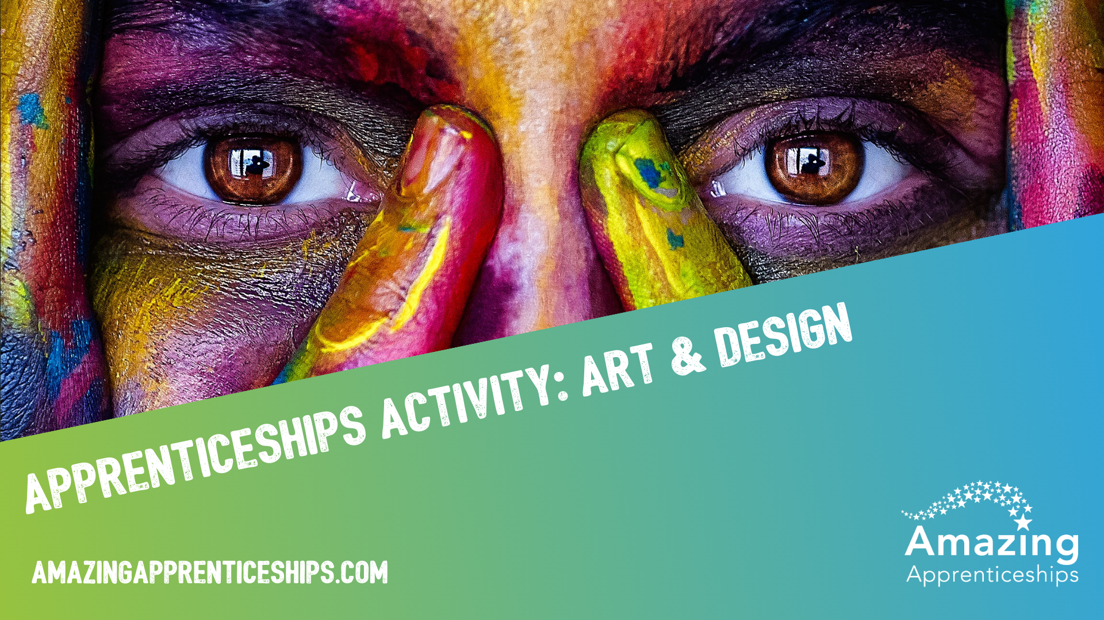

Slide 2

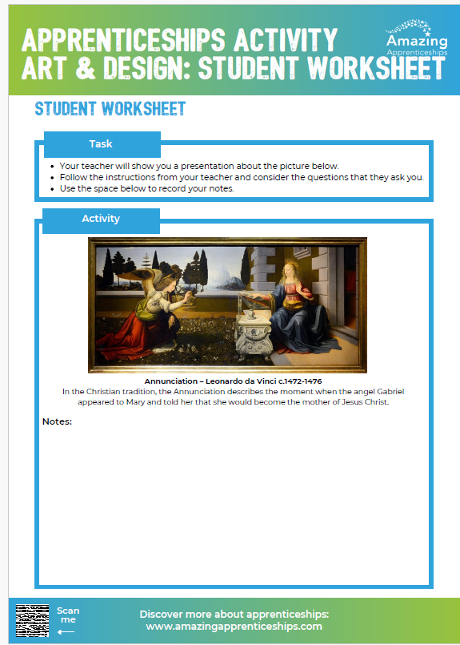
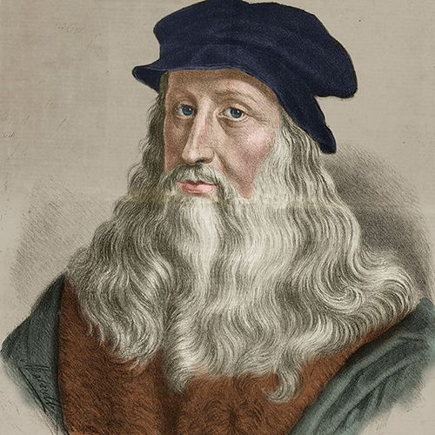
The true meaning of a masterpiece
We are going to be looking at a famous piece of art
called Annunciation by Leonardo da Vinci c.1472-1476
In the Christian tradition, the Annunciation describes the moment when the angel Gabriel appeared to Mary and told her that she would become the mother of Jesus Christ.
Can you think of any other famous pieces of art by da Vinci?

Slide 3
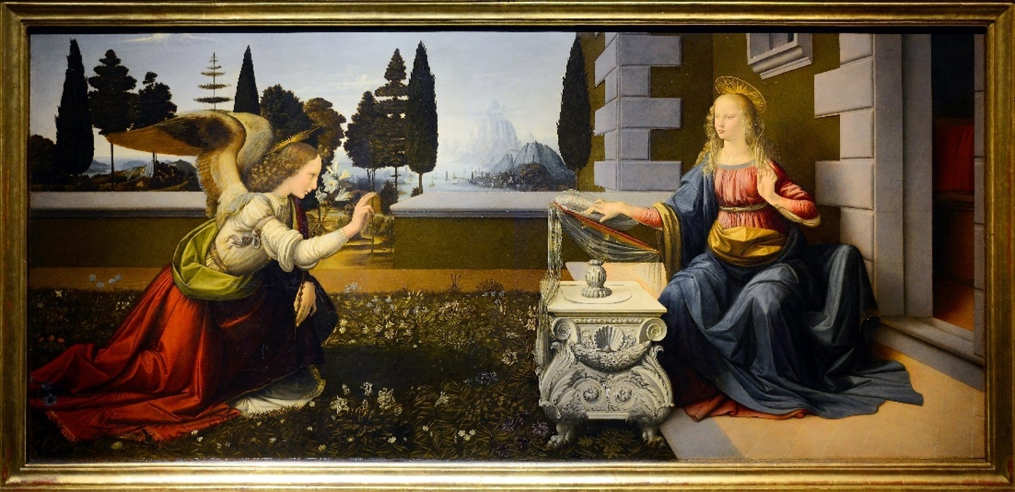

Slide 4

At what stage in his career do you think da Vinci created this piece?
Why do you think
he created it?
What did da Vinci want to say with this painting?
What makes it a masterpiece?
What is the definition of a masterpiece?
What is the main idea of this artwork?
What does this painting have to do with apprenticeships?!
Do you like it?

Slide 5
What does this painting have to do with apprenticeships?!
Annunciation is da Vinci’s masterpiece.
Today we use the term masterpiece to mean a work of outstanding artistry, skill or workmanship, but historically it was the term for the work created by a craftsperson to mark the end of their apprenticeship and them becoming a master craftsperson!
The term originated in the Middle Ages, when apprentice artisans had to prove their skills by submitting exemplary work for approval by the guild that governed their trade – painting, carving, metalwork, enamelling. If the piece demonstrated mastery of the craft, the apprentice would be promoted to master and authorised to train others.

Slide 6
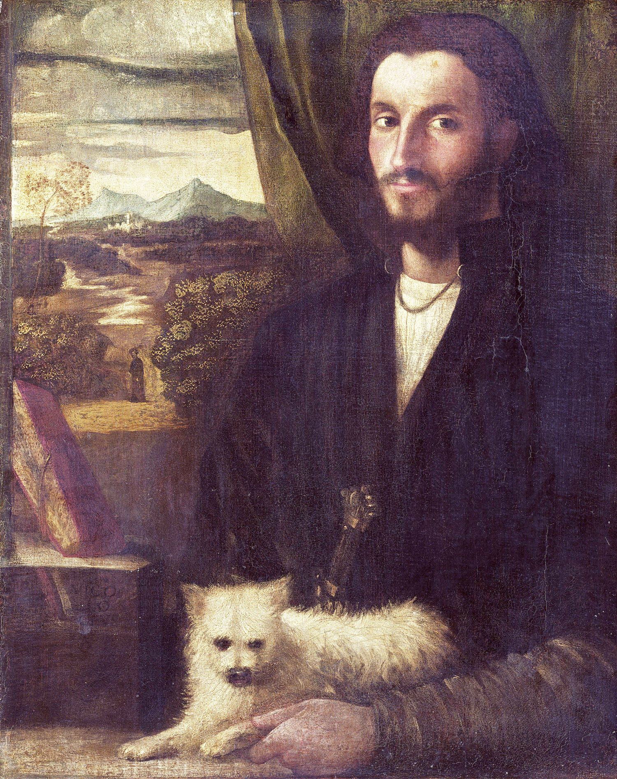
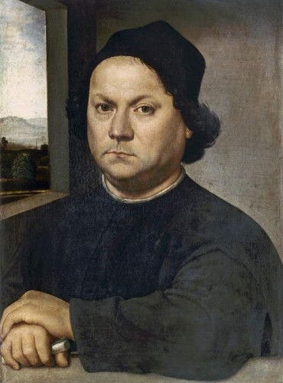
Leonardo da Vinci the apprentice
Leonardo da Vinci was an apprentice under master painter Andrea del Verrocchio, and his piece Annunciation would have been presented to the Florence painters’ guild.
Artist’s apprentices have been around for centuries. During Leonardo da Vinci's lifetime, apprentice artists developed their careers by working with master artists. This included helping these artists with the production of studio commissions, studio housekeeping and other tasks. An apprenticeship is still a fantastic way into the creative sector. Today Leonardo da Vinci would probably be undertaking an apprenticeship with the job title of Studio Assistant!
Leonardo da Vinci
Andrea del Verrocchio

Slide 7
Home learning
There are many apprenticeships linked to the creative and design sector.
Ask students to select one that interests them, research it and create a visual representation of the apprenticeship.
This site will be helpful in their research.
https://www.instituteforapprenticeships.org/apprenticeship-standards/?routes=creative-and-design

