Slide 1


Slide 2

Role play: Are apprenticeships a good option?
You are going to create a short dialogue (role-play) between a parent/carer and their child who are considering apprenticeships.
There are two scenarios:
Scenario 1: The child wants to do an apprenticeship, but the parent/carer doesn’t want them to.
Scenario 2: The parent/carer wants the child to do an apprenticeship, but they don’t want to.
Before you start planning, watch this short film about apprenticeships which will give you some ideas to assist you with this task.

Slide 3

Notes:
The film above should be embedded (it may ask you to ‘enable content’ for external links, or the film won’t work), but can also be found here: www.amazingapprenticeships.com/resources/the-apprenticeship-assembly-film/

Slide 4
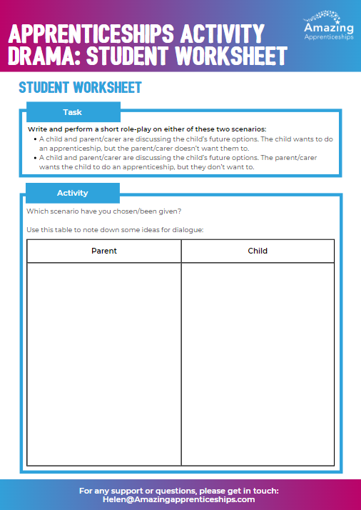
Use the student worksheet to note down some ideas for dialogue.
Key points you could include:
Finances
Being ready to work
Knowing which industry you want to work in
Social life
The range of options available

Slide 5
Home Learning
Research one of the apprenticeships discussed today. You can use this website to help you https://www.instituteforapprenticeships.org/apprenticeship-standards/
Create a 1-2 minute video describing the apprenticeship. We will use the video to raise awareness of apprenticeships in other drama lessons / at open evening / on our website.

