Slide 1
Notes to presenter
Please delete this slide before presenting to your students.
This resource contains 14-15 slides and should take around 15-20 minutes to deliver to students and/or parents and carers.
There is a link to the ‘Apprentices are Amazing’ film included and you may find it useful to download this in advance of delivering the session.
Please do make any appropriate edits for instructions or to include bespoke messaging from your school/college.
Each slide has an accompanying script in the notes section. This script is for guidance and can be adapted to suit the needs and interests of your students.
There is a hidden slide at the end of the presentation that is suitable for parents/carers. Please unhide this if suitable for your session.

Slide 2
Apprenticeships in Southwark
LSBU Group
Notes:
Presenter notes: Welcome to the students/audience.
Today’s presentation is going to explore apprenticeships and help you to understand the wide range of options available for you to consider.
Apprenticeships are one of the many fantastic options available to you when you leave school/college/sixth form and are becoming increasingly popular with students who are looking at their next steps and are eager to jump straight into the world of work and get earning and learning.
There are many fantastic opportunities available locally in Southwark from Level 2 all the way up to degree level.
So it’s really important to keep your options open about your future.

Slide 3
Contents
Overview of apprenticeships
How to find apprenticeships
Apprenticeships with LSBU Group
Next steps
Notes:
In this assembly, you will find out more about: - What apprenticeships are - How to find apprenticeships - What opportunities are available locally to you in Southwark/surrounding areas with the LSBU Group - and where to go next to search and apply.

Slide 4
Apprenticeships at LSBU Group
London South Bank University, South Bank Colleges, South Bank Academies, SBU Sixth Form
Offer training for 44 apprenticeships
Apprenticeships from Levels 2 – 7
From Arts & Creative, Built Environment & Architecture to Business, Nursing to Engineering & more!
Notes:
We are really lucky that we have a fantastic provider in Southwark who offer apprenticeships from Level 2 all the way up to degree level.
London South Bank University (LSBU) Group are based in Southwark and are made up of the University and South Bank Colleges, South Bank Academies and SBU Sixth Form.
They offer 44 different apprenticeships from Level 2 – Level 7 and across a variety of sectors, from production engineer to architecture, chartered surveyor to civil engineer, radiographer to occupational therapist and more.
LSBU Group are supporting schools and colleges in the area to share information and learn more about the apprenticeship opportunities available to students.

Slide 5
What is an apprenticeship?
Notes:
So what is an apprenticeship?
You may already know a bit about apprenticeships, but let’s run through some facts so that everyone understands the basics.
There are over 650+ apprenticeships in more than 1500 different job roles – covering a range of sectors and roles, from engineering, finance, business, creative and media, to zoo keeping, costume making, journalism, being a solicitor and more!
It is a real job, with a real employer. Apprentices work on projects, tasks and support the team, just like any other member of staff.
Apprenticeships can take anywhere between 1 year (all apprenticeships are a minimum of 12 months) and can last up to 6 years, depending on the level that you are studying at and the job role you are in.
You will be employed, which means you will be paid a salary and will get holiday pay, sick pay and other benefits of being an employee.
You will work full-time and have a real job, with real responsibility and your employer will work with you to develop your skills.
The equivalent of 6 hours per week will be spent undertaking training.
You will not pay for your training costs, even if it’s a degree apprenticeship, and will gain a qualification alongside your work
Anyone can do an apprenticeship if they are over 16 and living in England. Apprenticeships are for everyone.

Slide 6
Apprenticeship levels
NAME | LEVEL | EQUIVALENT
Intermediate | 2 | GCSE
Advanced | 3 | A level
Higher | 4, 5, 6 and 7 | Foundation degree and above
Degree | 6 and 7 | Bachelor’s or master’s degree
Notes:
There are many different levels of apprenticeship from intermediate level (which is sometimes called level 2) all the way through to degree level apprenticeships.
This table gives you an idea of what the levels mean and how they might compare to other qualifications you may be more familiar with.
So intermediate apprenticeships are at level 2 (which is equivalent to GCSE level), then advanced at level 3 which is equivalent to A levels. There are then higher and degree apprenticeships from level 4 – 7, with 4 being equivalent to a foundation year and 7 as a Master’s degree.
London South Bank University offer a variety of Level 4 – 7 apprenticeships, and the colleges that are part of the LSBU group offer Level 2 and Level 3 apprenticeships.
The apprenticeship level you start at will depend on your previous experience and qualifications, but LSBU have lots of information and advice on apprenticeships, entry requirements and application processes on their website, so can support you with which may be best for you.

Slide 7
Apprenticeship employers
Notes:
There are also a huge range of employers offering apprenticeships.
This slide shows you some really familiar logos of big companies in England who all recruit apprentices. You may recognise some of these brands and possibly may not have realised they offer fantastic apprenticeship schemes.

Slide 8
Local employers
Notes:
Locally in London, there are also some amazing employers – as well as many of those you will have seen on the previous slide.
All of these employers work with LSBU to offer excellent apprenticeship opportunities.
You may recognise some of these logos, such as Lidl or Parliament or Southwark Council. There may be others that you’re not as familiar with, but they offer brilliant apprenticeships in Construction, Finance, Healthcare, Engineering, Town Planning and more!
It can be tempting to think that the ‘best’ apprenticeships are with the big, well-known companies, but many of the employers you may not have heard of before have excellent programmes and offer roles you may not expect.
So it’s important to do your research and keep an open mind.

Slide 9
Apprentices are amazing
Notes:
Presenter note: Please download the film from Vimeo and embed it within this presentation. The film is available to download here: https://vimeo.com/613415806
I’m going to play you this short film which gives an insight into apprenticeships and what it’s like to be an apprentice, and then we’ll move on to discussing where you can find apprenticeships and apply in more detail.
So let’s take a look at the film to hear from some real apprentices. You might be surprised at some of the job roles!
Notes to presenter: Click to play the film.

Slide 10
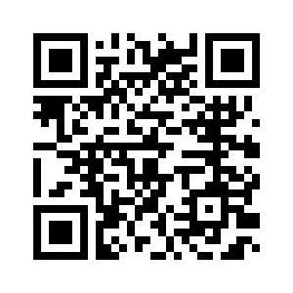
How do you find an apprenticeship?
www.lsbu.ac.uk/study/apprenticeships
Notes:
Where can you find an apprenticeship?
As we’ve said, LSBU have lots of useful information on their website – including a dedicated space on their website where you can go to look at what vacancies they have available and to register your interest for future opportunities.
You can find the website link on the slide or also scan the QR code.

Slide 11
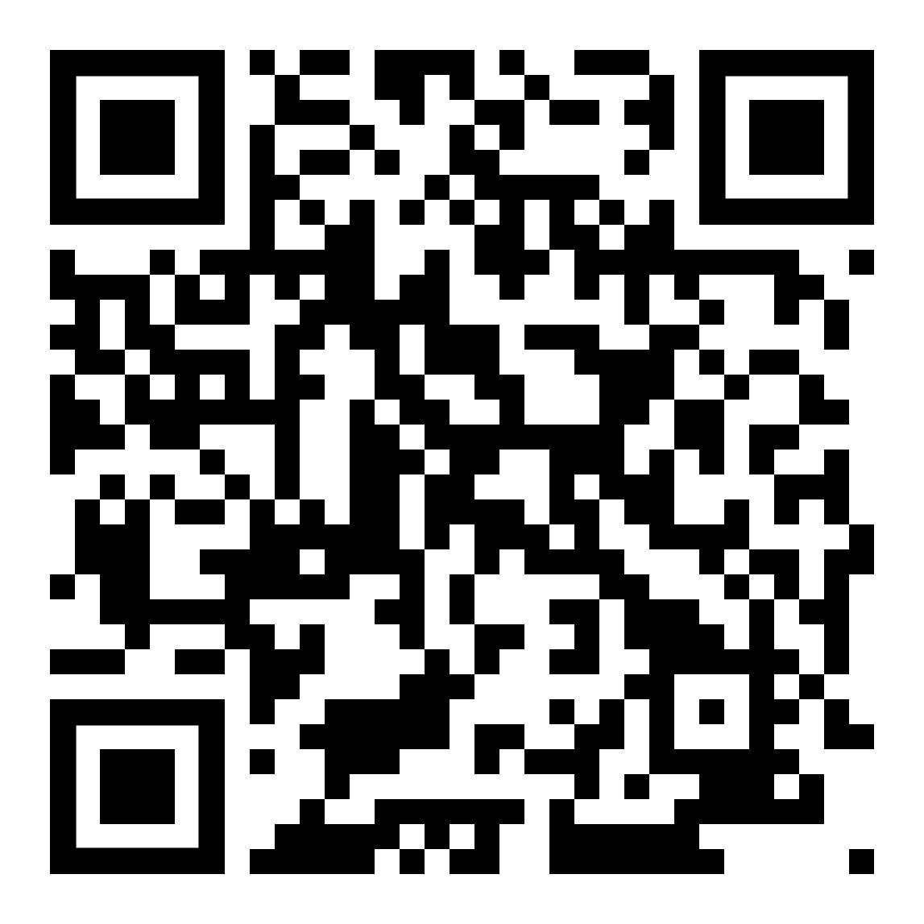
Application process
Visit LSBU website
Register your interest – vacancies open all year
3. Apply for current vacancies
https://www.lsbu.ac.uk/study/forms/register-your-interest
Notes:
Apprenticeships will be advertised on the platform throughout the year, although there may be peak times and other months where fewer vacancies appear.
You can therefore register your interest for future opportunities with the team so that you ensure that you don’t miss any being advertised.
You will also be able to apply for the vacancies through the website. LSBU Group also have useful guidance and information to help you to apply.

Slide 12
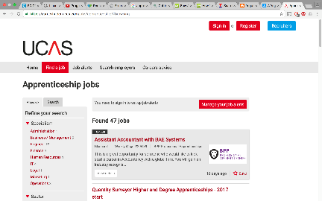
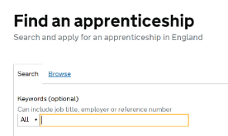
Find an apprenticeship
Register on Find an apprenticeship
Search and apply
Research
Manage alerts
Notes:
Another useful website to search for apprenticeships vacancies is on the Find An Apprenticeship website on gov.uk (the government website). If you type ‘Find an apprenticeship’ into Google, the link will come up.
It’s a large database of live apprenticeship vacancies – like other jobs sites – but for apprenticeships only.
You can register an account for free, and then start searching/applying for jobs that you might be interested in.
It tells you all of the key details about the apprenticeship, the level, the salary, the hours and what you’ll be doing in your role and training.
You can also set up alerts to send emails and text messages to you when jobs come up that you might be interested in.
LSBU vacancies are also advertised through the Find an apprenticeship website and you will find lots of other local and national vacancies available also.

Slide 13
More information
Apprenticeships information
Resources
Guidance for applying
www.lsbu.ac.uk/study/apprenticeships
Notes:
For more information on apprenticeships, LSBU and what they offer, visit their website.
You will find helpful resources and information to guide you through the process.

Slide 14
Any questions?
Notes:
Thank you for listening today.
We will be working with LSBU to bring you more information throughout the year about their apprenticeship opportunities.
For any questions, please just speak to our careers team / contact.

Slide 15
Thank you for listening
Supported by

Slide 16
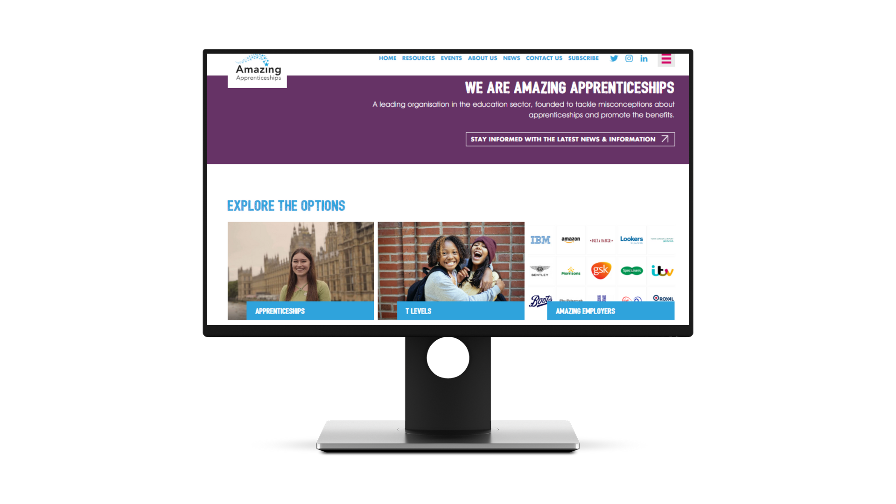
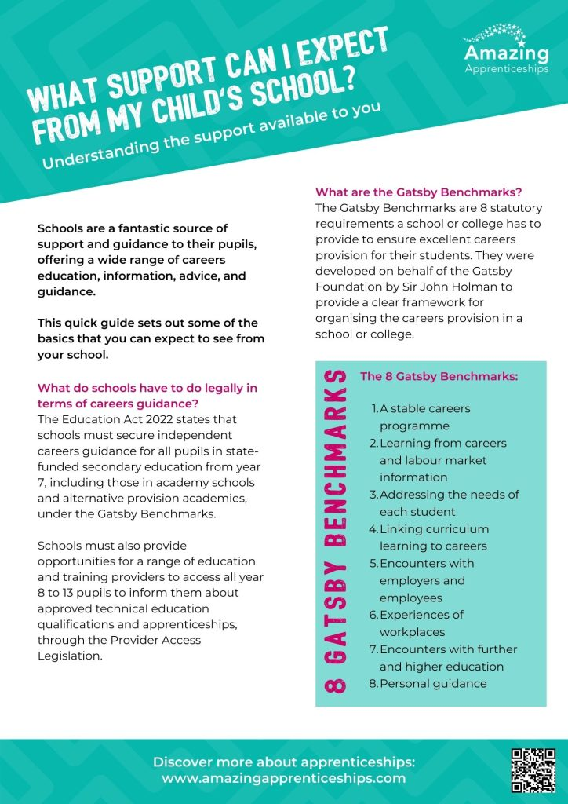
Supporting your child
www.amazingapprenticeships.com
Notes:
There are a range of useful resources created for parents/carers to understand more about apprenticeships available on the Amazing Apprenticeships website.
You can learn more about the range of apprenticeships available, how to support your child to search and apply for apprenticeships, which employers offer apprenticeships, the funding/support available or impact on family income, as well as lots of other useful information at their website (the link or which is on the screen).

